Slide 1

BIRIM SOUTH DISTRICT ASSEMBLY
    BUDGET STATEMENT
2025 FISCAL YEAR

Slide 2









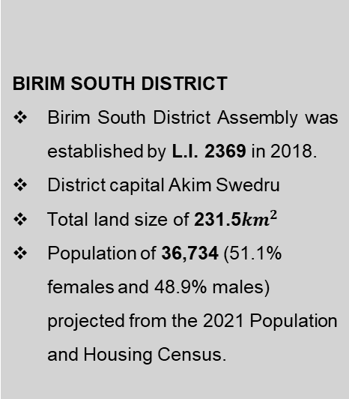
  STRATEGIC OVERVIEW OF BIRIM SOUTH DISTRICT
BIRIM SOUTH DISTRICT
Birim South District Assembly was established by L.I. 2369 in 2018.
District capital Akim Swedru
Total land size of 231.5${km}^{2}$
Population of 36,734 (51.1% females and 48.9% males) projected from the 2021 Population and Housing Census.
ESTABLISHMENT
B
Core Values
C
C
Mission
A
Vision
To improve the living standards of its citizens through sustainable socio-economic development and effective institutions that are responsive to the needs of people.
Transparency & Accountability
Client-oriented
Creativity and Innovativeness
Diligence and Discipline
Equity and Integrity
Timeliness
A world class local government institution promoting well-being and total peace.
1

Slide 3
CORE FUNCTIONS OF THE DISTRICT
The functions exercised by the Assembly are deliberative, legislative as well as executive. The specific functions among others as stipulated in the Local Governance Act of 2016, Act 936 include:
Responsible for the development, improvement and management of human settlements and the environment in the district;
The Assembly takes steps and measures that are necessary and expedient to execute approved development plans for the district;
Guide, encourage and support sub-district local structures, public agencies and local communities to perform their functions in the execution of approved development plans;
Initiate and encourage joint participation with other persons or bodies to execute approved development plans;
Promote or encourage other persons or bodies to undertake projects under approved development plans; and
Monitor the execution of projects under approved development plans and assess and evaluate their impact on the development of the district and national economy in accordance with government policy.
Exercise political and administrative authority in the district.
2

Slide 4
DISTRICT ADOPTED POLICY OBJECTIVES FOR 2024
FOCUS AREA | ADOPTED POLICY OBJECTIVE
Local Governance and Decentralisation | Deepen Political and Administrative Decentralisation
Strong and resilient economy | Strengthen domestic resource mobilization to improve capacity for revenue collection
Agriculture and rural development | Modernize and enhance agricultural production systems
Education and training | Enhance equitable access to and participation in quality education at all levels.
Health and health services | Ensure accessible, and quality Universal Health Coverage (UHC) for all.
Child protection and development | Prevent and protect children from all forms of violence, abuse, neglect and exploitation.
Gender equality | Attain gender equality and equity in political, social and economic development
 | Promote economic empowerment of particularly women
3

Slide 5
DISTRICT ADOPTED POLICY OBJECTIVES FOR 2024
FOCUS AREA | ADOPTED POLICY OBJECTIVE
Disability-inclusive development | Implement social protection systems and measures for the poor and vulnerable.
Reducing poverty and Inequality | Eradicate poverty and address vulnerability to poverty in all forms and dimensions.
Drainage and flood control | Address recurrent devastating floods
Human settlement development and housing | Promote sustainable spatially integrated development of human settlement
Water and Environmental Sanitation | Improve access to safe reliable and sustainable water supply services for all.
 | Enhance access to improved and sustainable environmental sanitation services.
Transport Infrastructure: Roads | Improve efficiency and effectiveness of road transport infrastructure and services.
4

Slide 6
DISTRICT ECONOMY
SECTORS OF THE ECONOMY
EDUCATION (LEVELS)
The number of schools in the District at each level: 25-KG, 23-Primary, 20-JHS, 1-SHS, 1-TVET.
1-KG, 1 primary school, 1 JHS and 1-TVET are under construction.
Agriculture being the main occupation of the district with majority into crop production (50% of economically active population)
Wholesale & retail 20%, Services 20% and Manufacturing 5%.
TOURISM / HOSPITALITY
Potential tourist sites:
Aboye confluence
Birim forest range
SANITATION
3 functional public toilets
1 WC public toilet under rehabilitation in Swedru.
11 skip containers across the district.
HEALTH
The District has 10 CHPS compounds, 2 Health Centres, 1 Clinic.
1 District hospital is under construction.
MARKET
There are three main market facilities in the district. (Swedru, Awisa, and Aduasa Markets).
Tuesdays and Fridays are the main market days for Aduasa whilst Wednesdays is for Swedru.
Lockable stores: 67
Stalls: 59
PHYSICAL ENVIRONMENT
Road coverage: 121.0km
Bitumen covers 29.1km (24%).
Earth surface roads 91.9km (76%)
5

Slide 7
KEY CHALLENGES
Poor Road and Drainage infrastructure
Inadequate Sanitary Facilities
Inadequate basic school infrastructure
Limited access to quality Health Service delivery
Inadequate market infrastructure
Low capacity of Substructures
Haphazard settlements and non-compliance to available planning schemes
Low Agricultural productivity
Low Internal Revenue Generation
Inadequate support for vulnerable groups, ie. PLWHAs and PWDs
Inadequate support for Child Protection Activities
6

Slide 8
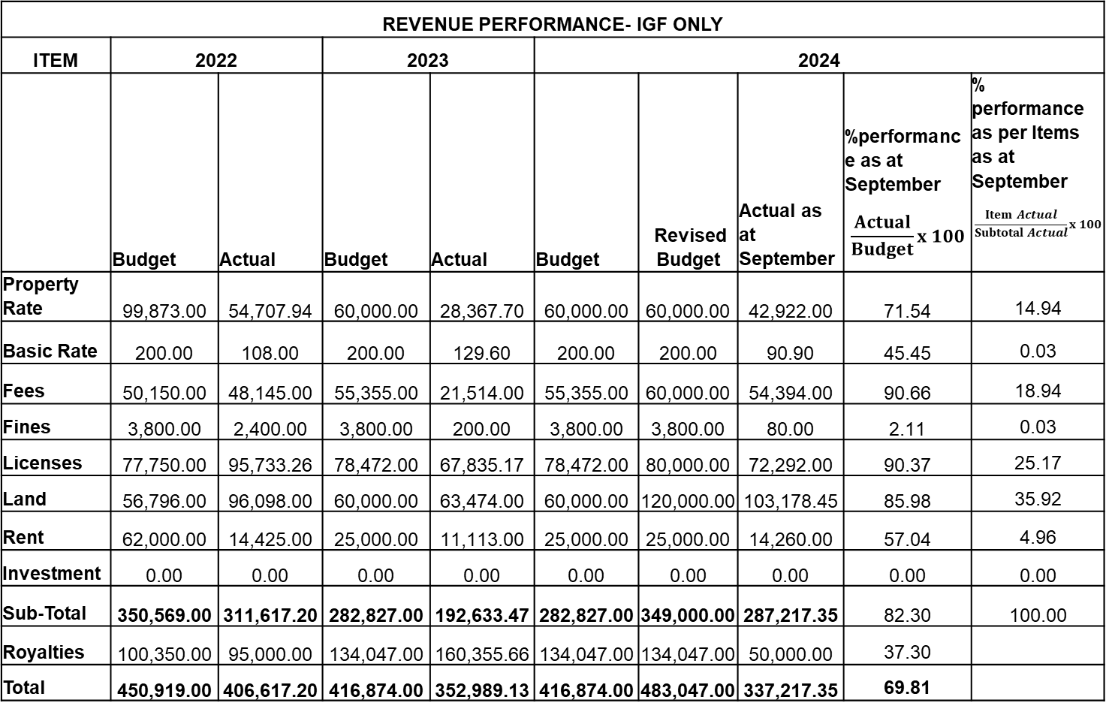
Financial Performance - Revenue
REVENUE PERFORMANCE- IGF ONLY
ITEM | 2022 |  | 2023 |  | 2024
 | Budget | Actual | Budget | Actual | Budget | Revised Budget | Actual as at September | %performance as at September $$\frac{Actual}{Budget}x 100$$ | % performance as per Items as at September $$\frac{Item Actual}{Subtotal Actual}x 100$$
Property Rate | 99,873.00 | 54,707.94 | 60,000.00 | 28,367.70 | 60,000.00 | 60,000.00 | 42,922.00 | 71.54 | 14.94
Basic Rate | 200.00 | 108.00 | 200.00 | 129.60 | 200.00 | 200.00 | 90.90 | 45.45 | 0.03
Fees | 50,150.00 | 48,145.00 | 55,355.00 | 21,514.00 | 55,355.00 | 60,000.00 | 54,394.00 | 90.66 | 18.94
Fines | 3,800.00 | 2,400.00 | 3,800.00 | 200.00 | 3,800.00 | 3,800.00 | 80.00 | 2.11 | 0.03
Licenses | 77,750.00 | 95,733.26 | 78,472.00 | 67,835.17 | 78,472.00 | 80,000.00 | 72,292.00 | 90.37 | 25.17
Land | 56,796.00 | 96,098.00 | 60,000.00 | 63,474.00 | 60,000.00 | 120,000.00 | 103,178.45 | 85.98 | 35.92
Rent | 62,000.00 | 14,425.00 | 25,000.00 | 11,113.00 | 25,000.00 | 25,000.00 | 14,260.00 | 57.04 | 4.96
Investment | 0.00 | 0.00 | 0.00 | 0.00 | 0.00 | 0.00 | 0.00 | 0.00 | 0.00
Sub-Total | 350,569.00 | 311,617.20 | 282,827.00 | 192,633.47 | 282,827.00 | 349,000.00 | 287,217.35 | 82.30 | 100.00
Royalties | 100,350.00 | 95,000.00 | 134,047.00 | 160,355.66 | 134,047.00 | 134,047.00 | 50,000.00 | 37.30
Total | 450,919.00 | 406,617.20 | 416,874.00 | 352,989.13 | 416,874.00 | 483,047.00 | 337,217.35 | 69.81
7

Slide 9
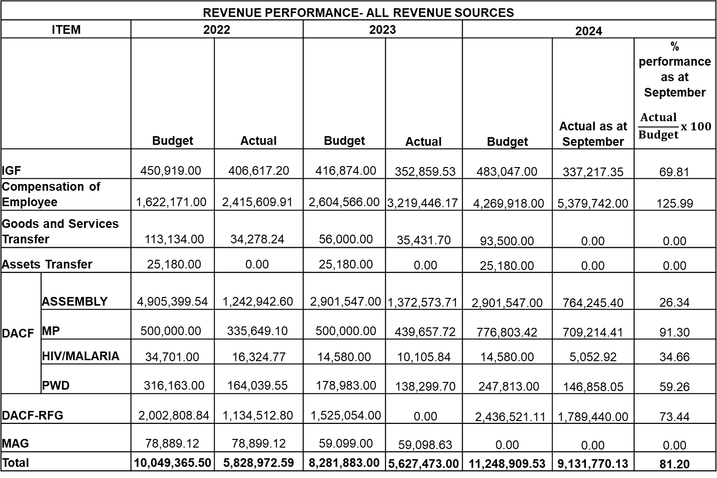
Financial Performance - Revenue
REVENUE PERFORMANCE- ALL REVENUE SOURCES
ITEM |  | 2022 |  | 2023 |  | 2024
 |  | Budget | Actual | Budget | Actual | Budget | Actual as at September | % performance as at September $$\frac{Actual}{Budget}x 100$$
IGF |  | 450,919.00 | 406,617.20 | 416,874.00 | 352,859.53 | 483,047.00 | 337,217.35 | 69.81
Compensation of Employee |  | 1,622,171.00 | 2,415,609.91 | 2,604,566.00 | 3,219,446.17 | 4,269,918.00 | 5,379,742.00 | 125.99
Goods and Services Transfer |  | 113,134.00 | 34,278.24 | 56,000.00 | 35,431.70 | 93,500.00 | 0.00 | 0.00
Assets Transfer |  | 25,180.00 | 0.00 | 25,180.00 | 0.00 | 25,180.00 | 0.00 | 0.00
DACF | ASSEMBLY | 4,905,399.54 | 1,242,942.60 | 2,901,547.00 | 1,372,573.71 | 2,901,547.00 | 764,245.40 | 26.34
 | MP | 500,000.00 | 335,649.10 | 500,000.00 | 439,657.72 | 776,803.42 | 709,214.41 | 91.30
 | HIV/MALARIA | 34,701.00 | 16,324.77 | 14,580.00 | 10,105.84 | 14,580.00 | 5,052.92 | 34.66
 | PWD | 316,163.00 | 164,039.55 | 178,983.00 | 138,299.70 | 247,813.00 | 146,858.05 | 59.26
DACF-RFG |  | 2,002,808.84 | 1,134,512.80 | 1,525,054.00 | 0.00 | 2,436,521.11 | 1,789,440.00 | 73.44
MAG |  | 78,889.12 | 78,899.12 | 59.099.00 | 59,098.63 | 0.00 | 0.00 | 0.00
Total |  | 10,049,365.50 | 5,828,972.59 | 8,281,883.00 | 5,627,473.00 | 11,248,909.53 | 9,131,770.13 | 81.20
8

Slide 10
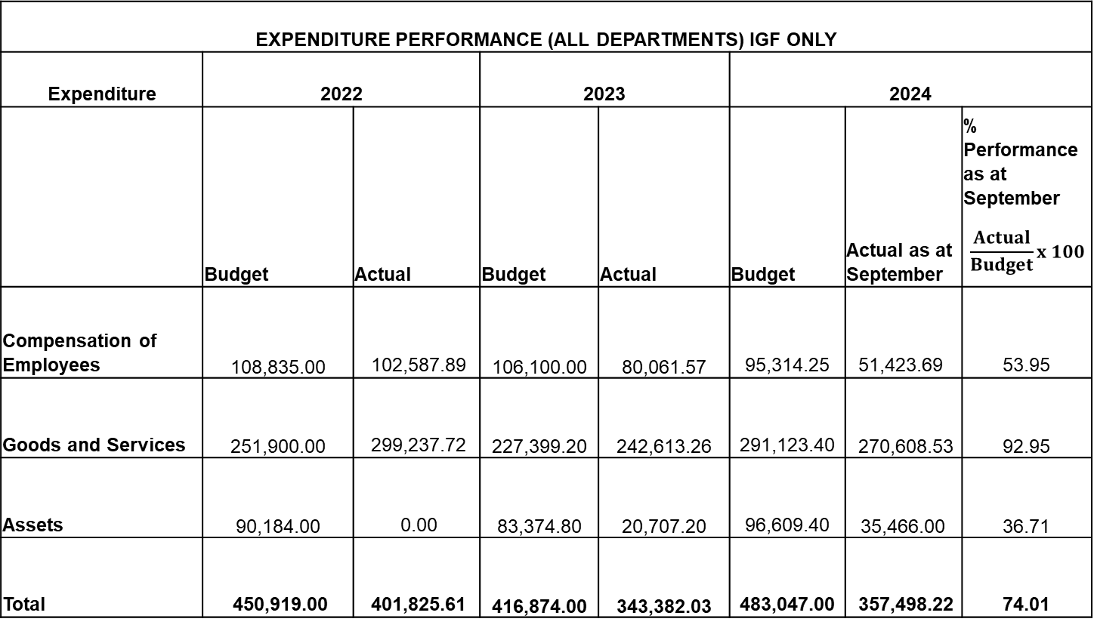
Financial Performance – Expenditure Cont’d.
EXPENDITURE PERFORMANCE (ALL DEPARTMENTS) IGF ONLY
Expenditure | 2022 |  | 2023 |  | 2024
 | Budget | Actual | Budget | Actual | Budget | Actual as at September | % Performance as at September $$\frac{Actual}{Budget}x 100$$
Compensation of Employees | 108,835.00 | 102,587.89 | 106,100.00 | 80,061.57 | 95,314.25 | 51,423.69 | 53.95
Goods and Services | 251,900.00 | 299,237.72 | 227,399.20 | 242,613.26 | 291,123.40 | 270,608.53 | 92.95
Assets | 90,184.00 | 0.00 | 83,374.80 | 20,707.20 | 96,609.40 | 35,466.00 | 36.71
Total | 450,919.00 | 401,825.61 | 416,874.00 | 343,382.03 | 483,047.00 | 357,498.22 | 74.01
9

Slide 11
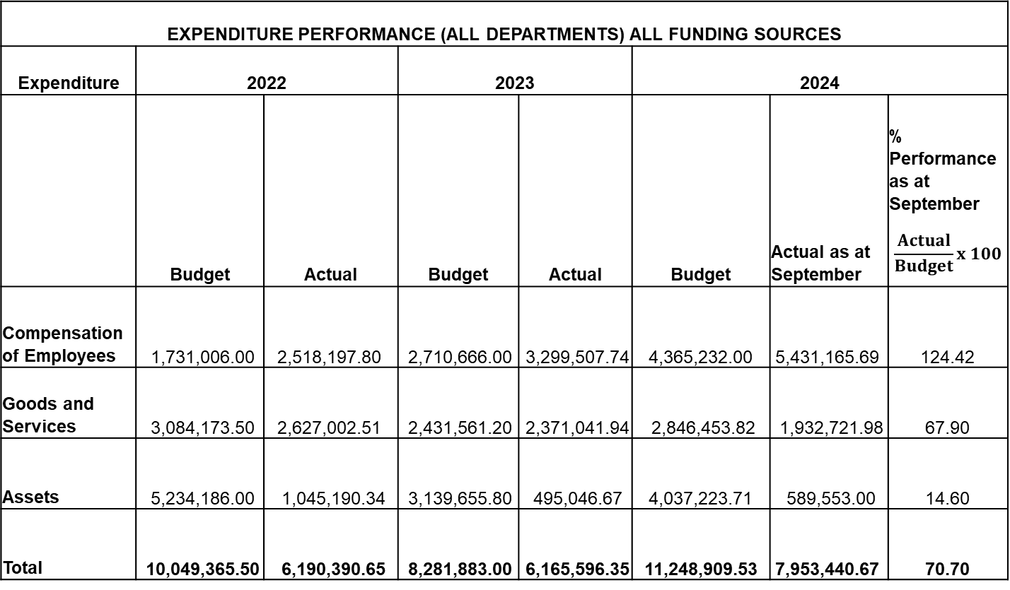
Financial Performance – Expenditure Cont’d.
EXPENDITURE PERFORMANCE (ALL DEPARTMENTS) ALL FUNDING SOURCES
Expenditure | 2022 |  | 2023 |  | 2024
 | Budget | Actual | Budget | Actual | Budget | Actual as at September | % Performance as at September $$\frac{Actual}{Budget}x 100$$
Compensation of Employees | 1,731,006.00 | 2,518,197.80 | 2,710,666.00 | 3,299,507.74 | 4,365,232.00 | 5,431,165.69 | 124.42
Goods and Services | 3,084,173.50 | 2,627,002.51 | 2,431,561.20 | 2,371,041.94 | 2,846,453.82 | 1,932,721.98 | 67.90
Assets | 5,234,186.00 | 1,045,190.34 | 3,139,655.80 | 495,046.67 | 4,037,223.71 | 589,553.00 | 14.60
Total | 10,049,365.50 | 6,190,390.65 | 8,281,883.00 | 6,165,596.35 | 11,248,909.53 | 7,953,440.67 | 70.70
10

Slide 12
Expenditure By Budget Programme And Economic Classification-all Funding Sources as at September 2024
BUDGET PROGRAMME | AMOUNT GH¢
 | BUDGET | COMPENSATION OF EMPLOYEES | GOODS & SERVICE | CAPITAL EXPENDITURE | TOTAL
Management and Administration | 5,568,796.82 | 3,328,640.08 | 1,618,442.20 | 15,617.00 | 4,962,699.28
Social Services Delivery | 1,758,641.00 | 891,108.28 | 251,279.78 | 16,166.00 | 1,158,554.06
Infrastructure Delivery and Management | 2,385,830.48 | 302,990.80 | 0.00 | 557,770.00 | 860,760.80
Economic Development | 1,475,641.23 | 908,426.53 | 23,000.00 | 0.00 | 931,426.53
Environmental Management | 60,000.00 | 0.00 | 40,000.00 | 0.00 | 40,000.00
TOTAL | 11,248,909.53 | 5,431,165.69 | 1,932,721.98 | 589,553.00 | 7,953,440.67
11

Slide 13
2024 Key Projects and Programmes from all funding sources
No | Name of Project / Programme | Amount budgeted | Actual Payment as at September, 2024 | Outstanding payment
1. | Rehabilitation of 12-Unit WC toilet and Bath house with mechanization of borehole at Akim Swedru | 198,584.00 | 21,626.20 | 176,957.80
2. | Completion of 5 Bedroom Bungalow for District Chief Executive at Akim Swedru | 224,641.84 | 0.00 | 224,641.84
 | Total | 423,225.80 | 21,626.20 | 401,599.60
12

Slide 14
NON-FINANCIAL PERFORMANCE BY PROGRAMMES
13

Slide 15
KEY ACHIEVEMENTS (2024)
Completed 1No. 6-unit classroom block at Oforikrom.
Completed 1No. 6-seater WC toilet block with mechanized borehole & elevated tank support at Oforikrom.
750 pieces of dual desks were distributed to public schools.
Completed 1No. 2-unit KG block at Apoli.
A total of 69,000 oil palm seedlings were distributed to 566 farmers.
Dredged 2km Kyekyerepua-Kosiko River.
Reshaped 9.7km Feeder Roads (Akortekrom-Mensakrom-Achiasehene Akura, & others).
Supervised payment of funds to 659 LEAP beneficiary households in 23 communities during the 88th, 89th, 90th, 91st and 92nd payment cycles.
Sensitized the public in 28 communities on the effects of child labour, child protection issues and gender empowerment.
Supported NHIA to carry out free renewal of NHIS cards for 500 indigents, and registered 350 indigents in 15 communities onto the NHIS.
Supported 50 PWDs with funds and startup kits to engage in IGA.
14

Slide 16
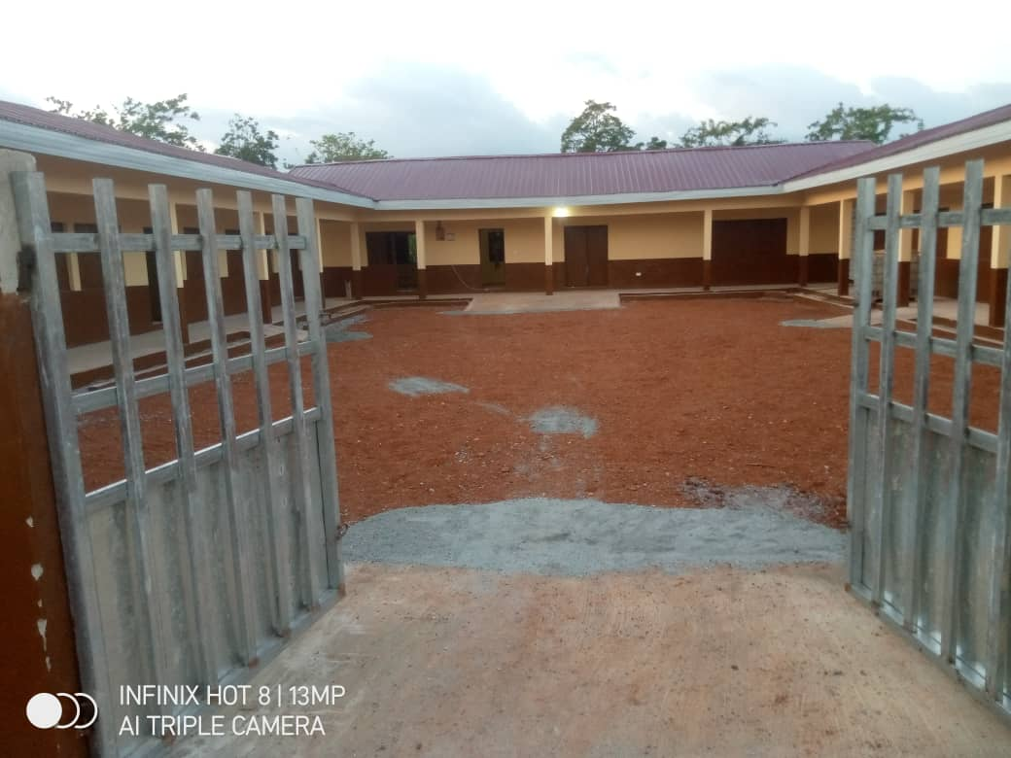
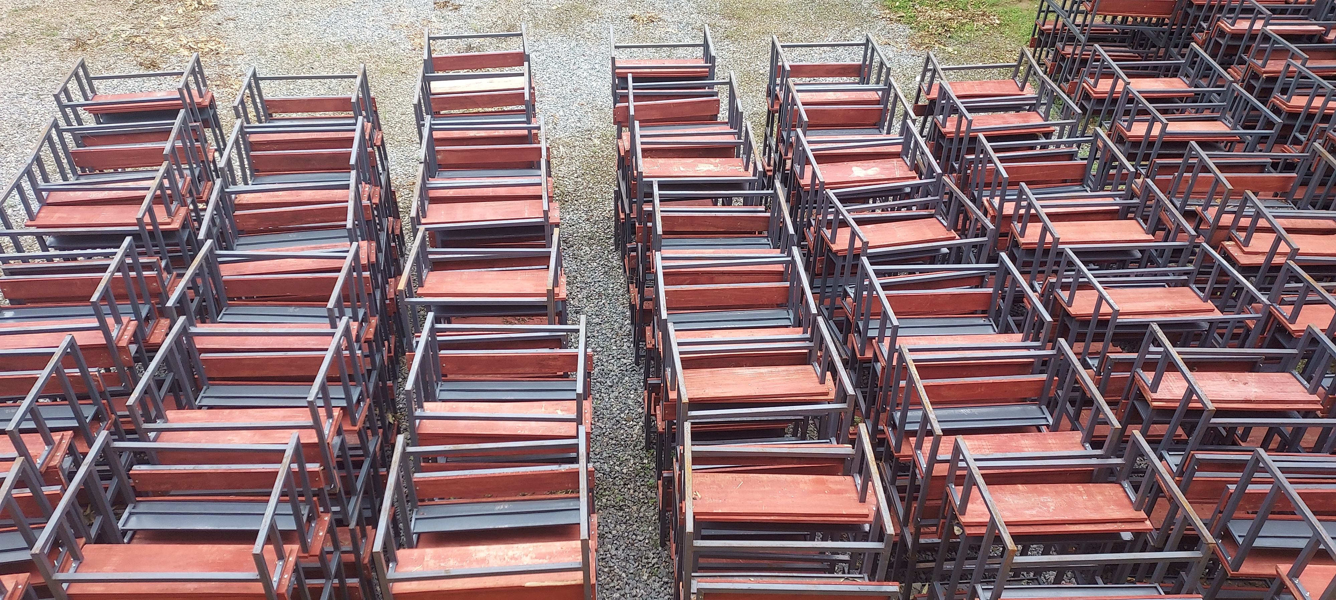
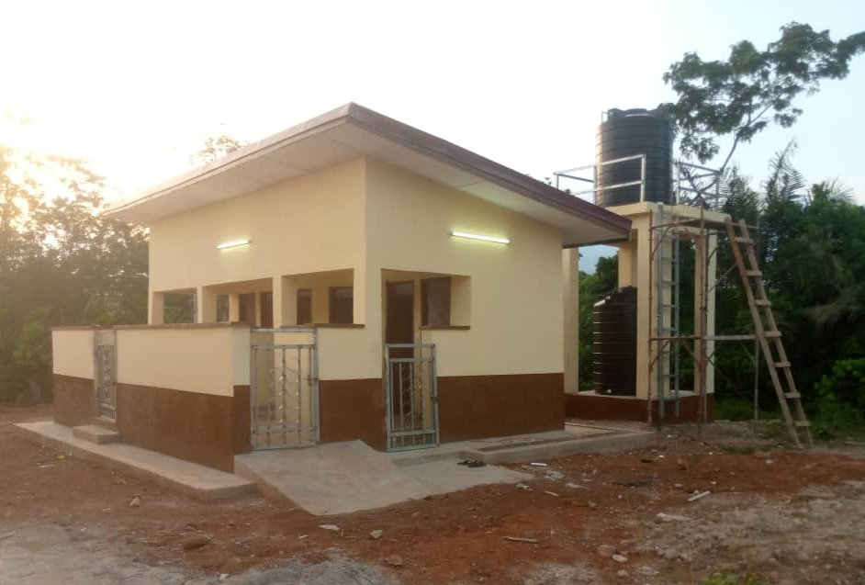
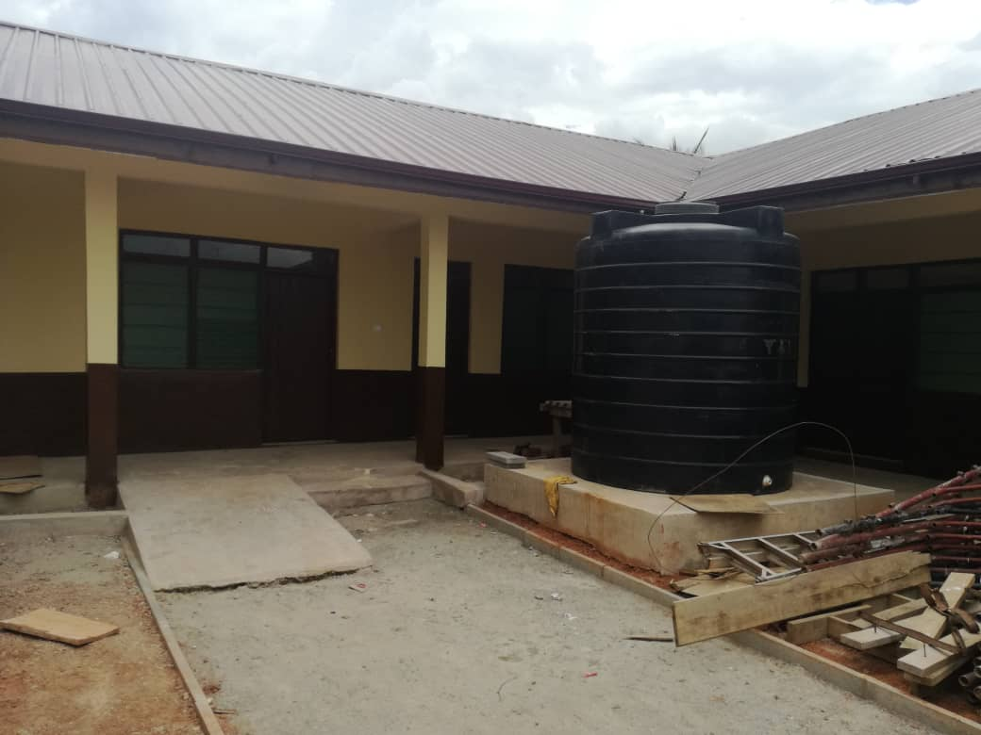
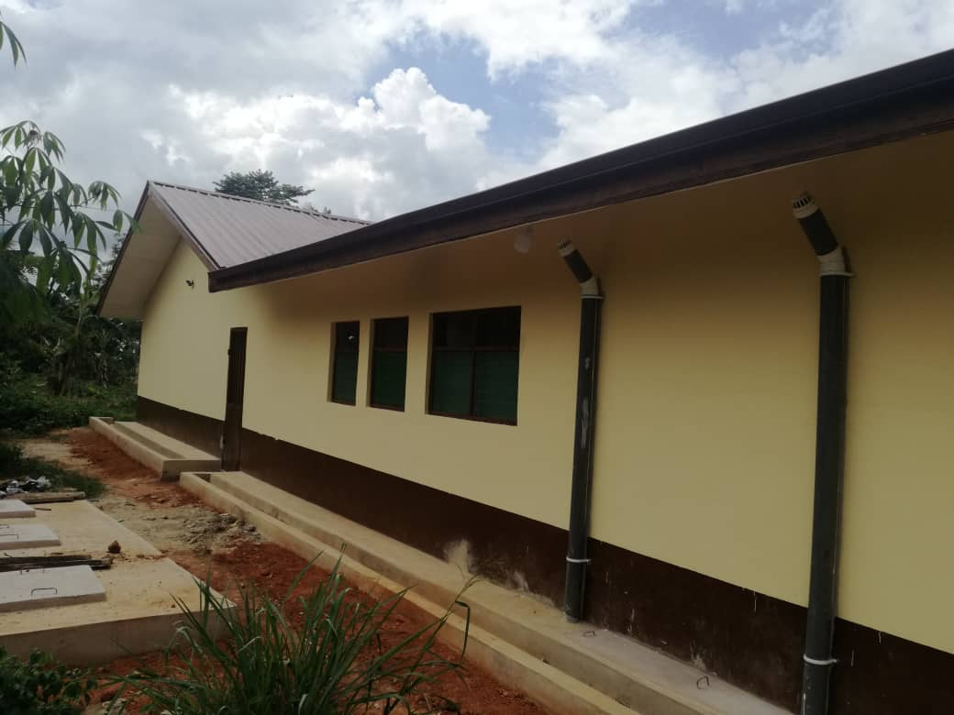
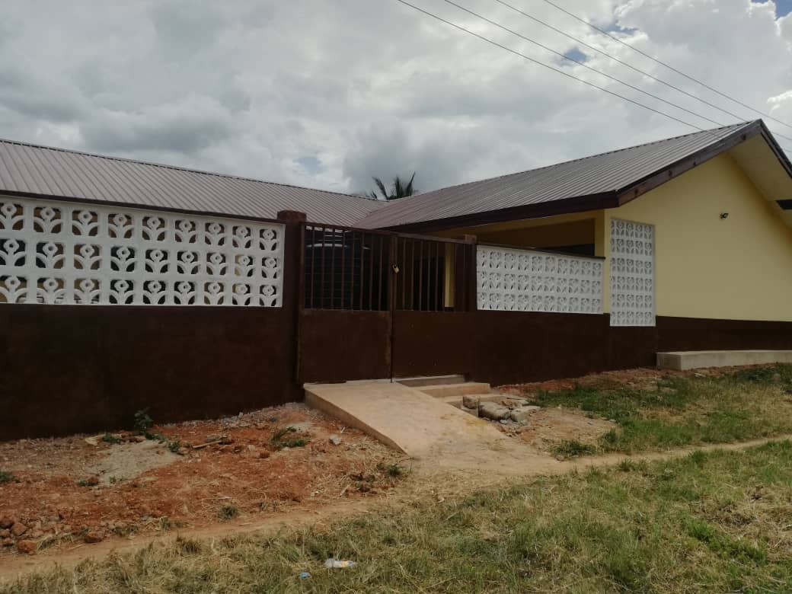
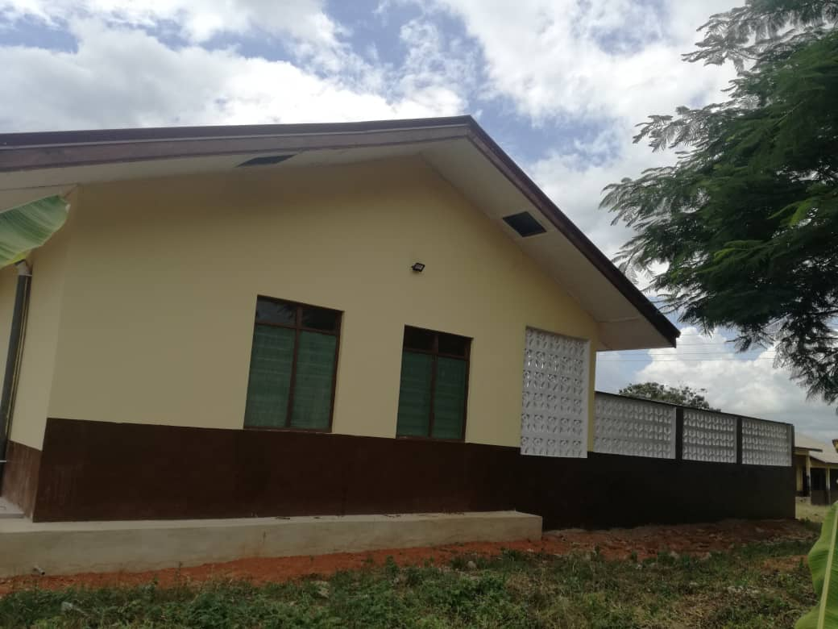
KEY ACHIEVEMENTS (2024)
EDUCATION
PHYSICAL INFRASTRUCTURAL DEVELOPMENT
Completed 1No. 6-unit classroom block at
Oforikrom
750 pieces of dual desks were distributed to public schools.
Completed 1No. 6-seater WC toilet block with mechanized borehole & elevated tank support at Oforikrom
Completed 1No. 2-unit KG block at Apoli
15

Slide 17
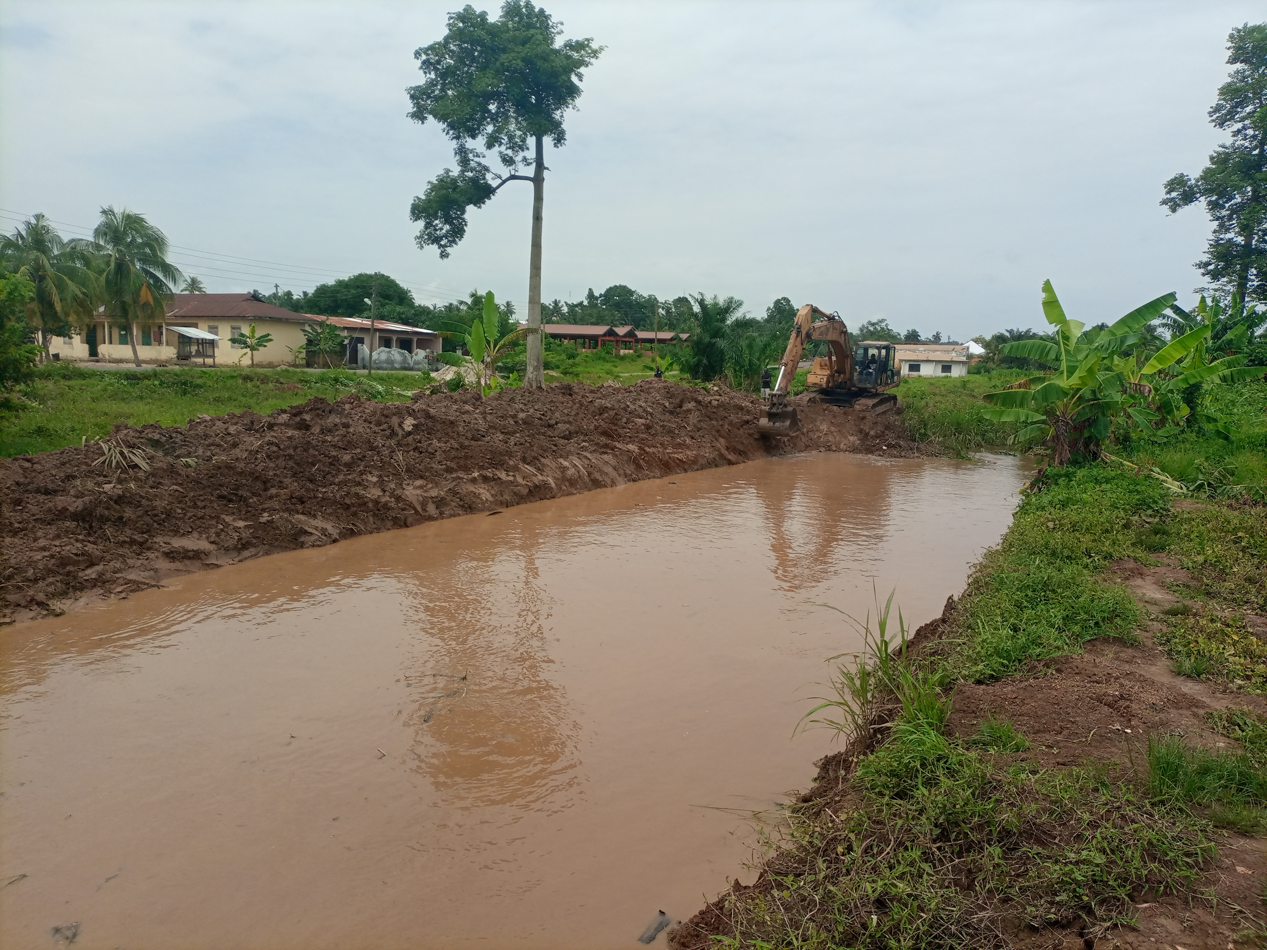
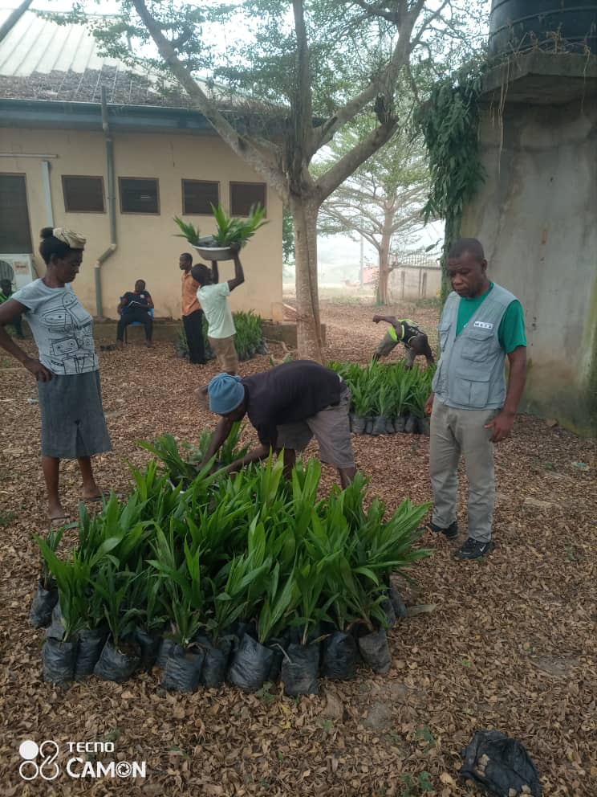
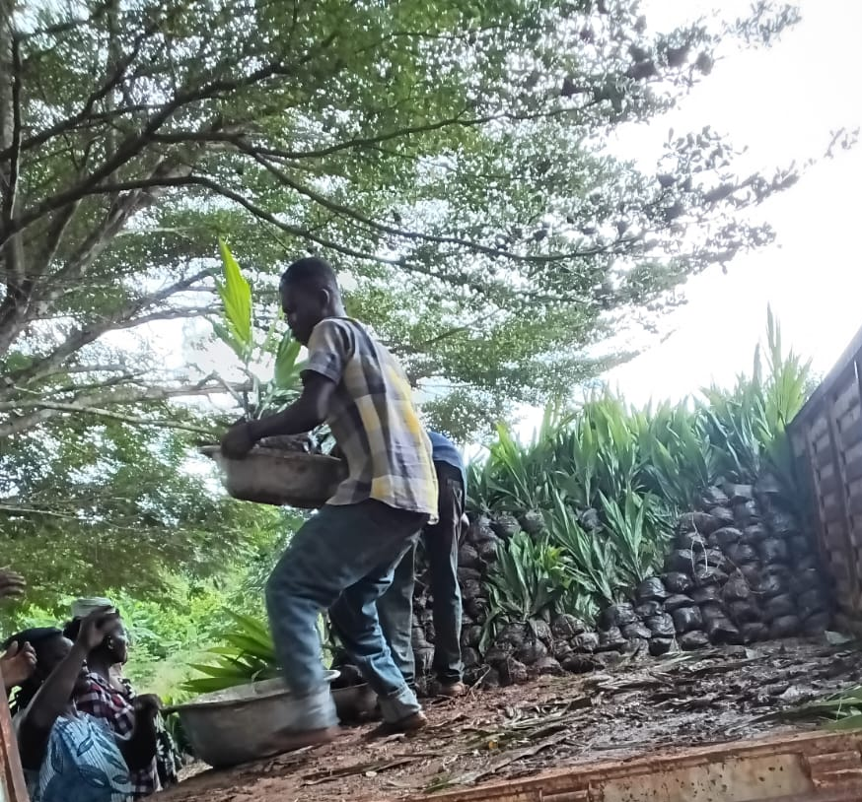
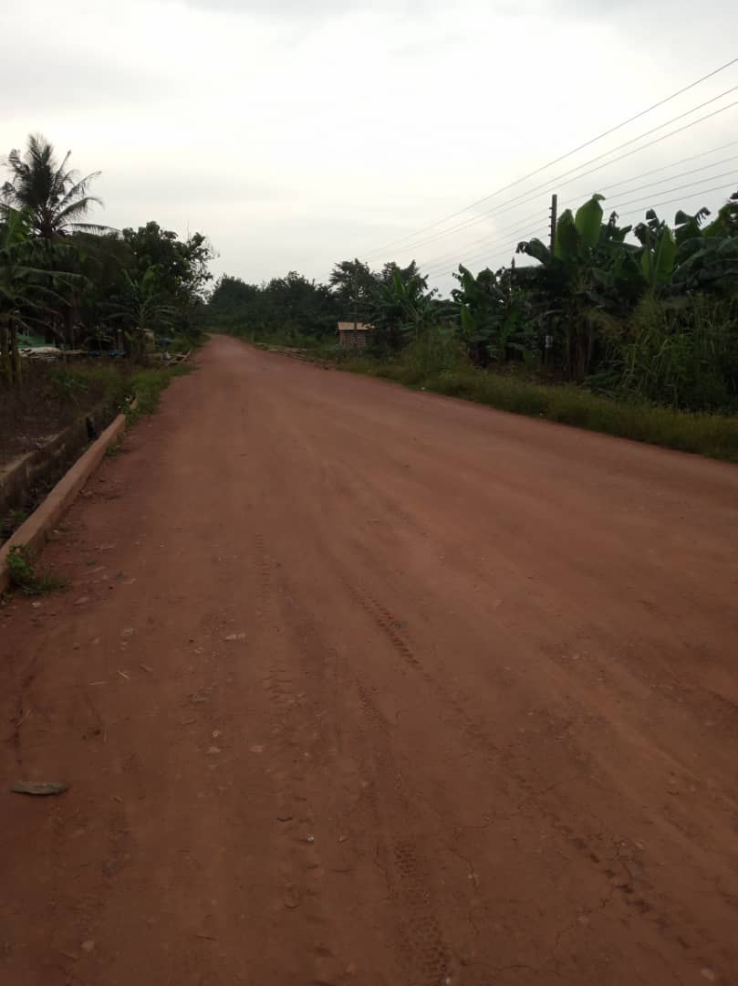
KEY ACHIEVEMENTS (2024)
  DREDGING
  Dredged 2km Kyekyerepua-Kosiko River
ECONOMIC DEVELOPMENT
  Oil palm
  A total of 69,000 oil palm seedlings were distributed to 566 farmers.
  TRANSPORTATION
  Reshaped 9.7km Feeder Roads (Akortekrom-Mensakrom-Achiasehene Akura, & others)
16

Slide 18
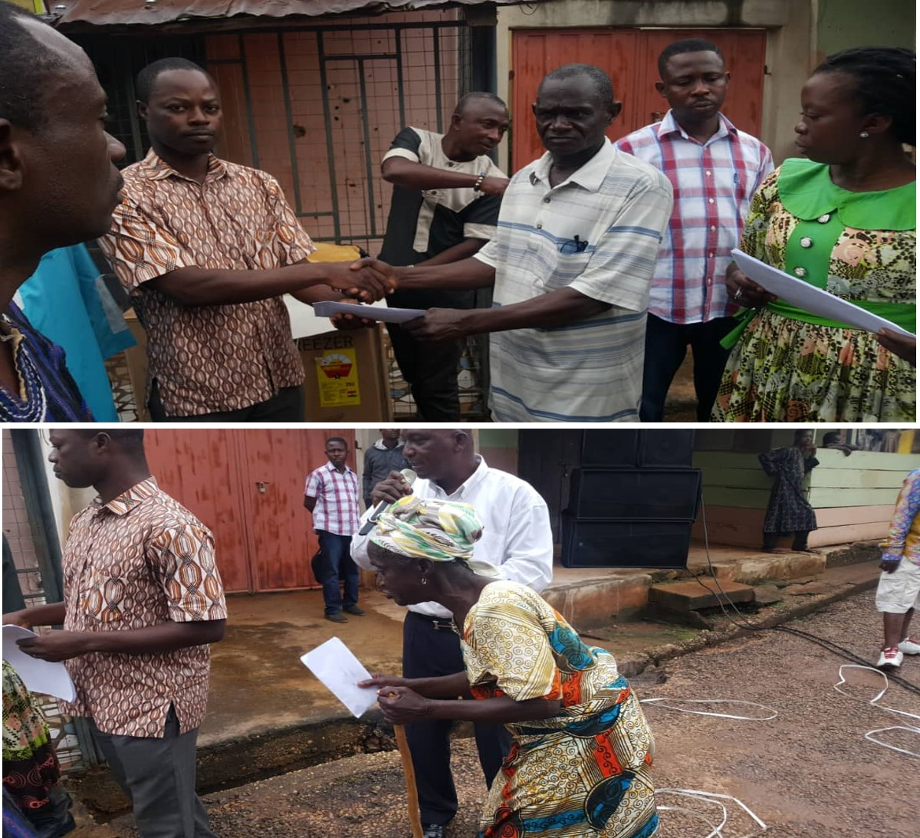
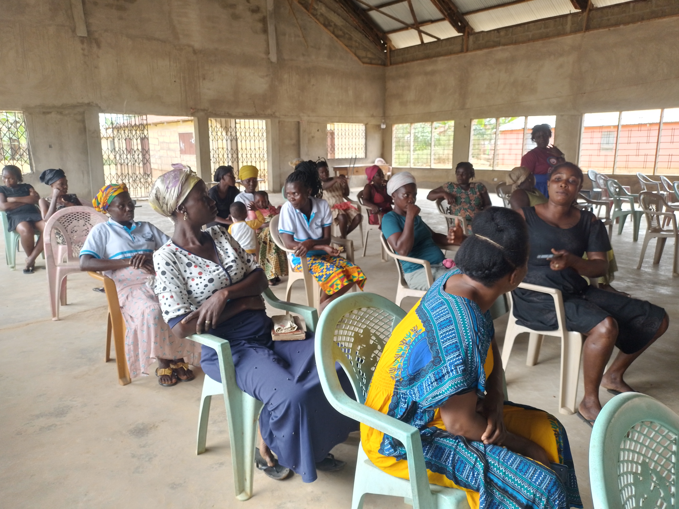
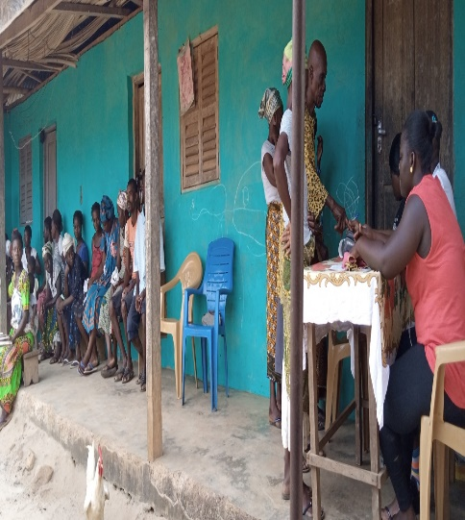
KEY ACHIEVEMENTS (2024)
SOCIAL WELFARE
  Supervised payment of funds to 659 LEAP beneficiary households in 23 communities during the 88th, 89th, 90th, 91st and 92nd payment cycles.
  Sensitized the public in 28 communities on the effects of child labour, child protection issues and gender empowerment.
  Supported NHIA to carry out free renewal of NHIS cards for 500 indigents, and registered 350 indigents in 15 communities onto the NHIS.
  Supported 50 PWDs with funds and startup kits to engage in IGA.
17

Slide 19
Policy Outcome Indicators and Targets
Outcome Indicator | Outcome Indicator Description | Unit of Measurement | Previous year’s performance (2023) |  | Current year’s Actual Performance (2024)
 |  |  | Target | Actual | Target | Actuals as at September
Net Enrolment Rate: KG Primary JHS | Net enrolment ratio is the number of boys and girls of the school age of a particular level of education (KG/Primary/JHS) that are enrolled in that level of education, expressed as a percentage of the total population in that age group | Percentage (%) | 65.0% | 49.3% | 55.3% | 49.3%
 |  |  | 61.8% | 46.8% | 50.2% | 47.3%
 |  |  | 30.0% | 23.2% | 25.6% | 23.5%
Average Productivity of selected crops (mt/ha) Maize, Rice, Cassava & Oil Palm | Output per hectare of selected crops (mt/ha) | Percentage change (mt/ha)
 |  | Maize | 3.0% | 2.95% | 3.0% | 2.75%
 |  | Rice | 4.4% | 4.25% | 4.5% | 4.35%
 |  | Cassava | 16.4% | 16.31% | 16.5% | 16.42%
 |  | Oil Palm | 7.8% | 7.65% | 8.0% | 7.54%
Proportion of population with access to basic sanitation services: Urban Rural | Share of population with access to basic sanitation services including ventilated improved pit latrines, flush toilets to sewer systems, septic tanks or pit latrines, composting toilets etc. expressed as a percentage of total district population. | Percentage (%) | 53% | 50% | 53% | 50.2%
 |  |  | 15% | 12% | 15% | 11.5%
Proportion of Vulnerable People Empowered | Number of PWDs supported over the total number of PWDs registered in the District. | Percentage (%) | 50% | 30% | 50% | 20%
18

Slide 20
Sanitation Budget Performance
Liquid Waste
No. | Name of Activity/Project | Budget | Actuals as at September, 2024
1. | Rehabilitation of 12-Unit Water Closet Toilet and Bath at AKIM SWEDRU | 198,584.00 | 21,626.20
2. | Fumigation | 161,000.00 | 0.00
 | Total | 359,584.00 | 21,626.20
Solid Waste
No. | Name of Activity/Project | Budget | Actuals as at September, 2024
1. | Clearing and Leveling of Refuse Sites | 160,000.00 | 27,000.00
2. | Refuse Evacuation | 30,000.00 | 0.00
 | Total | 190,000.00 | 27,000.00
19

Slide 21
Government Flagship Projects or Programmes (Support)
No | Type of Flagship project/programme | Name of Activity/Project | Budget | Actual as at September, 2024
1. | Planting for Food and Jobs | Sensitization of PFJ phase 2 | 30,000.00 | 10,000.00
 |  | Awareness Creation on the use of improved seedlings and fertilizer application | 10,000.00 | 5,000.00
 |  | Training farmers on good management practices | 10,000.00 | 8,000.00
 | TOTAL |  | 50,000.00 | 23,000.00
20

Slide 22
Outlook For 2025
21

Slide 23
District Adopted Policy Objectives for 2025
FOCUS AREA | ADOPTED POLICY OBJECTIVE | BUDGET ALLOCATION
Local Governance and Decentralisation | Deepen Political and Administrative Decentralisation | 2,101,553.75
Strong and resilient economy | Strengthen domestic resource mobilization to improve capacity for revenue collection | 175,000.00
Agriculture and rural development | Modernize and enhance agricultural production systems | 209,626.20
Education and training | Enhance equitable access to and participation in quality education at all levels. | 840,233.65
Health and health services | Ensure accessible, and quality Universal Health Coverage (UHC) for all. | 31,580.00
Child protection and development | Prevent and protect children from all forms of violence, abuse, neglect and exploitation. | 38,000.00
Gender equality | Attain gender equality and equity in political, social and economic development | 50,000.00
 | Promote economic empowerment of particularly women
SUB TOTAL |  | 3,445,993.60
22

Slide 24
District Adopted Policy Objectives for 2025
FOCUS AREA | ADOPTED POLICY OBJECTIVE | BUDGET ALLOCATION
Disability-inclusive development | Implement social protection systems and measures for the poor and vulnerable. | 247,813.00
Reducing poverty and Inequality | Eradicate poverty and address vulnerability to poverty in all forms and dimensions. | 203,295.90
Drainage and flood control | Address recurrent devastating floods | 60,000.00
Human settlement development and housing | Promote sustainable spatially integrated development of human settlement | 1,009,586.12
Water and Environmental Sanitation | Improve access to safe reliable and sustainable water supply services for all. | 196,957.80
 | Enhance access to improved and sustainable environmental sanitation services. | 351,000.00
Transport Infrastructure: Roads | Improve efficiency and effectiveness of road transport infrastructure and services. | 300,761.33
SUB TOTAL |  | 2,369,407.75
GRAND TOTAL |  | 5,815,407.75
23

Slide 25
Policy Outcome Indicators and Targets
Outcome Indicator | Outcome Indicator Description | Unit of Measurement | Baseline (2023) |  | Current year (2024) |  | Budget year (2025) | Indicative year (2026) | Indicative year (2027) | Indicative year (2028)
 |  |  | Target | Actual | Target | Actual as at September | Target | Target | Target | Target
Net Enrolment Rate: KG Primary JHS | Net enrolment ratio is the number of boys and girls of the school age of a particular level of education (KG/Primary/JHS) that are enrolled in that level of education, expressed as a percentage of the total population in that age group | Percentage (%) | 65.0% | 49.3% | 55.3% | 49.3% | 50.1% | 50.3% | 51.2% | 51.5%
 |  |  | 61.8% | 46.8% | 50.2% | 47.3% | 48.0% | 48.3% | 48.5% | 50.2%
 |  |  | 30.0% | 23.2% | 25.6% | 23.5% | 23.8% | 24.0% | 24.5% | 25.3%
Average Productivity of selected crops (mt/ha) Maize, Rice, Cassava & Oil Palm | Output per hectare of selected crops (mt/ha) | Percentage change (mt/ha)
 |  | Maize | 3.0% | 2.95% | 3.0% | 2.75% | 3.1% | 3.2% | 3.4% | 3.5%
 |  | Rice | 4.4% | 4.25% | 4.5% | 4.35% | 4.8% | 5.0% | 5.2% | 5.4%
 |  | Cassava | 16.4% | 16.31% | 16.5% | 16.42% | 16.5% | 16.7% | 16.8% | 17.0%
 |  | Oil Palm | 7.8% | 7.65% | 8.0% | 7.54% | 7.8% | 8.0% | 8.2% | 8.5%
24

Slide 26
Policy Outcome Indicators and Targets
Outcome Indicator | Outcome Indicator Description | Unit of Measurement | Baseline (2023) |  | Current year (2024) |  | Budget year (2025) | Indicative year (2026) | Indicative year (2027) | Indicative year (2028)
 |  |  | Target | Actual | Target | Actual as at September | Target | Target | Target | Target
Proportion of population with access to basic sanitation services: Urban Rural | Share of population with access to basic sanitation services including ventilated improved pit latrines, flush toilets to sewer systems, septic tanks or pit latrines, composting toilets etc. expressed as a percentage of total district population. | Percentage (%) | 53% | 50% | 53% | 50.2% | 55% | 60% | 65% | 70%
 |  |  | 15% | 12% | 15% | 11.5% | 17% | 20% | 25% | 30%
Proportion of Vulnerable People Empowered | Number of PWDs supported over the total number of PWDs registered in the District. | Percentage (%) | 50% | 30% | 50% | 20% | 60% | 65% | 70% | 75%
25

Slide 27
2025-2028 Revenue Projections – IGF Only
ITEM | 2024 |  | 2025 | 2026 | 2027 | 2028
 | Budget | Actual as at September | Budget | Projection | Projection | Projection
Property Rate | 60,000.00 | 42,922.00 | 60,000.00 | 61,200.00 | 62,424.00 | 63,672.48
Basic Rate | 200.00 | 90.90 | 200.00 | 204.00 | 208.08 | 212.24
Fees | 60,000.00 | 54,394.00 | 65,000.00 | 66,300.00 | 67,626.00 | 68,978.52
Fines | 3,800.00 | 80.00 | 3,800.00 | 3,876.00 | 3,953.52 | 4,032.59
Licence | 80,000.00 | 72,292.00 | 85,000.00 | 86,700.00 | 88,434.00 | 90,202.68
Land | 120,000.00 | 103,178.45 | 125,000.00 | 127,500.00 | 130,050.00 | 132,651.00
Rent | 25,000.00 | 14,260.00 | 30,000.00 | 30,600.00 | 31,212.00 | 31,836.24
Investment | 0.00 | 0.00 | 0.00 | 0.00 | 0.00 | 0.00
Sub-Total | 349,000.00 | 287,217.35 | 369,000.00 | 376,380.00 | 383,907.60 | 391,585.75
Royalties | 134,047.00 | 50,000.00 | 130,000.00 | 132,600.00 | 135,252.00 | 137,957.04
Total | 483,047.00 | 337,217.35 | 499,000.00 | 508,980.00 | 519,159.60 | 529,542.79
26

Slide 28
REVENUE IMPROVEMENT ACTION PLAN FOR 2025
OBJECTIVE | ACTIVITIES/STRATEGIES | QUARTER |  |  |  | EXPECTED OUTPUT | ESTIMATED COST (GH₵) | FUNDING SOURCE | IMPLEMENTATION AGENCY | COLLABORATORS
 |  | 1 QTR | 2 QTR | 3 QTR | 4 QTR
Strengthen Domestic Resource Mobilization | Rehabilitation of 12-Unit Water Closet with Borehole at Akim Swedru. |  |  |  |  | Fees increased by 2% | 176,957.80 | DACF | DA | Works Dept.
 | Update revenue database by June, 2025 |  |  |  |  | Business operating fees to increase by 2% | 20,000.00 | IGF/ DACF | Budget unit/ finance dept | Area Councils
 | Mount Revenue Post |  |  |  |  | Revenue performance levels to be increased | 15,000.00 | IGF | Finance dept /Works dept | Revenue Collectors
 | Empower taskforce to ensure land property developers pay approved fees |  |  |  |  | Increase in land and buildings by 5% | 10,000.00 | DACF | DA | Works Dept.
 | Sensitize stakeholder/revenue education |  |  |  |  | Responsiveness to revenue mobilization to improve | 5,000.00 | IGF | Budget unit/ Finance Dept | Stakeholders
 | Train revenue collectors on fee fixing and revenue collection strategies |  |  |  |  | Revenue collection to be increased by 5% | 10,000.00 | IGF/ DACF | Budget unit/ Finance Dept | HR Dept.
 | Rehabilitation of Akim Swedru market |  |  |  |  | Rent Increased by 2% | 203,295.90 | DACF-RFG | DA | Works Dept.
TOTAL |  |  |  |  |  |  | 440,253.70
27

Slide 29
REVENUE MOBILIZATION STRATEGIES FOR KEY REVENUE SOURCES
REVENUE SOURCE | KEY STRATEGIES
1. RATES (Basic Rates/Property Rates) | Basic Rate: Adding the Basic Rate component to all B.O. Ps and all other charges to reduce the cost of collection and make collection easier. Property Rates: Establish and Enforce Development Control Task Force. Provide logistical support for the Development Control Task Force.
2. LANDS | Undertake weekly monitoring of newly developed sites. Provide logistical support for the Development Control Task Force. Organising monthly Spatial Planning Committee meetings
3. LICENSES | Public education on payment of fees. Review and update existing business database. Establish Task Force for revenue mobilization in the District. Gazette Bye-laws. Prosecute rate defaulters.
28

Slide 30
REVENUE MOBILIZATION STRATEGIES FOR KEY REVENUE SOURCES
REVENUE SOURCE | KEY STRATEGIES
4. RENT | Sensitize occupants of Government stores on the need to pay rent. Timely Issuance of demand notice. Prosecute defaulters.
5. FEES AND FINES | Sensitize various business operators by organising stakeholders’ consultative meetings. Formation of revenue monitoring team to check on the activities of revenue collectors, especially on market days.
6. REVENUE COLLECTORS | Quarterly rotation of revenue collectors. Setting target for revenue collectors. Train and resource revenue collectors on effective strategies of mobilizing revenue. Sanction underperforming revenue collectors. Awarding best performing revenue collectors.
29

Slide 31
2025-2028 Revenue Projections – All Revenue Sources
ITEM |  | 2024 |  | 2025 | 2026 | 2027 | 2028
 |  | Budget | Actual as at September | Budget | Projection | Projection | Projection
IGF |  | 483,047.00 | 337,217.35 | 499,000.00 | 508,980.00 | 519,159.60 | 529,542.79
Compensation of Employee |  | 4,269,918.00 | 5,379,742.00 | 5,554,873.41 | 5,665,970.88 | 5,779,290.30 | 5,894,876.10
Goods and Services Transfer |  | 93,500.00 | 0.00 | 101,500.00 | 103,530.00 | 105,600.60 | 107,712.61
Assets Transfer |  | 25,180.00 | 0.00 | 25,180.00 | 25,683.60 | 26,197.27 | 26,721.22
DACF | Assembly | 2,901,547.00 | 764,245.40 | 2,901,547.00 | 2,959,577.94 | 3,018,769.50 | 3,079,144.89
 | MP | 776,803.42 | 709,214.41 | 776,803.00 | 792,339.06 | 808,185.84 | 824,349.56
 | HIV/MALARIA | 14,580.00 | 5,052.92 | 14,580.00 | 14,871.60 | 15,169.03 | 15,472.41
 | PWD | 247,813.00 | 146,858.05 | 247,813.00 | 252,769.26 | 257,824.65 | 262,981.14
DACF-RFG |  | 2,436,521.11 | 1,789,440.00 | 1,355,306.00 | 1,382,412.12 | 1,410,060.36 | 1,438,261.57
Total |  | 11,248,909.53 | 9,131,770.13 | 11,476,602.41 | 11,706,134.46 | 11,940,257.15 | 12,179,062.29
30

Slide 32
Expenditure By Budget Programme And Economic Classification-all Funding Sources
BUDGET PROGRAMME | AMOUNT GH¢
 | COMPENSATION OF EMPLOYEES | GOODS & SERVICE | CAPITAL EXPENDITURE | TOTAL
Management and Administration | 3,111,536.87 | 1,654,504.75 | 610,049.00 | 5,376,090.62
Social Services Delivery | 1,162,457.28 | 740,716.00 | 966,868.45 | 2,870,041.73
Infrastructure Delivery and Management | 678,735.54 | 158,000.00 | 1,172,345.45 | 2,009,082.99
Economic Development | 708,464.97 | 198,000.00 | 254,922.10 | 1,161,387.07
Environmental Management | 0.00 | 60,000.00 | 0.00 | 60,000.00
TOTAL | 5,661,194.66 | 2,811,220.75 | 3,004,187.00 | 11,476,602.41
31

Slide 33
Government Flagship Projects or Programmes For 2025 (Support)
No | Type of Flagship project/programme | Name of Activity/Project | Budget | Funding Source
1. | Planting for Food and Jobs | Sensitization of PFJ phase 2 | 30,000.00 | DACF/IGF
 |  | Awareness Creation on the use of improved seedlings and fertilizer application | 10,000.00 | DACF/IGF
 |  | Training farmers on good management practices | 10,000.00 | DACF/IGF
 | TOTAL |  | 50,000.00
32

Slide 34
Key Projects For 2025 and Corresponding Cost and Justification
List all Projects | IGF (GHc) | GOG (GHc) | DACF (GHc) | DACF-RFG (GHc) | MAG (GHc) | Total Budget (GHc) | Justification- What do you intend to achieve with the programmes/projects and how does this link to your objectives?
MANAGEMENT AND ADMINISTRATION
A. GENERAL ADMINISTRATION
1. Purchase of Office Equipment and Logistics |  | 25,180.00 | 60,000.00 |  |  | 85,180.00 | Work effectiveness and efficiency enhanced.
2. Purchase of Office Furniture |  |  | 60,000.00 |  |  | 60,000.00 | Work effectiveness and efficiency enhanced.
3. Legislative Enactment and Oversight – MP |  |  | 450,000.00 |  |  | 450,000.00 | Community development promoted.
4. Telecommunications and Internet Bosters |  |  | 14,869.00 |  |  | 14,869.00 | Staff work performance enhanced
SUB-TOTAL | 0.00 | 25,180.00 | 584,869.00 | 0.00 | 0.00 | 610,049.00
33

Slide 35
List all Projects | IGF (GHc) | GOG (GHc) | DACF (GHc) | DACF-RFG (GHc) | MAG (GHc) | Total Budget (GHc) | Justification- What do you intend to achieve with the programmes/projects and how does this link to your objectives?
SOCIAL SERVICES DELIVERY
A. EDUCATION,YOUTH AND SPORTS SERVICES
1. Construction of 1NO. 2-Bedroom Teachers Quarters with FURNISHING at ADENKYENSU |  |  | 310,000.00 |  | . | 310,000.00 | Quality of teaching and learning improved
2. Procurement of 510No. Desks for some selected schools in the District |  |  |  | 449,910.65 |  | 449,910.65 | Quality of teaching and learning improved
3. Procurement of office equipment |  |  | 30,000.00 |  |  | 30,000.00 | Work effectiveness and efficiency enhanced.
SUB-TOTAL | 0.00 | 0.00 | 340,000.00 | 449,910.65 | 0.00 | 789,910.65
34

Slide 36
List all Projects | IGF (GHc) |  | GOG (GHc) |  | DACF (GHc) | DACF-RFG (GHc) |  | MAG (GHc) |  | Total Budget (GHc) | Justification- What do you intend to achieve with the programmes/projects and how does this link to your objectives?
SOCIAL SERVICES DELIVERY
B. ENVIRONMENTAL HEALTH AND SANITATION SERVICES
1. Rehabilitation of 12-Unit Water Closet Toilet and Bathhouse with a Borehole at AKIM SWEDRU |  |  |  | 176,957.80 |  |  |  |  |  | 176,957.80 | Environmental Sanitation Improved
SUB-TOTAL |  | 0.00 | 0.00 | 176,957.80 |  |  | 0.00 |  | 0.00 | 176,957.80
35

Slide 37
List all Projects | IGF (GHc) | GOG (GHc) | DACF (GHc) | DACF-RFG (GHc) | MAG (GHc) | Total Budget (GHc) | Justification- What do you intend to achieve with the programmes/projects and how does this link to your objectives?
INFRASTRUCTURE DELIVERY AND MANAGEMENT
A. PUBLIC WORKS,RURAL HOUSING AND WATER MANAGEMENT
1. Completion of 5-bedroom DCE Bungalow at SWEDRU |  |  | 224,642.00 |  |  | 224,642.00 | Key Staff Accommodated
2. IGF Capital Project( Markets and Schools) | 99,800.00 |  |  |  |  | 99,800.00 | Assembly properties Maintained
3. Extension of Electricity Supply and Installation of 30No. Street lights |  |  |  | 547,144.12 |  | 547,144.12 | Night visibility improved
4. Construction of 1No. Lorry Park with one Office Room, passengers shed, graveling of ground and 2-cubicle open urinal |  |  |  | 154,955.33 |  | 154,955.33 | Road conditions improved for easy access/movement of people, goods and services
SUB-TOTAL | 99,800.00 | 0.00 | 224,642.00 | 702,099.45 | 0.00 | 1,026,541.45
36

Slide 38
List all Projects | IGF (GHc) | GOG (GHc) | DACF (GHc) | DACF-RFG (GHc) | MAG (GHc) | Total Budget (GHc) | Justification- What do you intend to achieve with the programmes/projects and how does this link to your objectives?
INFRASTRUCTURE DELIVERY AND MANAGEMENT
A. PUBLIC WORKS,RURAL HOUSING AND WATER MANAGEMENT
1. Self-help/ Community Initiated projects(Road Reshaping) |  |  | 145,806.00 |  |  | 145,806.00 | Road conditions improved for easy access/movement of people, goods and services
SUB-TOTAL |  |  | 145,806.00 |  |  | 145,806.00
37

Slide 39
List all Projects | IGF (GHc) | GOG (GHc) | DACF (GHc) | DACF-RFG (GHc) | MAG (GHc) | Total Budget (GHc) | Justification- What do you intend to achieve with the programmes/projects and how does this link to your objectives?
ECONOMIC DEVELOPMENT
A. AGRICULTURAL SERVICES AND MANAGEMENT
1. Rehabilitation of Veterinary Ofiice |  |  | 51,626.20 |  |  | 51,626.20 | Management of diseases and pests improved.
SUB-TOTAL | 0.00 | 0.00 | 51,626.20 |  | 0.00 | 51,626.20
38

Slide 40
List all Projects | IGF (GHc) | GOG (GHc) | DACF (GHc) | DACF-RFG (GHc) | MAG (GHc) | Total Budget (GHc) | Justification- What do you intend to achieve with the programmes/projects and how does this link to your objectives?
ECONOMIC DEVELOPMENT
B. TRADE ,TOURISM AND INDUSTRIAL DEVELOPMENT
1.Rehabilitation of AKIM SWEDRU Market |  |  |  | 203,295.90 |  | 203,295.90 | Local Business enterprises promoted for job creation
SUB-TOTAL | 0.00 | 0.00 |  | 203,295.90 | 0.00 | 203,295.90
GRAND TOTAL | 99,800.00 | 25,180.00 | 1,523,901.00 | 1,355,306.00 | 0.00 | 3,004,187.00
39

Slide 41
Sanitation Budget
Liquid Waste
No | Name of Activity/Project | Budget
1. | Rehabilitation of 12-Unit Water Closet Toilet and Bath at AKIM SWEDRU | 176,957.80
2. | Fumigation | 161,000.00
 | Total | 337,957.80
Solid Waste
No | Name of Activity/Project | Budget
1. | Clearing and Leveling of Refuse Sites | 160,000.00
2. | Refuse Evacuation | 30,000.00
 | Total | 190,000.00
40

