Slide 1

BIRIM SOUTH DISTRICT ASSEMBLY
BUDGET STATEMENT
2026 FISCAL YEAR

Slide 2









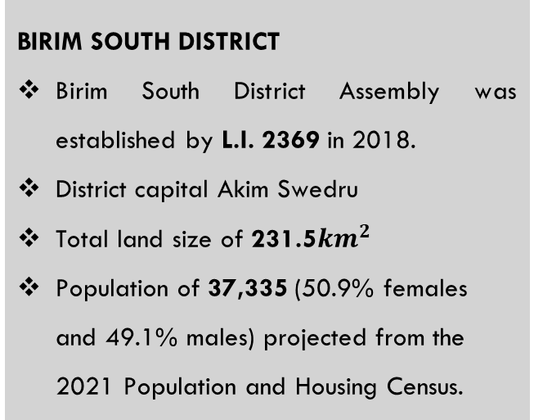
STRATEGIC OVERVIEW OF BIRIM SOUTH DISTRICT
ESTABLISHMENT
BIRIM SOUTH DISTRICT
Birim South District Assembly was established by L.I. 2369 in 2018.
District capital Akim Swedru
Total land size of 231.5${km}^{2}$
Population of 37,335 (50.9% females and 49.1% males) projected from the 2021 Population and Housing Census.
B
Core Values
C
C
Mission
A
Vision
To improve the living standards of its citizens through sustainable socio-economic development and effective institutions that are responsive to the needs of people.
Transparency & Accountability
Client-oriented
Creativity and Innovativeness
Diligence and Discipline
Equity and Integrity
Timeliness
A world class local government institution promoting well-being and total peace.
1

Slide 3
CORE FUNCTIONS OF THE DISTRICT
The functions exercised by the Assembly are deliberative, legislative as well as executive. The specific functions among others as stipulated in the Local Governance Act of 2016, Act 936 include:
Responsible for the development, improvement and management of human settlements and the environment in the district;
The Assembly takes steps and measures that are necessary and expedient to execute approved development plans for the district;
Guide, encourage and support sub-district local structures, public agencies and local communities to perform their functions in the execution of approved development plans;
Initiate and encourage joint participation with other persons or bodies to execute approved development plans;
Promote or encourage other persons or bodies to undertake projects under approved development plans; and
Monitor the execution of projects under approved development plans and assess and evaluate their impact on the development of the district and national economy in accordance with government policy.
Exercise political and administrative authority in the district.

Slide 4
DISTRICT ADOPTED POLICY OBJECTIVES FOR 2025
FOCUS AREA | ADOPTED POLICY OBJECTIVE
Local Governance and Decentralisation | Deepen Political and Administrative Decentralisation
Strong and resilient economy | Strengthen domestic resource mobilization to improve capacity for revenue collection
Agriculture and rural development | Modernize and enhance agricultural production systems
Education and training | Enhance equitable access to and participation in quality education at all levels.
Health and health services | Ensure accessible, and quality Universal Health Coverage (UHC) for all.
Child protection and development | Prevent and protect children from all forms of violence, abuse, neglect and exploitation.
Gender equality | Attain gender equality and equity in political, social and economic development
 | Promote economic empowerment of particularly women

Slide 5
DISTRICT ADOPTED POLICY OBJECTIVES FOR 2025
FOCUS AREA | ADOPTED POLICY OBJECTIVE
Disability-inclusive development | Implement social protection systems and measures for the poor and vulnerable.
Reducing poverty and Inequality | Eradicate poverty and address vulnerability to poverty in all forms and dimensions.
Drainage and flood control | Address recurrent devastating floods
Human settlement development and housing | Promote sustainable spatially integrated development of human settlement
Water and Environmental Sanitation | Improve access to safe reliable and sustainable water supply services for all.
 | Enhance access to improved and sustainable environmental sanitation services.
Transport Infrastructure: Roads | Improve efficiency and effectiveness of road transport infrastructure and services.

Slide 6
DISTRICT ECONOMY
SECTORS OF THE ECONOMY
EDUCATION (LEVELS)
The number of schools in the District at each level:
TOURISM / HOSPITALITY
Potential tourist sites:
Aboye confluence.
Birim forest range
Agriculture being the main occupation of the district with majority into crop production (50% of economically active population)
Wholesale & retail 20%, Services 20% and Manufacturing 5%.
Levels | Public | Private
Pre-School | 28 | 09
Primary | 28 | 09
JHS | 21 | 06
SHS | 01 | 00
SANITATION
3 functional public toilets
1 WC public toilet under rehabilitation in Swedru.
11 skip containers across the district.
HEALTH
24 Demarcated CHPS Zones
14 permanent health facilities in the District.
11 CHPS Compound
2 Health centers
1 Clinic
3 Labs Swedru, Awisa & Aduasa.
13 Mobile CHPS.
1 District hospital is under construction.
MARKET
There are three main market facilities in the district. (Swedru, Awisa, and Aduasa Markets).
Tuesdays and Fridays are the main market days for Aduasa whilst Wednesdays is for Swedru.
Lockable stores: 67
Stalls: 59
PHYSICAL ENVIRONMENT
Road coverage: 121.0km
Bitumen covers 29.1km (24%).
Earth surface roads 91.9km (76%)

Slide 7
KEY CHALLENGES
Poor Road and Drainage infrastructure
Inadequate Sanitary Facilities
Inadequate basic school infrastructure
Limited access to quality Health Service delivery
Inadequate market infrastructure
Low capacity of Substructures
Haphazard settlements and non-compliance to available planning schemes
High pest infestation
High level of Post-harvest losses
Inadequate support for vulnerable groups, ie. PLWHAs and PWDs
Inadequate support for Child Protection Activities

Slide 8
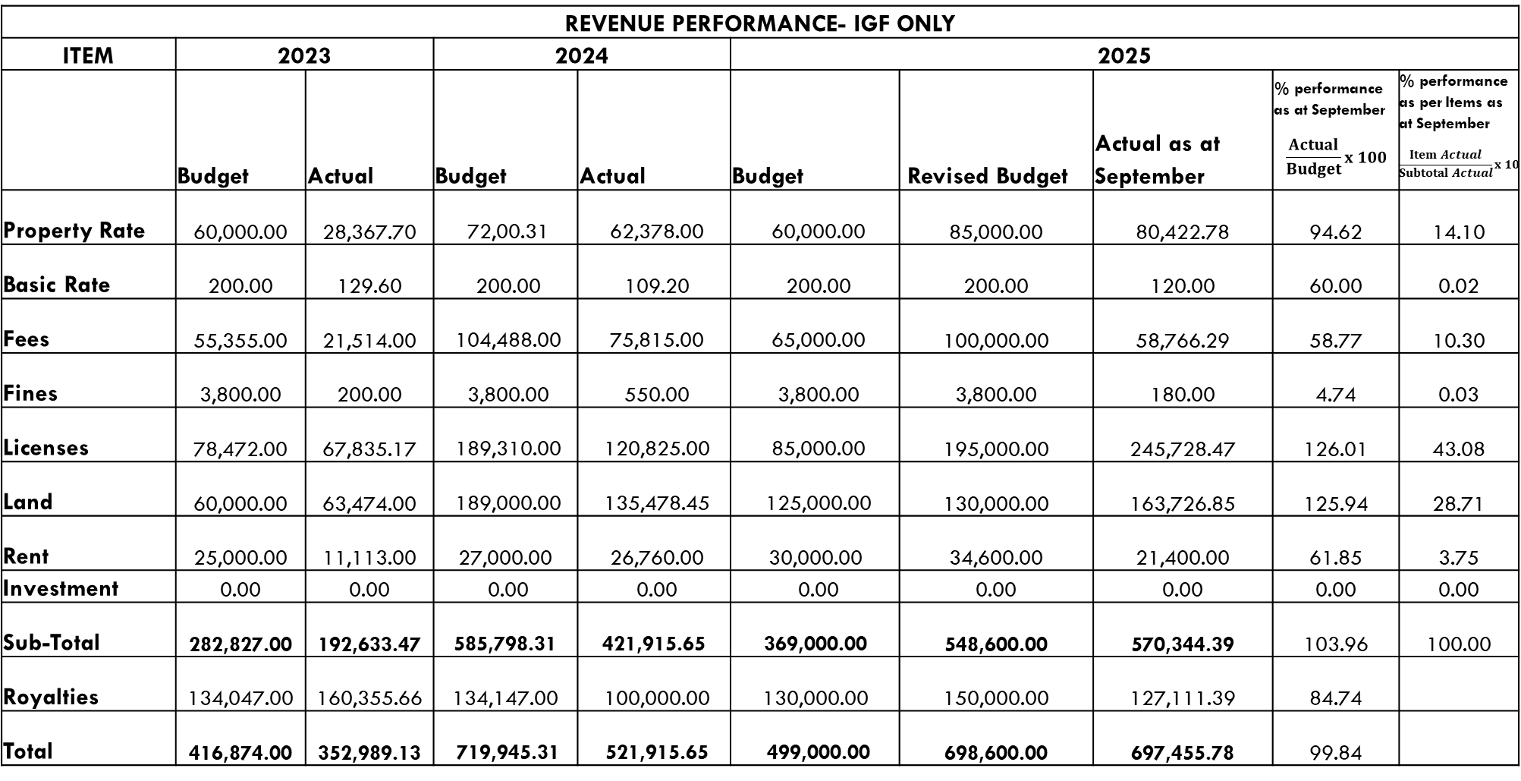
Financial Performance - Revenue
REVENUE PERFORMANCE- IGF ONLY
ITEM | 2023 |  | 2024 |  | 2025
 | Budget | Actual | Budget | Actual | Budget | Revised Budget | Actual as at September | % performance as at September $$\frac{Actual}{Budget}x 100$$ | % performance as per Items as at September $$\frac{Item Actual}{Subtotal Actual}x 100$$
Property Rate | 60,000.00 | 28,367.70 | 72,00.31 | 62,378.00 | 60,000.00 | 85,000.00 | 80,422.78 | 94.62 | 14.10
Basic Rate | 200.00 | 129.60 | 200.00 | 109.20 | 200.00 | 200.00 | 120.00 | 60.00 | 0.02
Fees | 55,355.00 | 21,514.00 | 104,488.00 | 75,815.00 | 65,000.00 | 100,000.00 | 58,766.29 | 58.77 | 10.30
Fines | 3,800.00 | 200.00 | 3,800.00 | 550.00 | 3,800.00 | 3,800.00 | 180.00 | 4.74 | 0.03
Licenses | 78,472.00 | 67,835.17 | 189,310.00 | 120,825.00 | 85,000.00 | 195,000.00 | 245,728.47 | 126.01 | 43.08
Land | 60,000.00 | 63,474.00 | 189,000.00 | 135,478.45 | 125,000.00 | 130,000.00 | 163,726.85 | 125.94 | 28.71
Rent | 25,000.00 | 11,113.00 | 27,000.00 | 26,760.00 | 30,000.00 | 34,600.00 | 21,400.00 | 61.85 | 3.75
Investment | 0.00 | 0.00 | 0.00 | 0.00 | 0.00 | 0.00 | 0.00 | 0.00 | 0.00
Sub-Total | 282,827.00 | 192,633.47 | 585,798.31 | 421,915.65 | 369,000.00 | 548,600.00 | 570,344.39 | 103.96 | 100.00
Royalties | 134,047.00 | 160,355.66 | 134,147.00 | 100,000.00 | 130,000.00 | 150,000.00 | 127,111.39 | 84.74
Total | 416,874.00 | 352,989.13 | 719,945.31 | 521,915.65 | 499,000.00 | 698,600.00 | 697,455.78 | 99.84

Slide 9
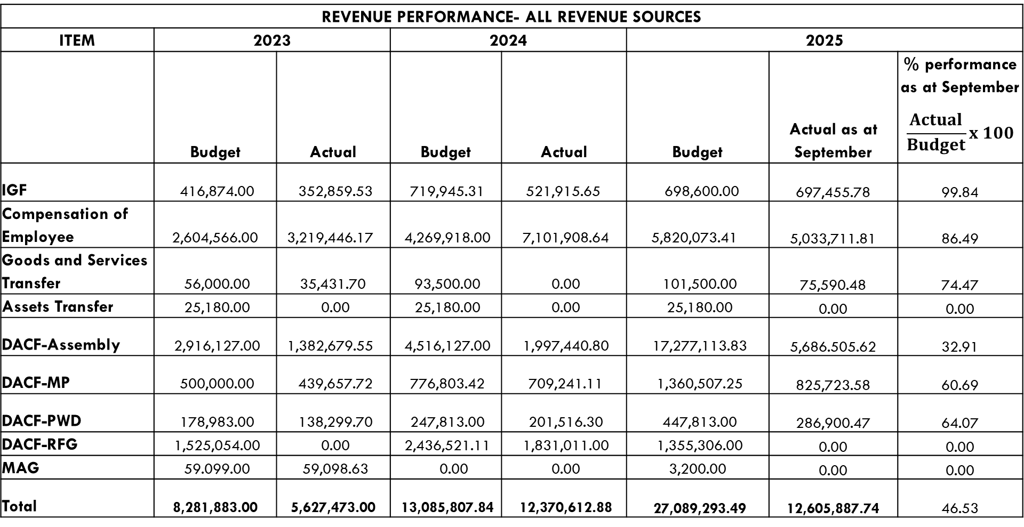
Financial Performance - Revenue
REVENUE PERFORMANCE- ALL REVENUE SOURCES
ITEM | 2023 |  | 2024 |  | 2025
 | Budget | Actual | Budget | Actual | Budget | Actual as at September | % performance as at September $$\frac{Actual}{Budget}x 100$$
IGF | 416,874.00 | 352,859.53 | 719,945.31 | 521,915.65 | 698,600.00 | 697,455.78 | 99.84
Compensation of Employee | 2,604,566.00 | 3,219,446.17 | 4,269,918.00 | 7,101,908.64 | 5,820,073.41 | 5,033,711.81 | 86.49
Goods and Services Transfer | 56,000.00 | 35,431.70 | 93,500.00 | 0.00 | 101,500.00 | 75,590.48 | 74.47
Assets Transfer | 25,180.00 | 0.00 | 25,180.00 | 0.00 | 25,180.00 | 0.00 | 0.00
DACF-Assembly | 2,916,127.00 | 1,382,679.55 | 4,516,127.00 | 1,997,440.80 | 17,277,113.83 | 5,686.505.62 | 32.91
DACF-MP | 500,000.00 | 439,657.72 | 776,803.42 | 709,241.11 | 1,360,507.25 | 825,723.58 | 60.69
DACF-PWD | 178,983.00 | 138,299.70 | 247,813.00 | 201,516.30 | 447,813.00 | 286,900.47 | 64.07
DACF-RFG | 1,525,054.00 | 0.00 | 2,436,521.11 | 1,831,011.00 | 1,355,306.00 | 0.00 | 0.00
MAG | 59.099.00 | 59,098.63 | 0.00 | 0.00 | 3,200.00 | 0.00 | 0.00
Total | 8,281,883.00 | 5,627,473.00 | 13,085,807.84 | 12,370,612.88 | 27,089,293.49 | 12,605,887.74 | 46.53

Slide 10
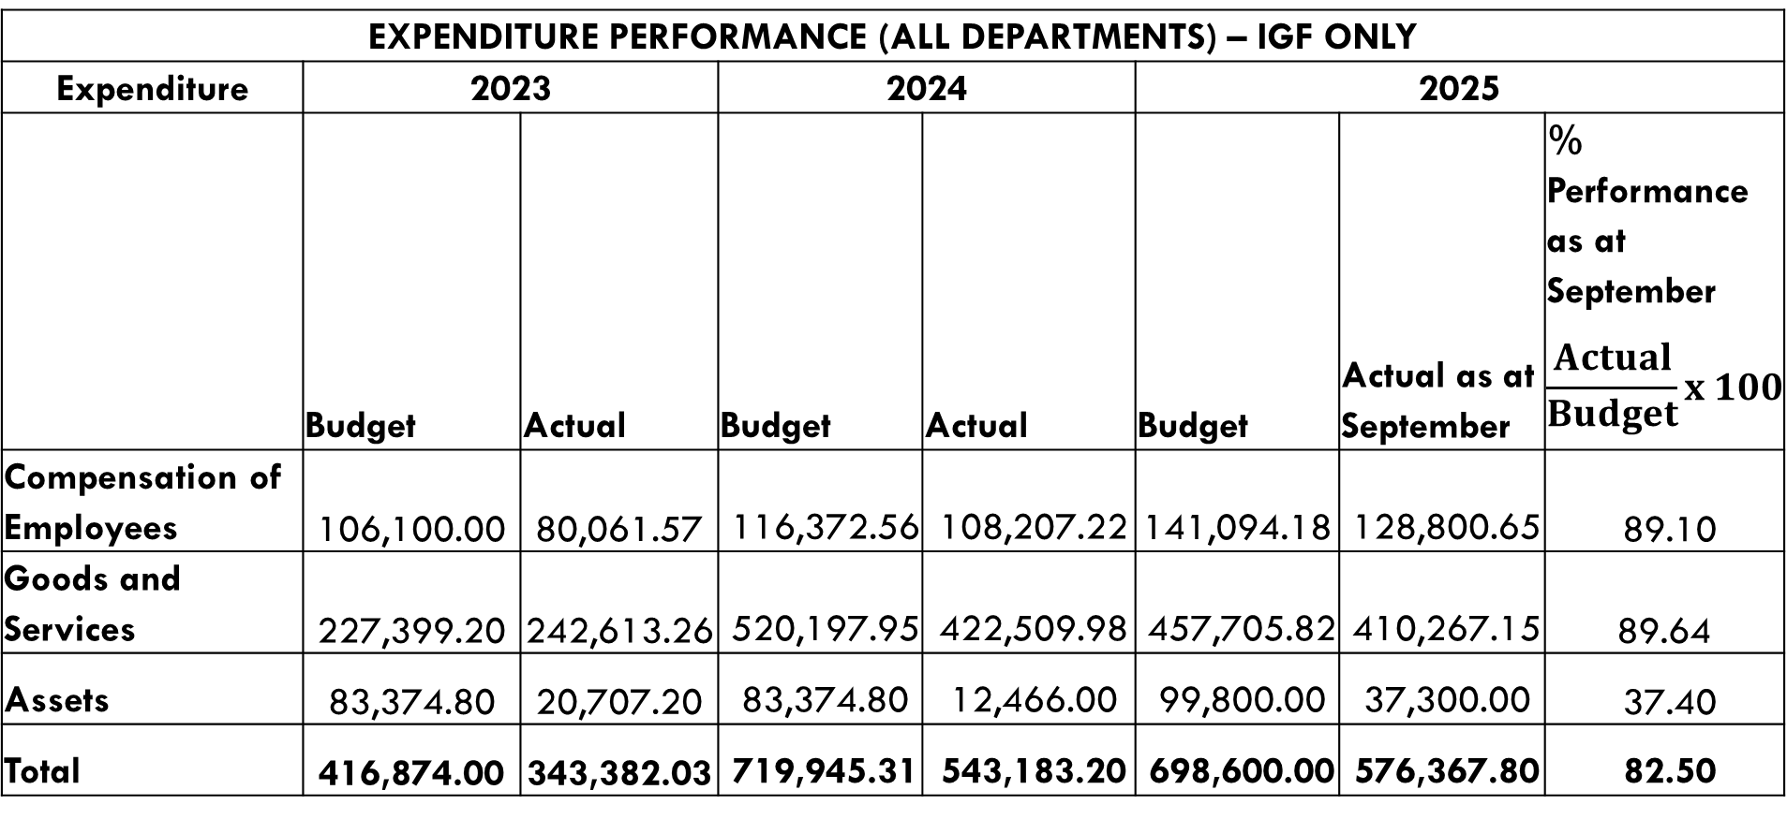
Financial Performance – Expenditure Cont’d.
EXPENDITURE PERFORMANCE (ALL DEPARTMENTS) – IGF ONLY
Expenditure | 2023 |  | 2024 |  | 2025
 | Budget | Actual | Budget | Actual | Budget | Actual as at September | % Performance as at September $$\frac{Actual}{Budget}x 100$$
Compensation of Employees | 106,100.00 | 80,061.57 | 116,372.56 | 108,207.22 | 141,094.18 | 128,800.65 | 89.10
Goods and Services | 227,399.20 | 242,613.26 | 520,197.95 | 422,509.98 | 457,705.82 | 410,267.15 | 89.64
Assets | 83,374.80 | 20,707.20 | 83,374.80 | 12,466.00 | 99,800.00 | 37,300.00 | 37.40
Total | 416,874.00 | 343,382.03 | 719,945.31 | 543,183.20 | 698,600.00 | 576,367.80 | 82.50

Slide 11
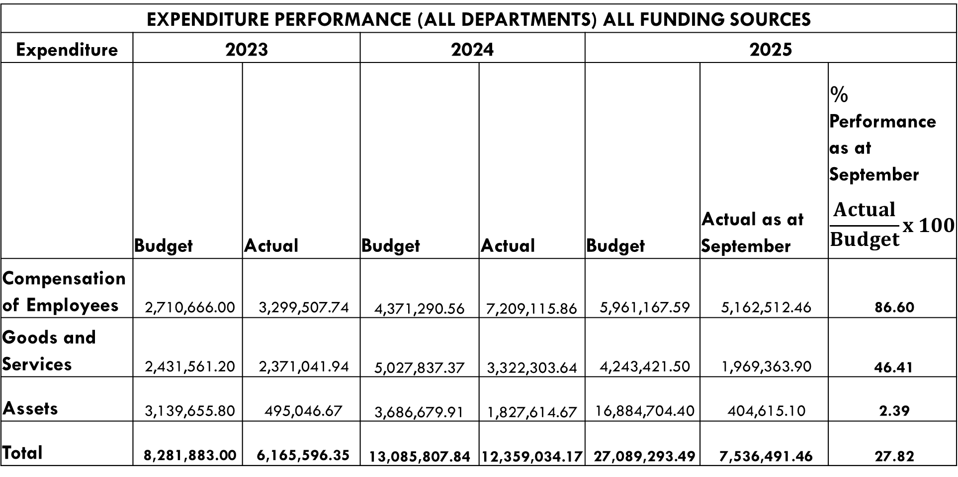
Financial Performance – Expenditure Cont’d.
EXPENDITURE PERFORMANCE (ALL DEPARTMENTS) ALL FUNDING SOURCES
Expenditure | 2023 |  | 2024 |  | 2025
 | Budget | Actual | Budget | Actual | Budget | Actual as at September | % Performance as at September $$\frac{Actual}{Budget}x 100$$
Compensation of Employees | 2,710,666.00 | 3,299,507.74 | 4,371,290.56 | 7,209,115.86 | 5,961,167.59 | 5,162,512.46 | 86.60
Goods and Services | 2,431,561.20 | 2,371,041.94 | 5,027,837.37 | 3,322,303.64 | 4,243,421.50 | 1,969,363.90 | 46.41
Assets | 3,139,655.80 | 495,046.67 | 3,686,679.91 | 1,827,614.67 | 16,884,704.40 | 404,615.10 | 2.39
Total | 8,281,883.00 | 6,165,596.35 | 13,085,807.84 | 12,359,034.17 | 27,089,293.49 | 7,536,491.46 | 27.82

Slide 12
Expenditure By Budget Programme And Economic Classification-all Funding Sources as at September 2025
BUDGET PROGRAMME | AMOUNT GH¢
 | BUDGET | COMPENSATION OF EMPLOYEES | GOODS & SERVICE | CAPITAL EXPENDITURE | TOTAL
Management and Administration | 5,641,797.87 | 3,209,348.52 | 1,398,942.90 | 218,888.80 | 4,827,180.22
Social Services Delivery | 10,761,976.20 | 855,914.58 | 435,621.00 | 0.00 | 1,291,535.58
Infrastructure Delivery and Management | 4,425,391.99 | 421,944.46 | 34,800.00 | 156,836.30 | 613,580.76
Economic Development | 6,200,127.43 | 675,304.90 | 75,000.00 | 28,890.00 | 779,194.90
Environmental Management | 60,000.00 | 0.00 | 25,000.00 | 0.00 | 25,000.00
TOTAL | 27,089,293.49 | 5,162,512.46 | 1,969,363.90 | 404,615.10 | 7,536,491.46

Slide 13
2025 Key Projects and Programmes from all funding sources (Liabilities)
No | Name of Project / Programme | Amount budgeted | Actual Payment as at September, 2025 | Outstanding payment
1. | Construct 1No. CHPS Compound with furniture/equipment at Coppon | 868,196.70 | 0.00 | 868,196.70
2. | Construct 1No. CHPS Compound with furniture/equipment at Akim Swedru Zongo | 868,196.70 | 0.00 | 868,196.70
3. | Construct 1No. 2-unit KG block with furniture/ancillary facility and toilet at Atutunmirem | 700,000.00 | 0.00 | 700,000.00
4. | Construct 1No. 3-unit classroom block with furniture, 1no. Mechanized borehole & 6-seater W/C toilet at Adinkrom | 1,036,393.40 | 0.00 | 1,036,393.40
5. | Drill and mechanize 10No. Boreholes with elevated RC concrete stand and 350ltr water storage in some selected communities | 1,526,393.40 | 0.00 | 1,526,393.40
6. | Procure School Furniture | 1,736,393.40 | 0.00 | 1,736,393.40

Slide 14
2025 Key Projects and Programmes from all funding sources (Liabilities)
No | Name of Project / Programme | Amount budgeted | Actual Payment as at September, 2025 | Outstanding payment
7. | Completion of the renovation of the District Health Directorate block | 520,918.02 | 0.00 | 520,918.02
8. | Completion of 1No. 6-unit lockable stores | 694,557.36 | 0.00 | 694,557.36
 | TOTAL | 7,951,048.98 | 0.00 | 7,951,048.98

Slide 15
NON-FINANCIAL PERFORMANCE BY PROGRAMMES

Slide 16



















Key Achievements (2025)
Constructed 1no. Lorry Park at Akim Aduasa.
Rehabilitated Akim Swedru Market.
Procured and distributed 510 pieces of furniture to public schools.
Extended electricity to newly developed areas in Akim Swedru.
Completed 1no. CHPS Compound with nurses' quarters at Kojo Kumi.
Trained 70 PWDs in Income Generating Activities.
The Assembly facilitated the distribution of 54,000 oil palm seedlings to 440 farmers.
The Assembly facilitated the distribution of 1,500 coconut seedlings to 14 farmers.
Supervised payment of funds to 660 LEAP beneficiary households in 23 communities during the 96th and 97th payment cycles.
Sensitized the public in 23 communities on the effects of child labour, child protection issues and parenting.
Supervised the disbursement of GHC75,000.00 to 50 PWD’s in the district.

Slide 17
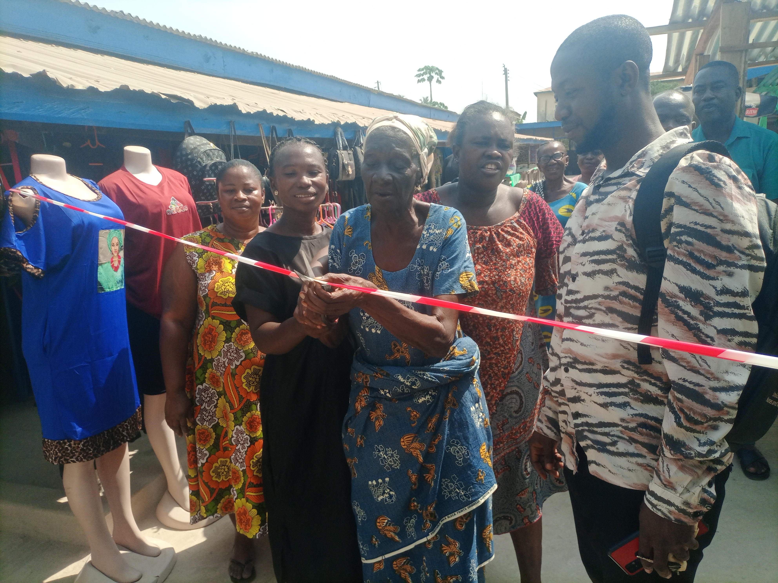
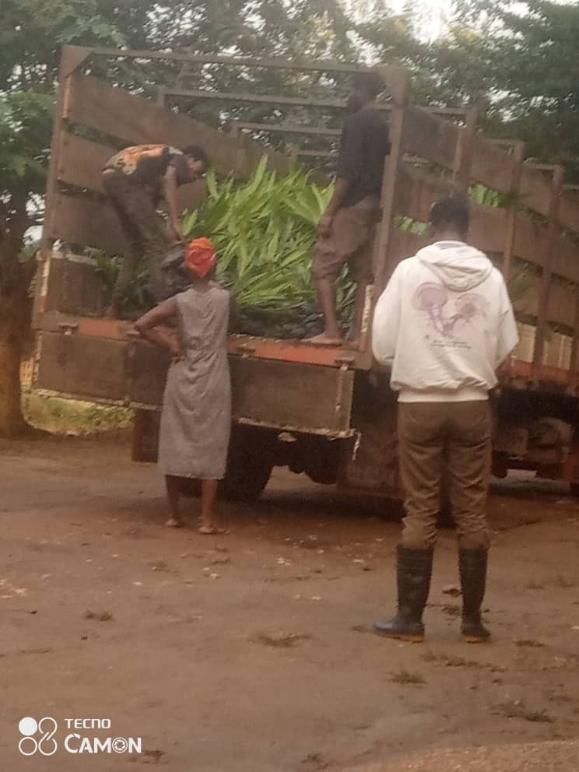
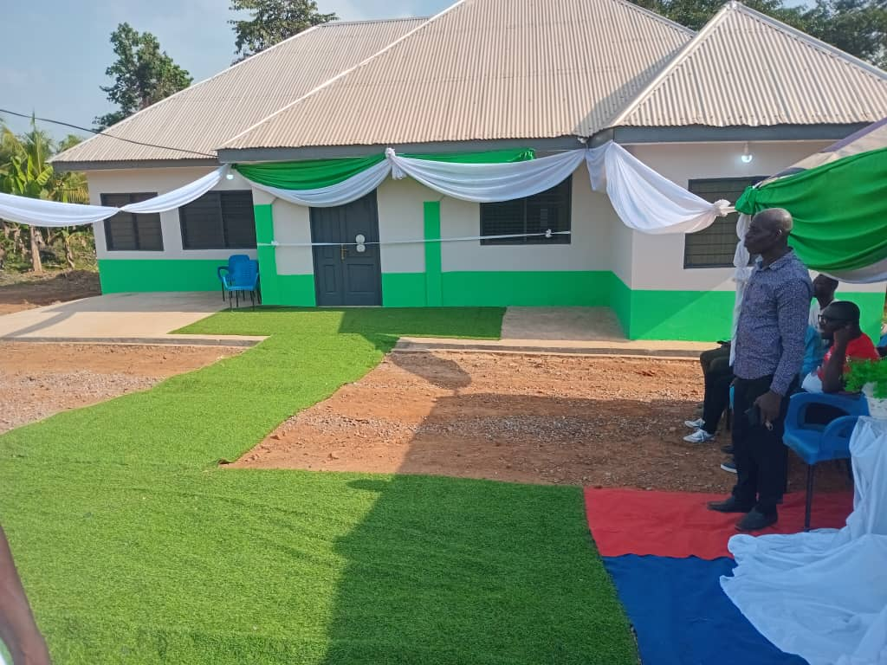
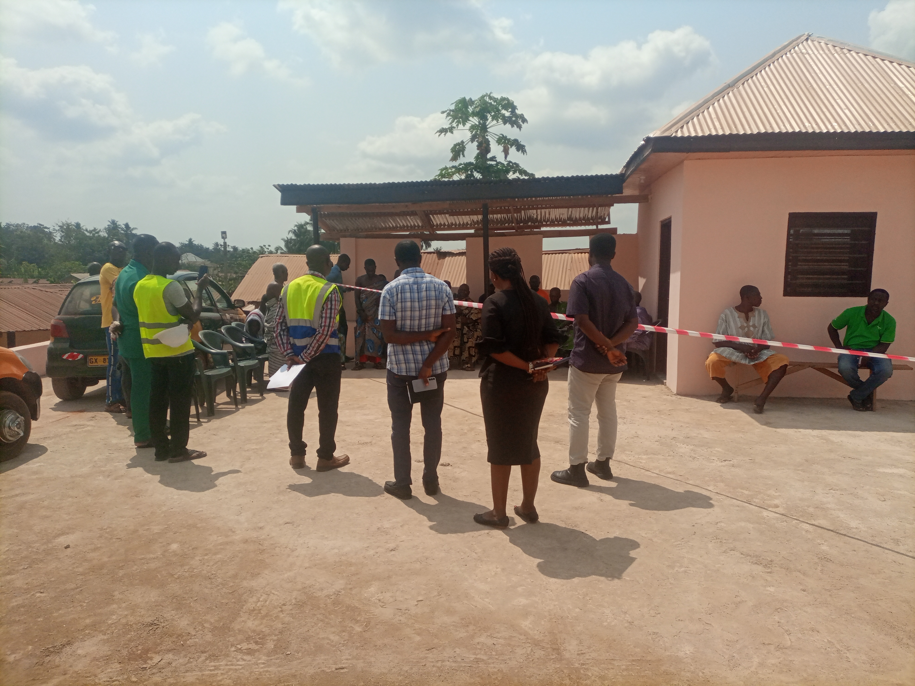
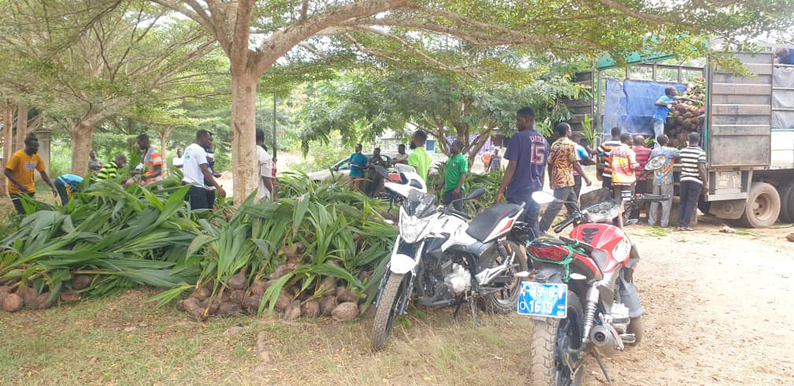
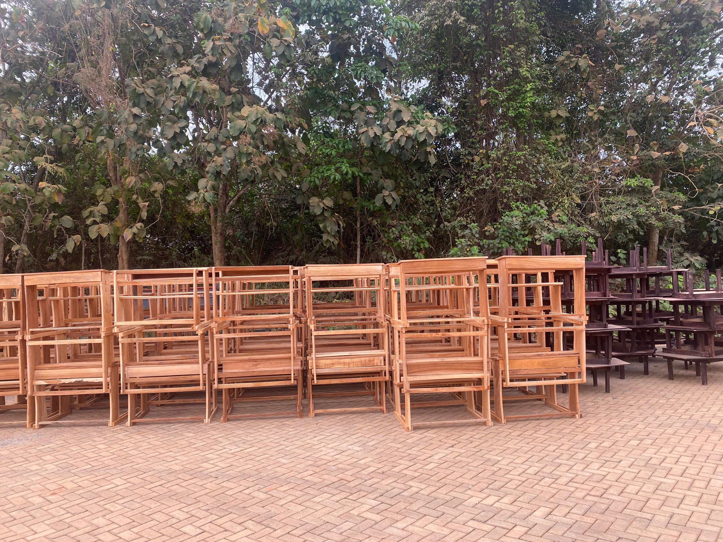
Key Achievements (2025)
LOCAL ECONOMIC DEVELOPMENT
The Assembly facilitated the distribution of 54,000 oil palm 440 farmers.
HEALTH
Rehabilitated Akim Swedru Market.
Completed 1no. CHPS Compound with nurses’
quarters at Kojo Kumi.
Completed 1no. Lorry Park at Akim Aduasa.
The Assembly facilitated the distribution of 1,500 coconut seedlings to14 farmers.
EDUCATION
Procured and distributed 510 pieces of
furniture to public schools.

Slide 18
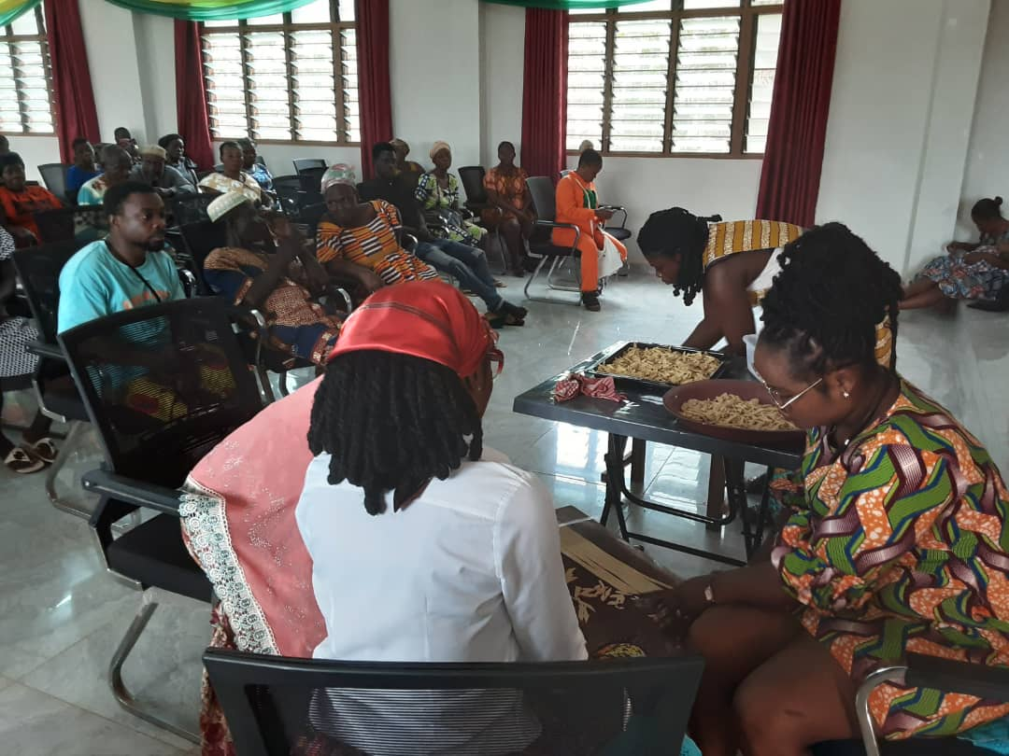
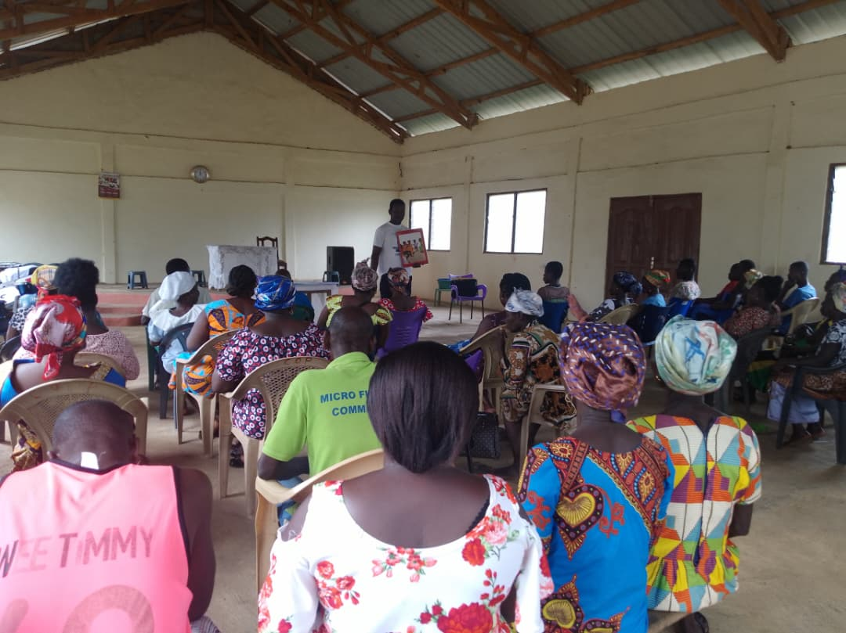
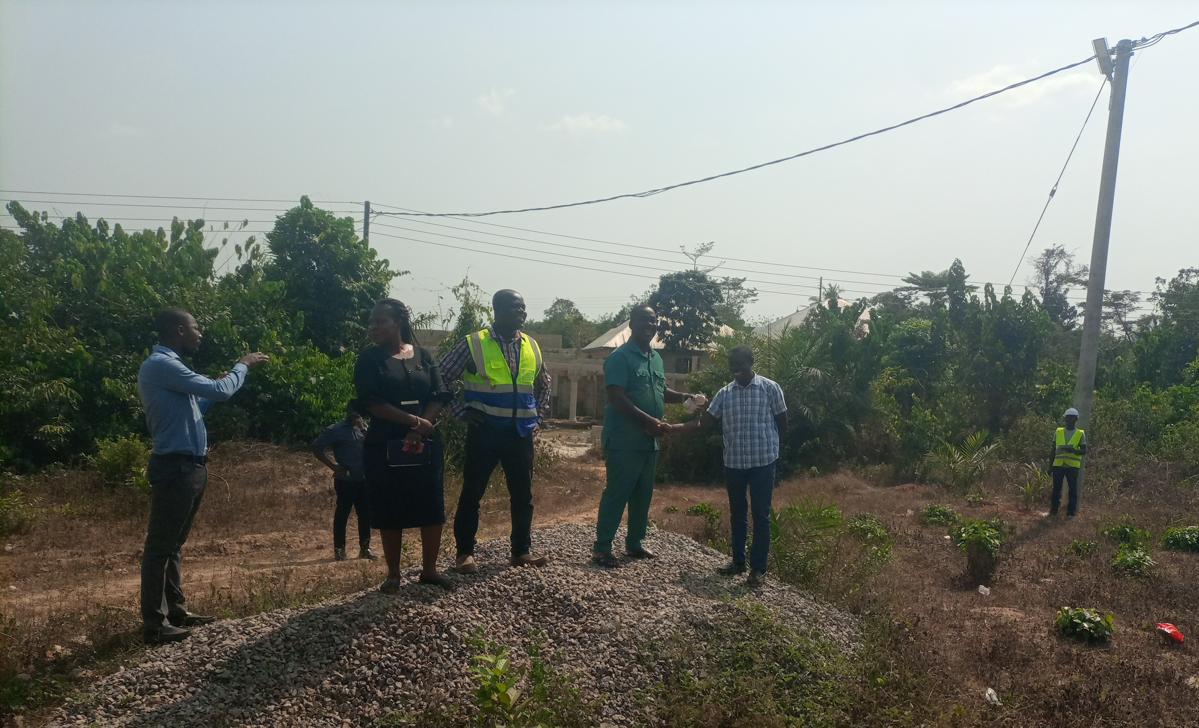
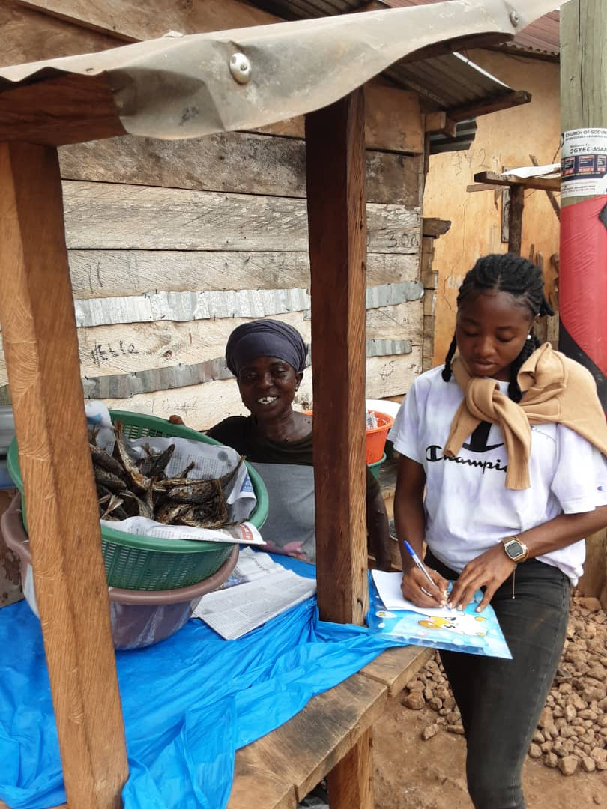
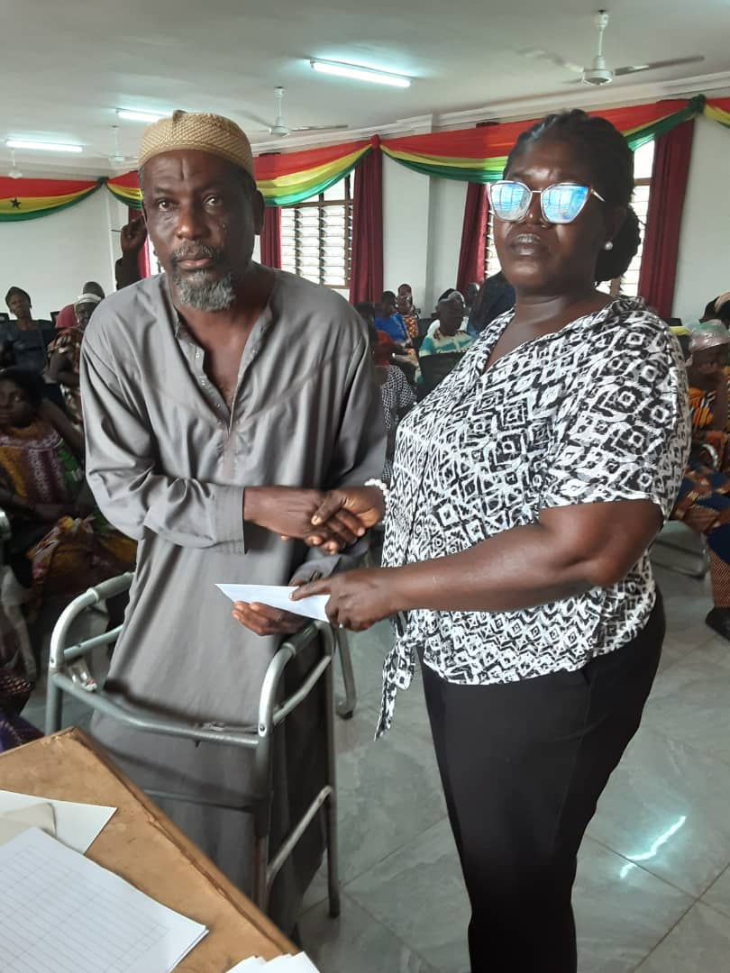
Key Achievements (2025)
ELECTRICITY EXTENSION
Extended electricity to newly developed
areas in Akim Swedru
SOCIAL WELFARE
Trained 70 PWDs in Income Generating Activities.
Supervised payment of funds to 660 LEAP beneficiary households in 23 communities during the 96th and 97th payment cycles.
Sensitized the public in 23 communities on the effects of child labour, child protection issues and parenting.
Supervised the disbursement of GHC75,000.00 to 50 PWD’s in the district.

Slide 19
Policy Outcome Indicators and Targets
Outcome Indicator |  |  | Outcome Indicator Description | Unit of Measurement | Baseline (2024) |  | Current year (2025)
 |  |  |  |  | Target | Actual | Target | Actual as at September
Net enrolment ratio | KG |  | Measures enrolment levels and participation in Education | Percentage (%) | 68% | 53.7% | 60.3% | 55.2%
 | Primary |  |  |  | 62.9% | 50.1% | 62.0% | 52.3%
 | JHS |  |  |  | 36% | 29.6% | 36.6% | 27.8%
Proportion of Vulnerable People Empowered |  |  | Number of PWDs supported over the total number of PWDs registered in the District. | Percentage (%) | 50% | 20% | 60% | 16.7%
Per cent of the population with sustainable access to safe drinking water sources |  |  | Measures citizen's access to potable water such as mechanized boreholes and pipe-borne water | Percentage (%) | 88% | 85.8% | 90% | 86.1%
Average Productivity of selected crops (mt/ha) |  | Maize | Percentage change in post-harvest losses of selected crops (mt/ha) | Percentage change (mt/ha) | 3.0% | 2.80% | 3.0% | 2.60%
 |  | Rice |  |  | 4.5% | 4.35% | 4.5% | 4.36%
 |  | Cassava |  |  | 16.5% | 16.12% | 16.5% | 16.20%
 |  | Oil Palm |  |  | 8.0% | 7.34% | 7.8% | 7.10%

Slide 20
Sanitation Budget Performance
Liquid Waste
No. | Name of Activity/Project | Budget | Actuals as at September, 2025
1. | Rehabilitation of 12-Unit Water Closet Toilet and Bath at Akim Swedru | 347,297.00 | 0.00
2. | Dislodgement of Fecal waste | 494,317.32 | 51,100.00
3. | Fumigation | 366,275.00 | 19,617.00
 | Total | 1,207,889.32 | 70,717.00
Solid Waste
No. | Name of Activity/Project | Budget | Actuals as at September, 2025
1. | Clearing and leveling of refuse sites | 160,000.00 | 12,000.00
2. | Refuse Evacuation | 30,000.00 | 10,000.00
 | Total | 190,000.00 | 22,000.00

Slide 21
DP Supported Programmes (Modernization of Agriculture in Ghana (MAG))
Modernization of Agriculture in Ghana (MAG)
No | Name of Activity/Project | Budget | Actual as at September, 2025
1. | Support 8 technical officer to participate in workshops and training | 1,000.00 | 0.00
2. | Field monitoring activities | 1,500.00 | 0.00
3. | Support the Department of Agric attend monthly technical review meetings | 700.00 | 0.00
 | Total | 3,200.00 | 0.00

Slide 22
OUTLOOK FOR 2026

Slide 23
MMDA Adopted Policy Objectives for 2026
FOCUS AREA | ADOPTED POLICY OBJECTIVE | BUDGET ALLOCATION
Local Governance and Decentralisation | Deepen political and administrative decentralization | 1,836,448.10
Agriculture and Agribusiness Development | Improve post-harvest management | 212,727.99
 | Promote livestock and Poultry development. | 122,845.00
Education and Training | Enhance equitable access to, and participation in quality education at all levels | 5,699,229.60
Health and Health Services | Ensure equitable, affordable and quality Universal Health Coverage (UHC). | 2,133,684.74
Child Protection and Development | Prevent and protect children from all forms of violence, abuse, neglect and exploitation. | 100,440.39
 | Promote the rights and welfare of children. | 82,851.90
Gender Equality | Promote economic empowerment of women. | 83,000.00
 | Attain gender equality and equity in political and social development. | 50,000.00

Slide 24
MMDA Adopted Policy Objectives for 2026
FOCUS AREA | ADOPTED POLICY OBJECTIVE | BUDGET ALLOCATION
Water, Environmental Sanitation and Hygiene | Enhance access to improved and sustainable environmental sanitation services. | 1,994,942.70
 | Improve access to safe, reliable and sustainable water supply services for all. | 2,102,961.80
Disability-Inclusive Development | Promote the active participation and equal inclusion of PWDs in all dimensions of social and economic development. | 619,000.00
Human Settlements Development | Promote sustainable spatially integrated development of human settlements. | 4,913,913.60
Trade and Investment | Improve connectivity & reduce transport costs. | 5,577,771.74
Transport: Road | Improve efficiency and effectiveness of road transport infrastructure and Services. | 500,000.00
Hydrological threats | Improve District resilience to Hydrological threats. | 71,000.00
Total |  | 26,100,817.56

Slide 25
Policy Outcome Indicators and Targets
Outcome Indicator |  | Outcome Indicator Description | Unit of Measurement | Baseline (2024) |  | Current year (2025) |  | Budget year (2026) | Indicative year (2027) | Indicative year (2028) | Indicative year (2029)
 |  |  |  | Target | Actual | Target | Actual as at September | Target | Target | Target | Target
Net enrolment ratio | KG | Measures enrolment levels and participation in Education | Percentage (%) | 68% | 53.7% | 60.3% | 55.2% | 65.2% | 65.4% | 70.3% | 70.3%
 | Primary |  |  | 62.9% | 50.1% | 62.0% | 52.3% | 62.4% | 53.5% | 54.0% | 65.1%
 | JHS |  |  | 36% | 29.6% | 36.6% | 27.8% | 37.1% | 37.1% | 38.0% | 38.2%
Proportion of Vulnerable People Empowered |  | Number of PWDs supported over the total number of PWDs registered in the District. | Percentage (%) | 50% | 20% | 60% | 16.7% | 70% | 75% | 80% | 85%
Per cent of the population with sustainable access to safe drinking water sources |  | Measures citizen's access to potable water such as mechanized boreholes and pipe-borne water | Percentage (%) | 88% | 85.8% | 90% | 86.1% | 88.6% | 90.5% | 93.4% | 95.2%
Average Productivity of selected crops (mt/ha) | Maize | Percentage change in post-harvest losses of selected crops (mt/ha) | Percentage change (mt/ha) | 3.0% | 2.80% | 3.0% | 2.60% | 3.4% | 3.5% | 3.6% | 3.7%
 | Rice |  |  | 4.5% | 4.35% | 4.5% | 4.36% | 5.2% | 5.4% | 5.5% | 5.6%
 | Cassava |  |  | 16.5% | 16.12% | 16.5% | 16.20% | 16.5% | 17.0% | 17.2% | 17.3%
 | Oil Palm |  |  | 8.0% | 7.34% | 7.8% | 7.10% | 8.0% | 8.2% | 8.3% | 8.4%

Slide 26
2026-2029 Revenue Projections – IGF Only
ITEM | 2025 |  | 2026 | 2027 | 2028 | 2029
 | Budget | Actual as at September | Budget | Projection | Projection | Projection
Property Rate | 85,000.00 | 80,422.78 | 97,500.00 | 99,450.00 | 101,439.00 | 103,467.78
Basic Rate | 200.00 | 120.00 | 300.00 | 306.00 | 312.12 | 318.36
Fees | 100,000.00 | 58,766.29 | 93,400.00 | 95,268.00 | 97,173.36 | 99,116.83
Fines | 3,800.00 | 180.00 | 3,800.00 | 3,876.00 | 3,953.52 | 4,032.59
Licence | 195,000.00 | 245,728.47 | 217,000.00 | 221,340.00 | 225,766.80 | 230,282.14
Land | 130,000.00 | 163,726.85 | 185,000.00 | 188,700.00 | 192,474.00 | 196,323.48
Rent | 34,600.00 | 21,400.00 | 47,300.00 | 48,246.00 | 49,210.92 | 50,195.14
Investment | 0.00 | 0.00 | 0.00 | 0.00 | 0.00 | 0.00
Sub-Total | 548,600.00 | 570,344.39 | 644,300.00 | 657,186.00 | 670,329.72 | 683,736.31
Royalties | 150,000.00 | 127,111.39 | 155,000.00 | 158,100.00 | 161,262.00 | 164,487.24
Total | 698,600.00 | 697,455.78 | 799,300.00 | 815,286.00 | 831,591.72 | 848,223.55

Slide 27
REVENUE IMPROVEMENT ACTION PLAN FOR 2026
OBJECTIVE | ACTIVITIES/STRATEGIES | QUARTER |  |  |  | EXPECTED OUTPUT | ESTIMATED COST (GH₵) | FUNDING SOURCE | IMPLEMENTATION AGENCY | COLLABORATORS
 |  | 1 QTR | 2 QTR | 3 QTR | 4 QTR
Strengthen Domestic Resource Mobilization | Rehabilitation of 12-Unit Water Closet with Borehole at Akim Swedru. |  |  |  |  | Fees increased by 2% | 400,000.00 | DACF | DA | Works Dept.
 | Update revenue database by June, 2026 |  |  |  |  | Business operating fees to increase by 2% | 20,000.00 | IGF/ DACF | Budget unit/ finance dept | Area Councils
 | Mount Revenue Post |  |  |  |  | Revenue performance levels to be increased | 15,000.00 | IGF | Finance dept /Works dept | Revenue Collectors
 | Empower taskforce to ensure land property developers pay approved fees |  |  |  |  | Increase in land and buildings by 5% | 10,000.00 | DACF | DA | Works Dept.
 | Sensitize stakeholder/revenue education |  |  |  |  | Responsiveness to revenue mobilization to improve | 5,000.00 | IGF | Budget unit/ Finance Dept | Stakeholders
 | Train revenue collectors on fee fixing and revenue collection strategies |  |  |  |  | Revenue collection to be increased by 5% | 10,000.00 | IGF/ DACF | Budget unit/ Finance Dept | HR Dept.
 | Completion of 1no. 6-unit lockable stores at Akim Swedru |  |  |  |  | Rent Increased by 2% | 987,726.90 | DACF | DA | Works Dept.
TOTAL |  |  |  |  |  |  | 1,447,726.90

Slide 28
REVENUE MOBILIZATION STRATEGIES FOR KEY REVENUE SOURCES
REVENUE SOURCE | KEY STRATEGIES
1. RATES (Basic Rates/Property Rates) | Basic Rate: Adding the Basic Rate component to all B.O. Ps and all other charges to reduce the cost of collection and make collection easier. Property Rates: Establish and Enforce Development Control Task Force. Provide logistical support for the Development Control Task Force.
2. LANDS | Undertake weekly monitoring of newly developed sites. Provide logistical support for the Development Control Task Force. Organising monthly Spatial Planning Committee meetings
3. LICENSES | Public education on payment of fees. Review and update existing business database. Establish Task Force for revenue mobilization in the District. Prosecute rate defaulters.

Slide 29
REVENUE MOBILIZATION STRATEGIES FOR KEY REVENUE SOURCES
REVENUE SOURCE | KEY STRATEGIES
4. RENT | Sensitize occupants of Government stores on the need to pay rent. Timely Issuance of demand notice. Prosecute defaulters.
5. FEES AND FINES | Sensitize various business operators by organising stakeholders’ consultative meetings. Formation of revenue monitoring team to check on the activities of revenue collectors, especially on market days.
6. REVENUE COLLECTORS | Quarterly rotation of revenue collectors. Setting target for revenue collectors. Train and resource revenue collectors on effective strategies of mobilizing revenue. Sanction underperforming revenue collectors. Awarding best performing revenue collectors.

Slide 30
2026-2029 Revenue Projections – All Revenue Sources
ITEM | 2025 |  | 2026 | 2027 | 2028 | 2029
 | Budget | Actual as at September | Budget | Projection | Projection | Projection
IGF | 698,600.00 | 697,455.78 | 799,300.00 | 815,286.00 | 831,591.72 | 848,223.55
Compensation of Employee | 5,820,073.41 | 5,033,711.81 | 5,759,974.53 | 5,875,174.02 | 5,992,677.50 | 6,112,531.05
Goods and Services Transfer | 101,500.00 | 75,590.48 | 321,405.00 | 327,833.10 | 334,389.76 | 341,077.56
Assets Transfer | 25,180.00 | 0.00 | 25,180.00 | 25,683.60 | 26,197.27 | 26,721.22
DACF-Assembly | 17,277,113.83 | 5,676,226.35 | 21,029,617.98 | 23,966,456.78 | 24,445,785.92 | 24,934,701.63
DACF-MP | 1,360,000.00 | 825,723.58 | 1,360,507.25 | 1,387,717.40 | 1,415,471.74 | 1,443,781.18
DACF-DRIP | 0.00 | 0.00 | 500,000.00 | 510,000.00 | 520,200.00 | 530,604.00
DACF-PWD | 447,813.00 | 286,900.47 | 863,218.39 | 880,482.76 | 898,092.41 | 916,054.26
DACF-RFG | 1,355,306.00 | 0.00 | 2,856,079.00 | 2,913,200.58 | 2,971,464.59 | 3,030,893.88
MAG | 3,200.00 | 0.00 | 0.00 | 0.00 | 0.00 | 0.00
Total | 27,089,293.49 | 12,605,887.74 | 33,515,282.15 | 36,701,834.24 | 37,435,870.91 | 38,184,588.33

Slide 31
Expenditure By Budget Programme And Economic Classification-all Funding Sources
BUDGET PROGRAMME | AMOUNT GH¢
 | COMPENSATION OF EMPLOYEES | GOODS & SERVICE | CAPITAL EXPENDITURE | TOTAL
Management and Administration | 3,356,715.81 | 1,681,848.59 | 889,180.00 | 5,927,744.40
Social Services Delivery | 917,623.62 | 3,624,106.54 | 7,984,191.40 | 12,525,921.56
Infrastructure Delivery and Management | 785,232.72 | 450,951.28 | 6,362,028.10 | 7,598,212.10
Economic Development | 854,119.44 | 285,352.25 | 6,252,932.40 | 7,392,404.09
Environmental Management | - | 71,000.00 | - | 71,000.00
TOTAL | 5,913,691.59 | 6,113,258.66 | 21,488,331.90 | 33,515,282.15

Slide 32
Key Projects For 2026 and Corresponding Cost and Justification
List all Projects | IGF (GHc) | GOG (GHc) | DACF (GHc) | DACF-RFG (GHc) | MAG (GHc) | Total Budget (GHc) | Justification- What do you intend to achieve with the programmes/projects and how does this link to your objectives?
MANAGEMENT AND ADMINISTRATION
A. GENERAL ADMINISTRATION
1. Purchase of Office Equipment and Logistics |  | 25,180.00 | 60,000.00 |  |  | 85,180.00 | Work effectiveness and efficiency enhanced.
2. Purchase of Office Furniture |  |  | 70,000.00 |  |  | 70,000.00 | Work effectiveness and efficiency enhanced.
3. Legislative Enactment and Oversight – MP |  |  | 500,000.00 |  |  | 500,000.00 | Community development promoted.
4. Telecommunications and Internet Boosters |  |  | 15,000.00 |  |  | 15,000.00 | Staff work performance enhanced
5. Procurement of Air-conditions |  |  | 20,000.00 |  |  | 20,000.00 | Work effectiveness and efficiency enhanced.
6. Procurement of Electrical Equipment |  |  | 10,000.00 |  |  | 10,000.00 | Work effectiveness and efficiency enhanced.
SUB-TOTAL | 0.00 | 25,180.00 | 675,000.00 | 0.00 | 0.00 | 700,180.00

Slide 33
List all Projects | IGF (GHc) | GOG (GHc) | DACF (GHc) | DACF-RFG (GHc) | MAG (GHc) | Total Budget (GHc) | Justification- What do you intend to achieve with the programmes/projects and how does this link to your objectives?
SOCIAL SERVICES DELIVERY
A. EDUCATION,YOUTH AND SPORTS SERVICES
1. Construct 1No. 2-Unit KG block with furniture/ancillary facility and toilet at Atutunmirem |  |  | 800,000.00 |  | . | 800,000.00 | Quality of teaching and learning improved
2. Construct 1No. 3-Unit classroom block with furniture, 1no. Mechanized borehole and 6-seater W/C toilet at Adinkrom |  |  | 1,302,961.80 |  |  | 1,302,961.80 | Quality of teaching and learning improved
3. Procure school furniture |  |  | 2,102,961.80 |  |  | 2,102,961.80 | Quality of teaching and learning improved
SUB-TOTAL | 0.00 | 0.00 | 4,205,923.60 | 0.00 | 0.00 | 4,205,923.60

Slide 34
List all Projects | IGF (GHc) | GOG (GHc) | DACF (GHc) | DACF-RFG (GHc) | MAG (GHc) | Total Budget (GHc) | Justification- What do you intend to achieve with the programmes/projects and how does this link to your objectives?
SOCIAL SERVICES DELIVERY
B. PUBLIC HEALTH SERVICES
1. Construct of 1No. CHPS compound with furniture/equipment at Coppon |  |  | 880,287.00 |  |  | 880,287.00 | Access to Health Care Increased
2. Construct of 1No. CHPS compound with furniture/equipment at Akim Swedru Zongo |  |  | 1,222,674.80 |  |  | 1,222,674.80 | Access to Health Care Increased
SUB-TOTAL | 0.00 | 0.00 | 2,102,961.80 |  | 0.00 | 2,102,961.80

Slide 35
List all Projects | IGF (GHc) |  | GOG (GHc) |  | DACF (GHc) | DACF-RFG (GHc) |  | MAG (GHc) |  | Total Budget (GHc) | Justification- What do you intend to achieve with the programmes/projects and how does this link to your objectives?
SOCIAL SERVICES DELIVERY
C. ENVIRONMENTAL HEALTH AND SANITATION SERVICES
1. Completion of 12-Unit Water Closet Toilet and Bathhouse with a Borehole at AKIM SWEDRU |  |  |  | 400,000.00 |  |  |  |  |  | 400,000.00 | Environmental Sanitation Improved
SUB-TOTAL |  | 0.00 | 0.00 | 400,000.00 |  |  | 0.00 |  | 0.00 | 400,000.00

Slide 36
List all Projects | IGF (GHc) | GOG (GHc) | DACF (GHc) | DACF-RFG (GHc) | MAG (GHc) | Total Budget (GHc) | Justification- What do you intend to achieve with the programmes/projects and how does this link to your objectives?
INFRASTRUCTURE DELIVERY AND MANAGEMENT
A. PUBLIC WORKS,RURAL HOUSING AND WATER MANAGEMENT
1. Completion of 5-bedroom DCE Bungalow at SWEDRU |  |  | 868,196.70 |  |  | 868,196.70 | Key Staff Accommodated
2. IGF Capital Project( Markets) | 159,860.00 |  |  |  |  | 159,860.00 | Assembly properties Maintained
3. Completion of 4-bedroom DCD Bungalow at SWEDRU |  |  | 1,200,000.00 |  |  | 1,200,000.00 | Key Staff Accommodated
4. Completion of the renovation of the District Health Directorate block at Akim Swedru |  |  | 750,000.00 |  |  | 750,000.00 | Assembly properties Maintained
SUB-TOTAL | 159,860.00 | 0.00 | 2,818,196.70 | 0.00 | 0.00 | 2,978,056.70

Slide 37
List all Projects | IGF (GHc) | GOG (GHc) | DACF (GHc) | DACF-RFG (GHc) | MAG (GHc) | Total Budget (GHc) | Justification- What do you intend to achieve with the programmes/projects and how does this link to your objectives?
INFRASTRUCTURE DELIVERY AND MANAGEMENT
A. PUBLIC WORKS,RURAL HOUSING AND WATER MANAGEMENT
1. Self-help/ Community Initiated projects(Road Reshaping) |  |  | 300,000.00 |  |  | 300,000.00 | Road conditions improved for easy access/movement of people, goods and services
2. Drill and Mechanize 10No. Boreholes with elevated RC concrete stand and 350 water storage in some selected communities |  |  | 1,800,000.00 |  |  | 1,800,000.00 | Access to potable water improved
3. Construction of Bridges in some selected areas |  |  |  | 1,378,039.80 |  | 1,378,039.80 | Easy access/movement of people, goods and services
SUB-TOTAL | 0.00 | 0.00 | 2,100,000.00 | 1,378,039.80 | 0.00 | 3,478,039.80

Slide 38
List all Projects | IGF (GHc) | GOG (GHc) | DACF (GHc) | DACF-RFG (GHc) | MAG (GHc) | Total Budget (GHc) | Justification- What do you intend to achieve with the programmes/projects and how does this link to your objectives?
ECONOMIC DEVELOPMENT
B. TRADE ,TOURISM AND INDUSTRIAL DEVELOPMENT
1.Completion of 1No. 6-Unit lockable stores at Akim Swedru |  |  | 987,726.90 |  |  | 987,726.90 | Local Business enterprises promoted for job creation
2.Design and Construct 24hr economy model market |  |  | 5,257,404.50 |  |  | 5,257,404.50 | Local Business enterprises promoted for job creation
3. Construction of slaughter house |  |  |  | 1,378,039.80 |  | 1,378,039.80 | Local Business enterprises promoted for job creation
SUB-TOTAL | 0.00 | 0.00 | 6,245,131.40 | 1,378,039.80 |  | 7,623,171.20
GRAND TOTAL | 159,860.00 | 25,180.00 | 18,547,212.30 | 2,756,079.60 | 0.00 | 21,488,331.90

Slide 39
Sanitation Budget
Liquid Waste
No | Name of Activity/Project | Budget
1. | Sanitation Improvement package (SIP) | 387,205.00
2. | Evacuation of refuse dumps and maintenance of final disposal Landfill sites | 276,600.00
3. | Evacuation and levelling of refuse dump site in peri-urban communities | 100,000.00
4. | Desilting drains and monthly clean-up exercise (National Sanitation Day) | 441,317.80
 | Total | 1, 205,122.80
Solid Waste
No | Name of Activity/Project | Budget
1 | Regular dislodging of all institutions and public toilets | 494,317.00
2 | Support implementation of Community Led Total Sanitation (CLTS) | 20,000.00
3 | Disinfection and fumigation services district wide | 366,275.00
4 | Health education on environmental sanitation and disease preventions | 17,247.00
 | Total | 897,839.00

