Slide 1

BIRIM SOUTH DISTRICT ASSEMBLY
    BUDGET STATEMENT
2023 FISCAL YEAR

Slide 2
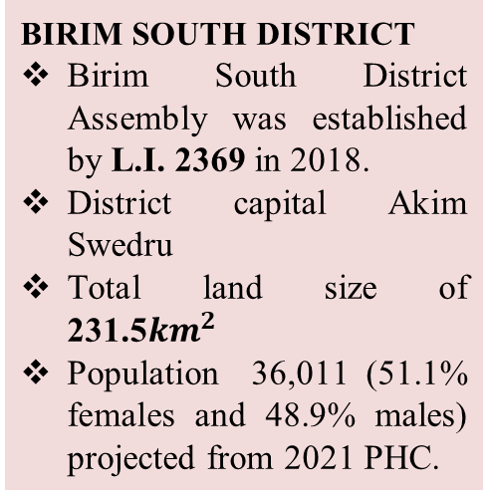
  STRATEGIC OVERVIEW BIRIM SOUTH DISTRICT
ESTABLISHMENT
DISTRICT ECONOMY
SECTORS OF THE ECONOMY
BIRIM SOUTH DISTRICT
Birim South District Assembly was established by L.I. 2369 in 2018.
District capital Akim Swedru
Total land size of 231.5${km}^{2}$
Population 36,011 (51.1% females and 48.9% males) projected from 2021 PHC.
EDUCATION (LEVELS)
25-KG, 23-Primary, 20-JHS, 1-SHS & 1-TVET
HEALTH
11 CHPS compounds, 2 Health Centres, 1 Clinic & 1 Maternity home, 1 District hospital under construction
PHYSICAL ENVIRONMENT
Road coverage: 121.0km Bitumen covers 29.1km (24%).
Earth surface roads 91.9km (76%)
TOURISM / HOSPITALITY
Potentials tourist sites:
Aboye confluence
Birim forest range
Agriculture being the main occupation of the district with majority into crop production (58.0% of economically active population)
Whole sales & retail 13%, others 22% and Manufacturing 7.0%.
MARKET
SANITATION
There are three main market facilities in the district. (Swedru, Awisa, and Aduasa Markets).
Tuesdays and Fridays are the main market days for Aduasa whilst Wednesdays is for Swedru.
21-unit lockable stores in Swedru
10-unit lockable stores in Awisa.
10-unit lockable stores in Aduasa.
4 functional public toilets
1 WC public toilet under rehabilitation in Swedru.
11 skip containers across the district.

Slide 3
KEY CHALLENGES
Poor Road and Drainage infrastructure
Poor level of sanitation
Poor and inadequate basic school infrastructure
Limited access to Health Services
Inadequate market infrastructure
Low Internal Revenue Generation
Inadequate support for Child Protection Activities
Inadequate support for vulnerable groups, ie. PLWHAs and PWDs
Poor human settlement development
Post harvest losses

Slide 4









VISION, MISSION & CORE VALUES OF BIRIM SOUTH DISTRICT
Vision
C
Core Values
A
B
Mission
C
Transparency & Accountability
Client-oriented
Creativity and Innovativeness
Diligence and Discipline
Equity and Integrity
Timeliness
A world class local government institution promoting well-being and total peace.
To improve the living standards of its citizens through sustainable socio-economic development and effective institutions that are responsive to the needs of people.

Slide 5

CORE FUNCTIONS OF THE DISTRICT
The functions exercised by the Assembly are deliberative, legislative as well as executive. The specific functions among others as stipulated in the Local Governance Act of 2016, Act 936 include: Responsible for the development, improvement and management of human settlements and the environment in the district;
The Assembly take steps and measures that are necessary and expedient to execute approved development plans for the district;
Guide, encourage and support sub-district local structures, public agencies and local communities to perform their functions in the execution of approved development plans;
Initiate and encourage joint participation with other persons or bodies to execute approved development plans;
Promote or encourage other persons or bodies to undertake projects under approved development plans; and
Monitor the execution of projects under approved development plans and assess and evaluate their impact on the development of the district and national economy in accordance with government policy.
Exercise political and administrative authority in the district.
CORE FUNCTIONS OF THE DISTRICT

Slide 6
DISTRICT ADOPTED POLICY OBJECTIVES FOR 2022
ADOPTED POLICY OBJECTIVE
Ensure improved fiscal performance and sustainability
Improve post-harvest management
Enhance equitable access to and participation in quality education at all levels
Reduce the incidence of new HIV, AIDS/STIs and other infections, especially among vulnerable groups
Deepen Political, Financial and Administration Decentralisation
Prevent and protect children from all forms of violence, abuse, neglect and exploitation
Promote economic empowerment of particularly women
Strengthen social protection for the vulnerable

Slide 7
DISTRICT ADOPTED POLICY OBJECTIVES FOR 2022
ADOPTED POLICY OBJECTIVE
Ensure all learners acquire knowledge and skill to promote sustainability development
Promote sustainable spatially integrated development of human settlement
Address recurrent devastating floods
Eradicate poverty and address vulnerability to poverty in all forms and dimensions
Improve access to safe reliable and sustainable water supply services for all
Improve transport and road safety

Slide 8

FINANCIAL
FINANCIAL PERFORMANCE - REVENUE
REVENUE PERFORMANCE- IGF ONLY
ITEM | 2020 |  | 2021 |  | 2022
 | Budget | Actual | Budget | Actual | Budget | Actual as at August | % performance as at August
Property Rate | 115,500.00 | 68,762.50 | 66,000.00 | 76,507.38 | 99,873.00 | 35,346.94 | 16.6
Basic Rates | 7,500.00 | 1,573.00 | 500.00 | 0.00 | 550.00 | 0.00 | 0.00
Fees | 61,373.00 | 68,292.08 | 58,610.00 | 27,254.50 | 50,150.00 | 24,726.00 | 11.60
Fines | 3,000.00 | 5,853.86 | 3,800.00 | 400.00 | 3,800.00 | 0.00 | 0.00
Licenses | 126,979.00 | 54,931.45 | 95,350.00 | 66,184.25 | 77,750.00 | 48,304.00 | 22.63
Land | 83,762.19 | 89,081.00 | 107,500.00 | 173,646.43 | 156,796.00 | 101,760.00 | 47.70
Rent | 62,500.00 | 52,640.00 | 85,000.00 | 300.00 | 62,000.00 | 1,245.00 | 0.58
Investment | 0.00 | 0.00 | 10,00.00 | 0.00 | 10,000.00 | 2,000.00 | 0.94
Sub-Total | 460,614.19 | 341,133.89 | 426,760.00 | 344,292.56 | 460,919.00 | 213,381.94
Royalties | 0.00 | 0.00 | 0.00 | 0.00 | 0.00 | 0.00 | 0.00
TOTAL | 460,614.19 | 341,133.89 | 426,760.00 | 344,292.56 | 460,919.00 | 213,381.94
PERFORMANCE
REVENUE

Slide 9
FINANCIAL PERFORMANCE - REVENUE
REVENUE PERFORMANCE- ALL REVENUE SOURCES
ITEM | 2020 |  | 2021 |  | 2022
 | Budget | Actual | Budget | Actual | Budget | Actual as at August | % performance as at August
IGF | 460,614.19 | 341,133.89 | 426,760.00 | 344,292.56 | 460,919.00 | 213,381.94 | 46.29
Compensation of Employee | 1,443,282.66 | 2,255,557.00 | 1,247,369.17 | 2,999,325.24 | 1,622,171.00 | 1,657,847.81 | 102.20
Goods and Services Transfer | 102,596.86 | 64,535.62 | 89,441.00 | 52,558.71 | 113,134.00 | 34,278.24 | 30.30
Assets Transfer | 0.00 | 0.00 | 0.00 | 0.00 | 25,180.00 | 0.00 | 0.00
DACF | 4,223,233.14 | 2,427,424.12 | 4,202,117.49 | 1,168,944.70 | 4,905,399.54 | 907,394.90 | 18.50
DACF-RFG | 603,863.16 | 296,349.81 | 1,329,237.40 | 320,160.00 | 2,002,808.84 | 1,134,512.80 | 56.65
MAG | 172,578.71 | 141,732.56 | 108,564.00 | 86,811.96 | 78,889.12 | 78,899.12 | 100.01
MP – DACF | 550,000.00 | 503,412.27 | 500,000.00 | 354,652.07 | 500,000.00 | 238,761.93 | 47.75
Covid Funds | 20,000.00 | 20,000.00 | 10,000.00 | 10,000.00 | 0.00 | 0.00 | 0.00
HIV/Malaria | 26,000.00 | 9,178.04 | 21,116.11 | 5,842.11 | 34,701.00 | 11,660.55 | 33.60
PWD-Funds | 182,697.00 | 158,160.00 | 190,045.00 | 78,703.65 | 316,163.00 | 86,526.77 | 27.37
Total | 7,784,865.72 | 6,217,483.31 | 8,124,650.17 | 5,421,291.00 | 10,059,365.50 | 4,363,264.06 | 43.38

Slide 10
FINANCIAL PERFORMANCE - EXPENDITURE
EXPENDITURE PERFORMANCE (ALL DEPARTMENTS) GOG ONLY
Expenditure | 2020 |  | 2021 |  | 2022
 | Budget | Actual | Budget | Actual | Budget | Actual as at August | % Performance (as at August)
Compensation of Employees | 1,443.282.66 | 2,255,557.00 | 1,247,369.17 | 2,999,325.24 | 1,622,171.00 | 1,657,847.81 | 102.20
Goods and Services | 102,596.86 | 42,974.85 | 89,441.00 | 54,181.05 | 113,134.00 | 17,320.53 | 15.31
Assets | 0.00 | 0.00 | 0.00 | 0.00 | 25,180.00 | 0.00 | 0.00
Total | 1,545,879.52 | 2,298,531.85 | 1,333,810.17 | 3,053,506.29 | 1,760,485.00 | 1,675,168.34 | 95.15

Slide 11
FINANCIAL PERFORMANCE – EXPENDITURE CONT’D.
EXPENDITURE PERFORMANCE (ALL DEPARTMENTS) IGF ONLY
Expenditure | 2020 |  | 2021 |  | 2022
 | Budget | Actual | Budget | Actual | Budget | Actual as at August | % age Performance as at August
Compensation of Employees | 212,220.00 | 73,981.14 | 100,712.00 | 92,557.09 | 108,835.00 | 57,726.07 | 12.52
Goods and Services | 168,394.14 | 243,830.17 | 240,696.00 | 247,675.79 | 259,900.00 | 150,209.90 | 32.59
Assets | 80,000.00 | 25,104.00 | 85,352.00 | 4,536.00 | 92,184.00 | 0.00 | 0.00
Total | 460,614.19 | 342,915.31 | 426,760.00 | 344,768.88 | 460,919.00 | 207,935.97 | 45.11

Slide 12
FINANCIAL PERFORMANCE – EXPENDITURE CONT’D.
EXPENDITURE PERFORMANCE (ALL DEPARTMENTS) ALL FUNDING SOURCES
Expenditure | 2020 |  | 2021 |  | 2022
 | Budget | Actual | Budget | Actual | Budget | Actual as at August | % age Performance as at August
Compensation of Employees | 1,655,502.66 | 2,329,538.14 | 1,348,081.17 | 3,091,882.33 | 1,731,006.00 | 1,715,573.88 | 99.11
Goods and Services | 3,846,053.78 | 3,404,523.68 | 2,755,342.00 | 1,732,184.31 | 3,094,164.50 | 1,475,639.96 | 47.69
Assets | 2,283,309.28 | 843,341.83 | 4,021,227.00 | 600,361.43 | 5,234,186.00 | 129,460.04 | 2.47
Total | 7,784,865.72 | 6,577,403.65 | 8,124,650.17 | 5,424,428.07 | 10,059,356.50 | 3,320,673.88 | 33.01

Slide 13
2022 BUDGET PROGRAMME PERFORMANCE
Budget Programme | Budget | Actual as at August 2022
Management & Administration | 2,982,245.00 | 2,030,101.21
Social Services Delivery | 2,860,994.00 | 348,394.95
Infrastructure Delivery and Management | 3,369,872.00 | 766,495.84
Economic Development | 606,254.00 | 55,640.75
Environmental Management | 240,000.00 | 120,041.13
Total | 10,059,365.00 | 3,320,673.88

Slide 14
2022 KEY PROJECTS AND PROGRAMMES FROM ALL FUNDING
SOURCES
No | Name of project | Amount budgeted | Actual Payment as at August, 2022 | Outstanding payment
SOCIAL SERVICES DELIVERY
1. | Completion of 1no. 2-Unit Classroom Block with Ancillary facilities at AKIM ADUASA | 297,596.00 | 44,639.40 | 252,956.60
 | Total | 297,596.00 | 44,639.40 | 252,956.60

Slide 15
2022 KEY PROJECTS AND PROGRAMMES FROM ALL FUNDING
SOURCES
No | Name of project | Amount budgeted | Actual Payment as at August, 2022 | Outstanding payment
INFRASTRUCTURE DELIVERY AND MANAGEMENT
1. | Completion of DCE Bungalow at AKIM SWEDRU | 424,835.59 | 127,078.2 | 297,757.39
2. | Completion of 7No. Mechanized boreholes at ASAWASE, SWEDRU. | 256,060.00 | 230,454.00 | 25,606.00
3. | Completion of 1N0. Fire Hydrant at AKIM SWEDRU | 54,850.00 | 49,365.00 | 5,485.00
 | Total | 735,745.59 | 406,897.20 | 328,848.39

Slide 16
2022 KEY PROJECTS AND PROGRAMMES FROM ALL FUNDING
SOURCES
No | Name of project | Amount budgeted | Actual Payment as at August, 2022 | Outstanding payment
ECONOMIC DEVELOPMENT
1. | Reshaping of Access Roads (25.9km) at FOSUKROM, BREPRO, AKOTEKROM | 219,000.00 | 197,008.00 | 21,992.00
2. | Extension of Electricity at ADUASA, ASAWASE, AKISS | 247,898.66 | 223,108.8 | 24,789.86
 | Total | 466,898.66 | 420,116.80 | 46,781.86

Slide 17

NON FINANCIAL PERFORMANCE BY PROGRAMMES

Slide 18
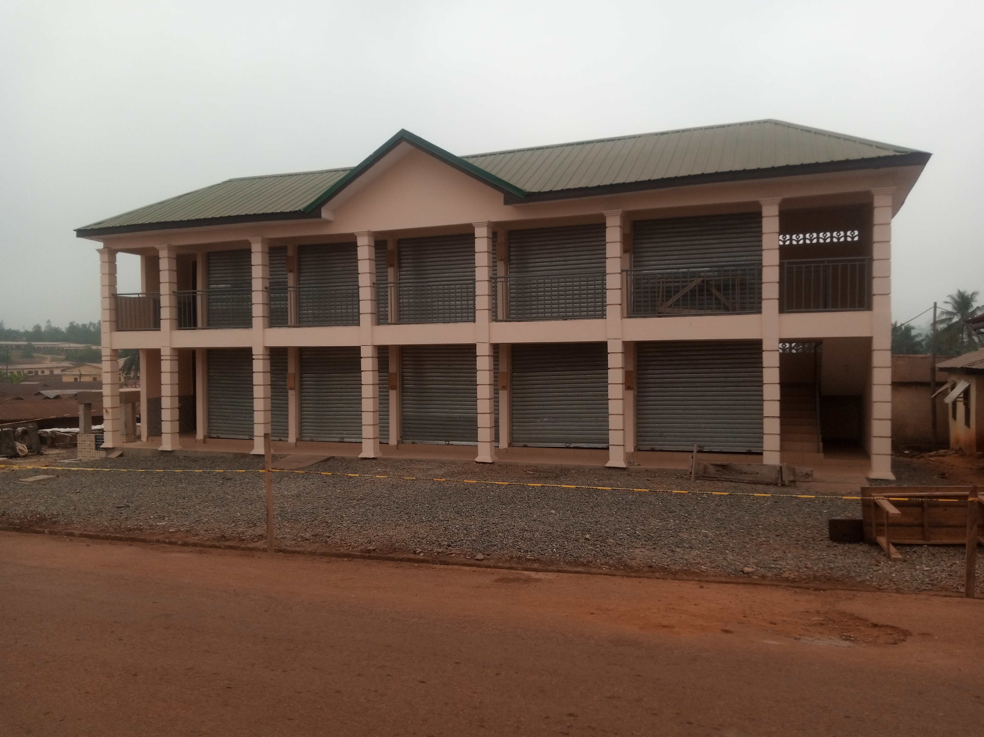
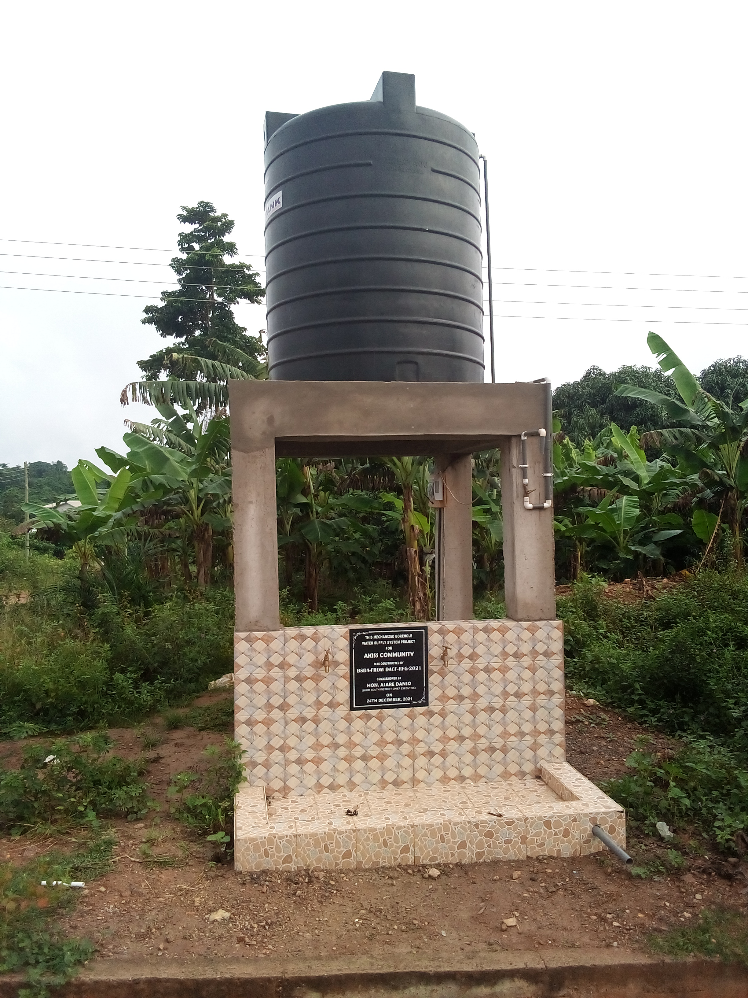
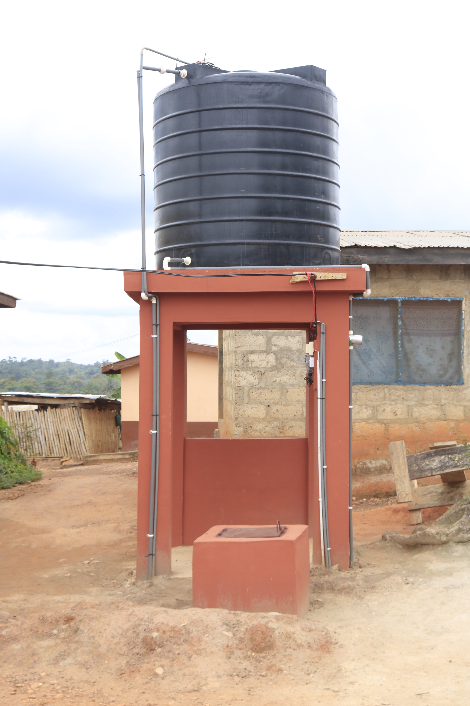
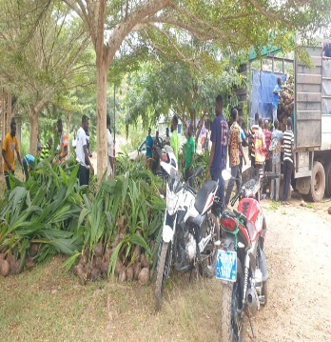
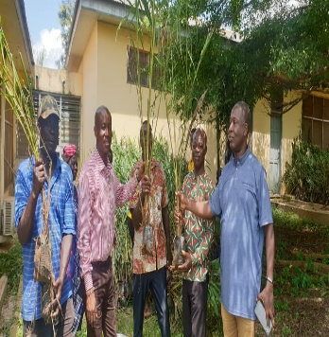
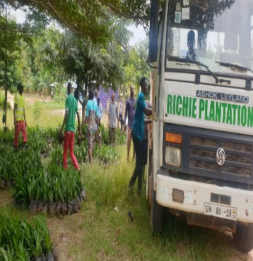
KEY ACHIEVEMENTS (2022)
PHYSICAL INFRASTRUCTURAL DEVELOPMENT
ECONOMIC DEVELOPMENT
Completed 1No. 10-unit lockable stores at Akim Aduasa.
Completed 7No. boreholes fitted with Rambo 400 Overhead Tank in Selected communities.
  Oil palm
  A total of 96,000 oil palm seedlings were distributed.
  330 farmers benefited from the seedlings.

Slide 19

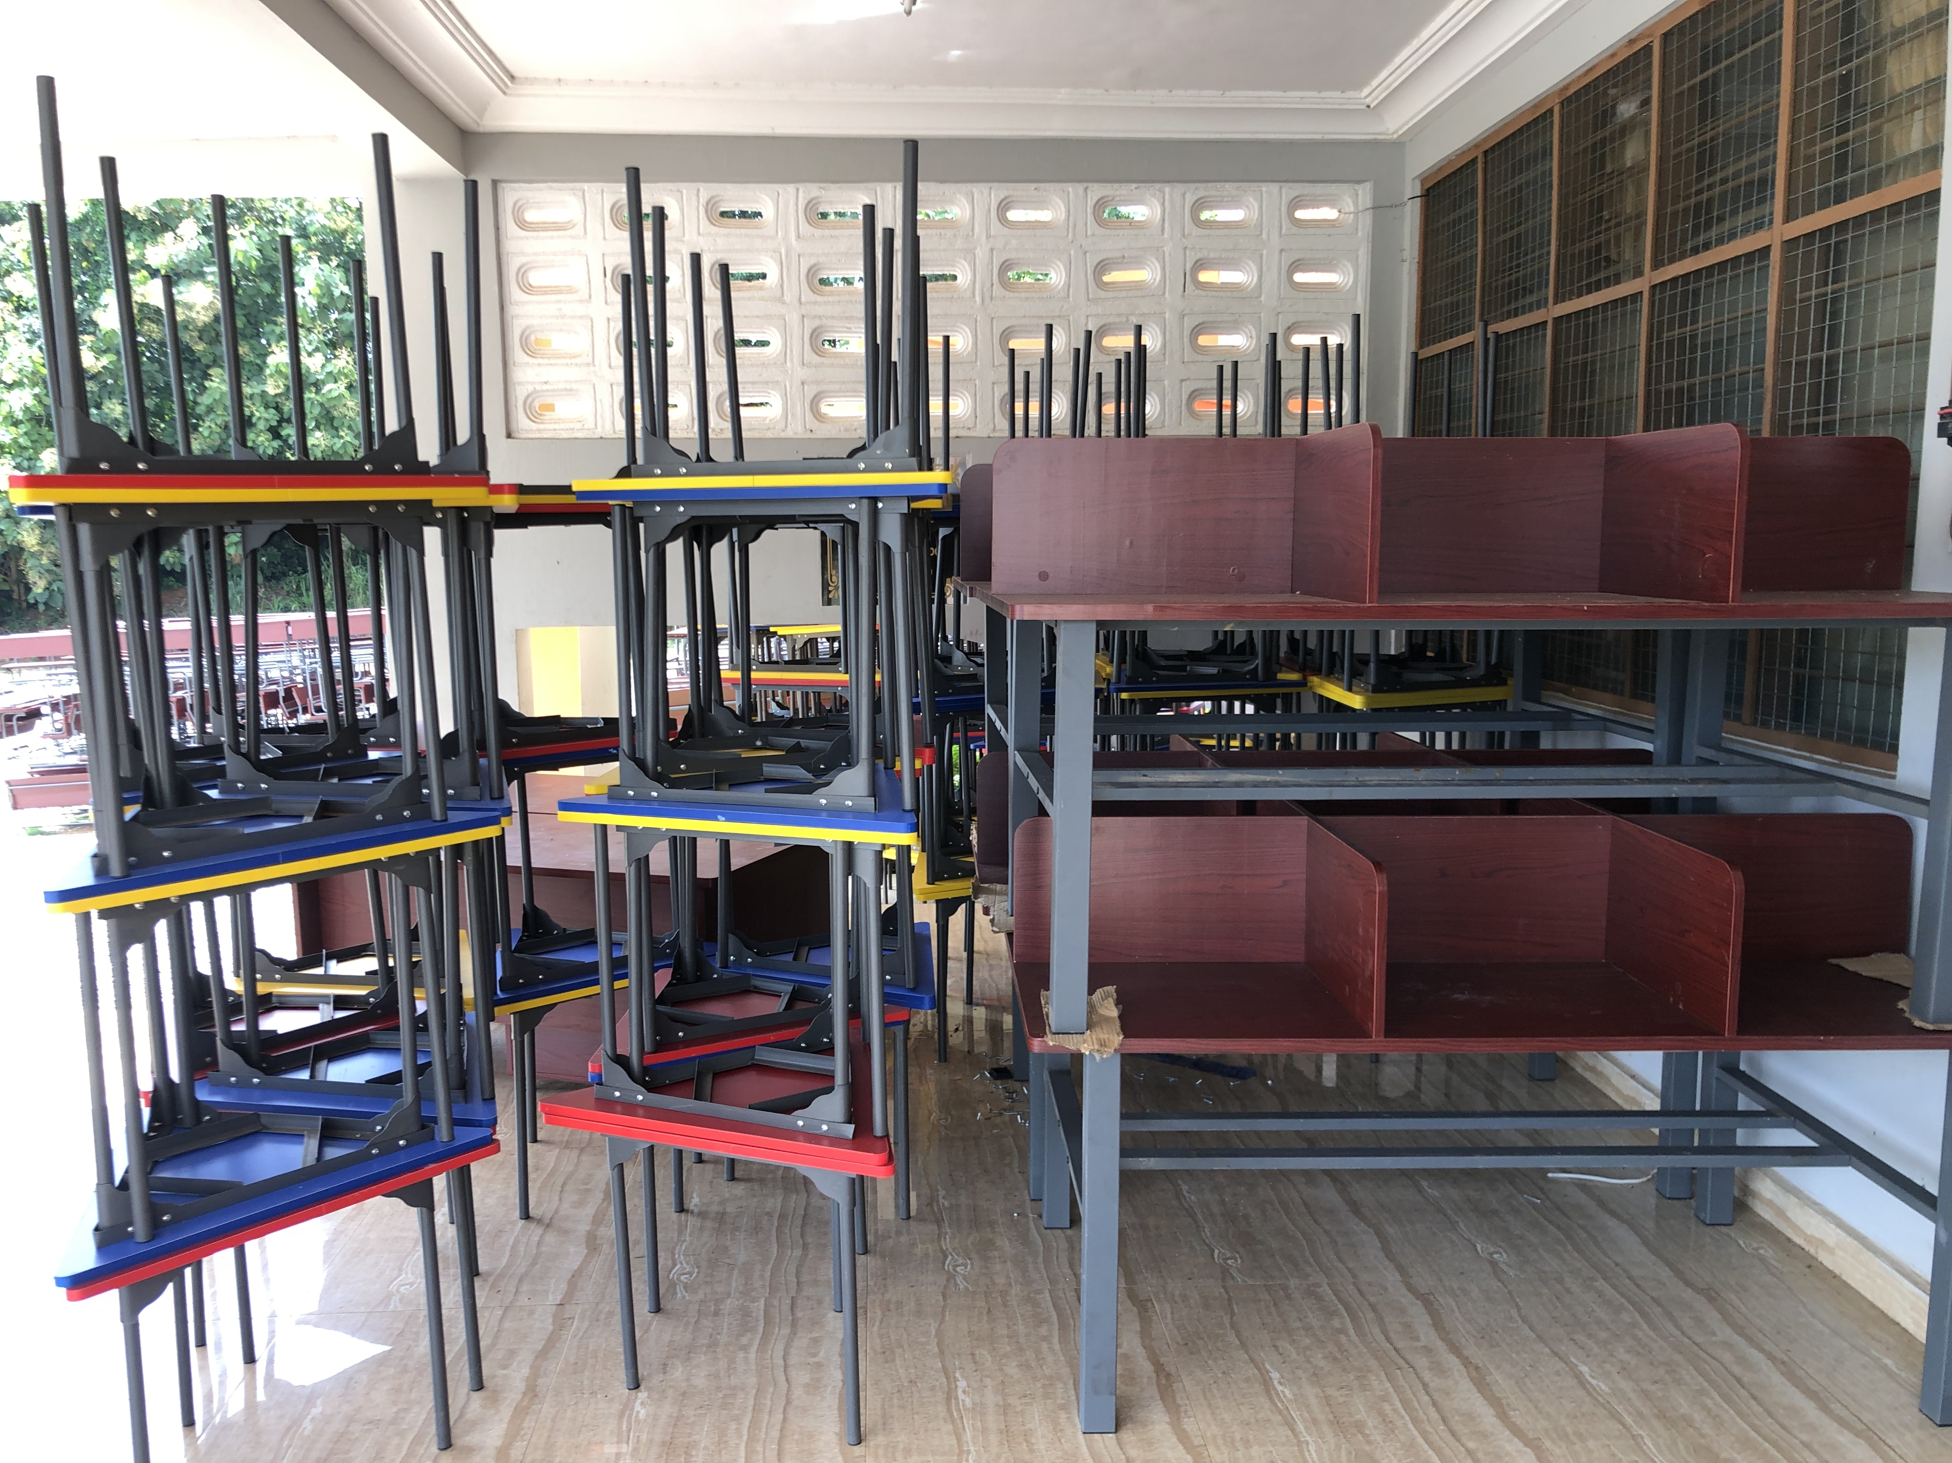
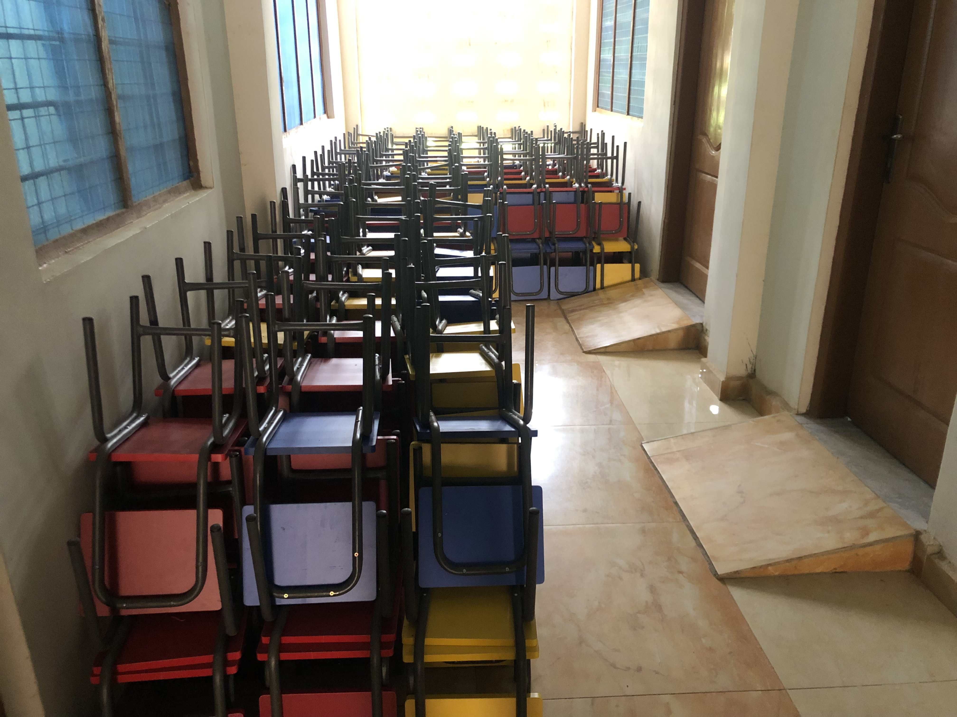
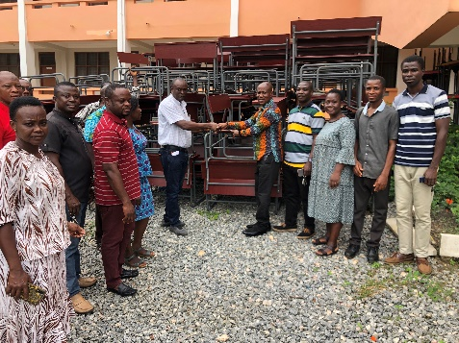
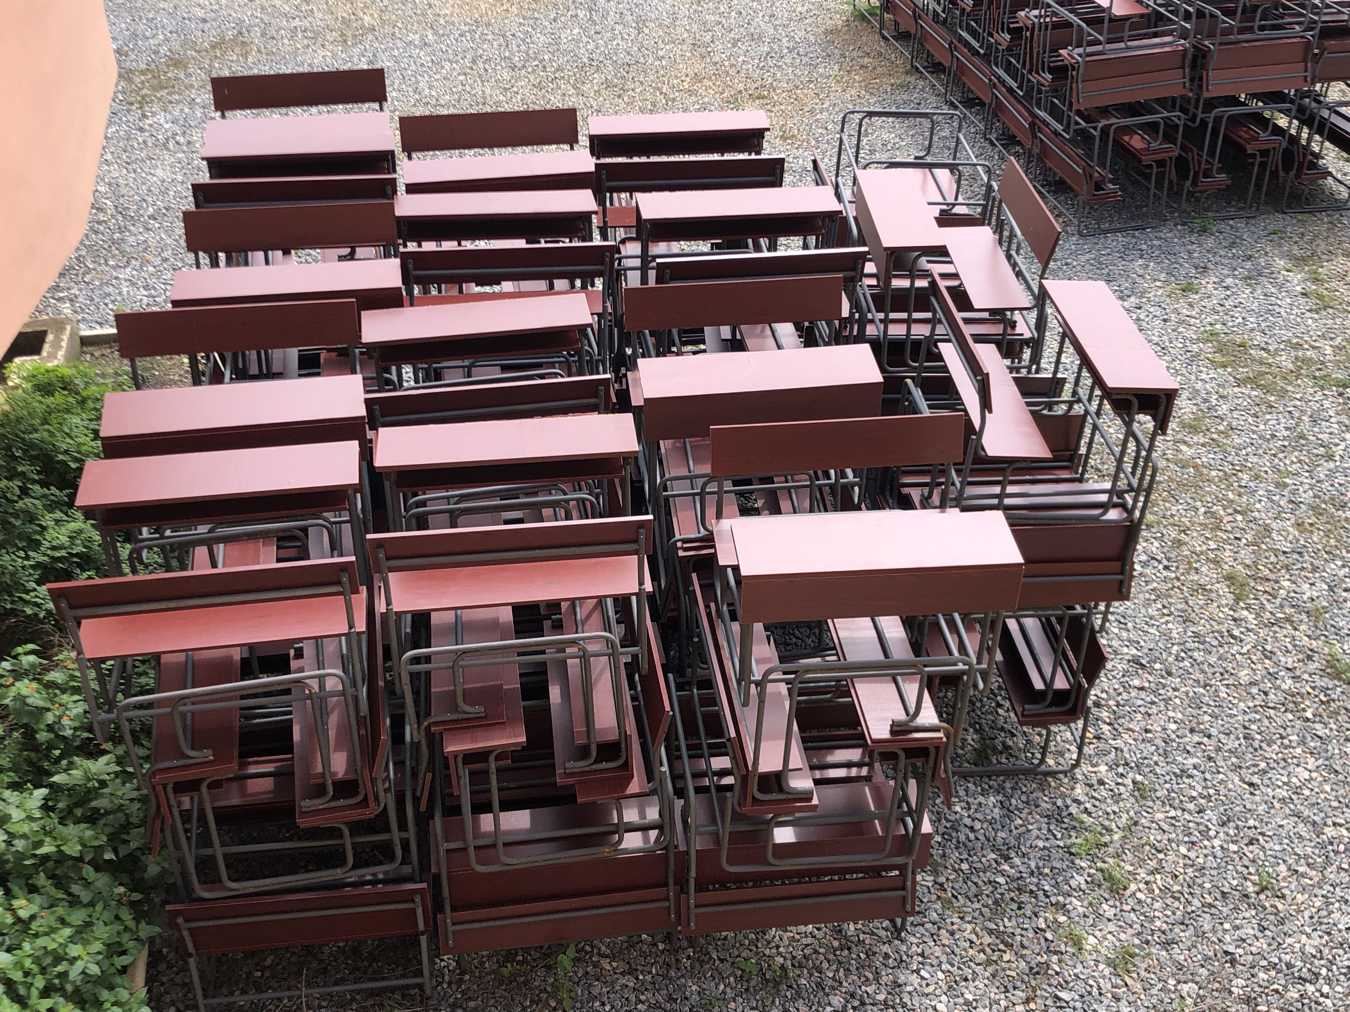
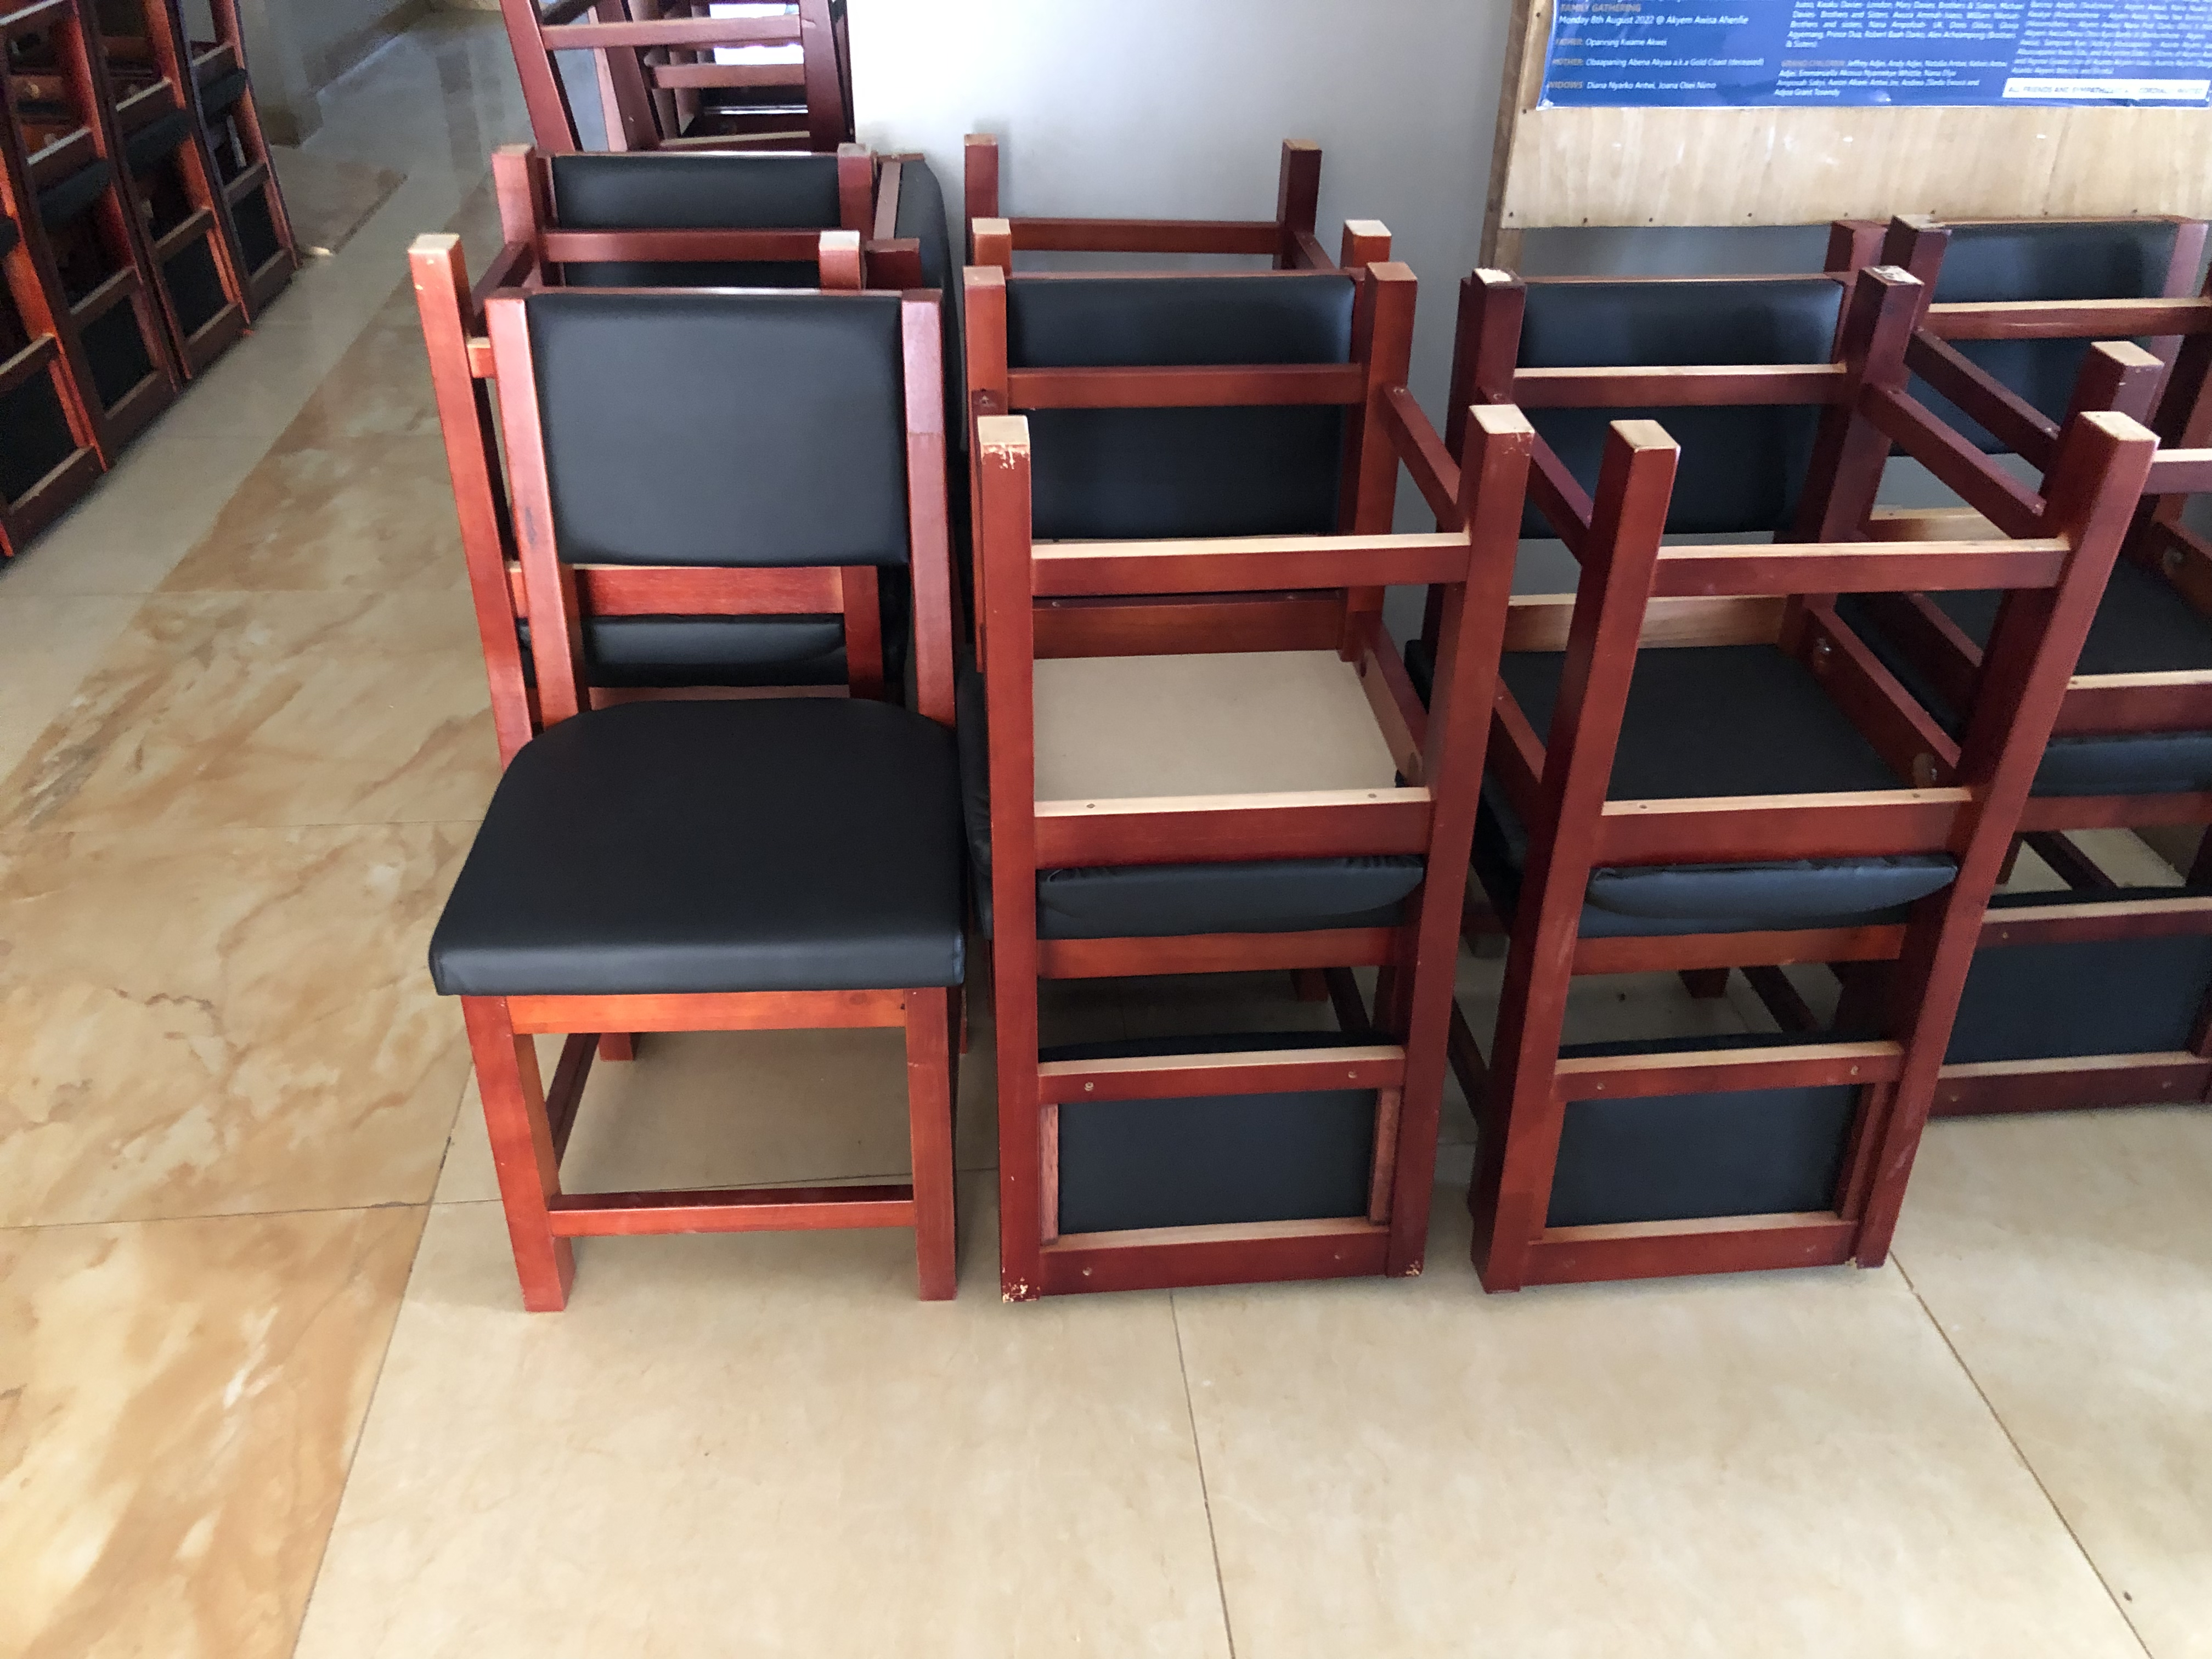
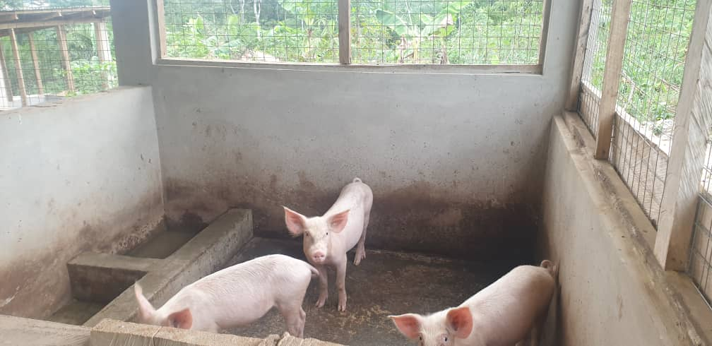
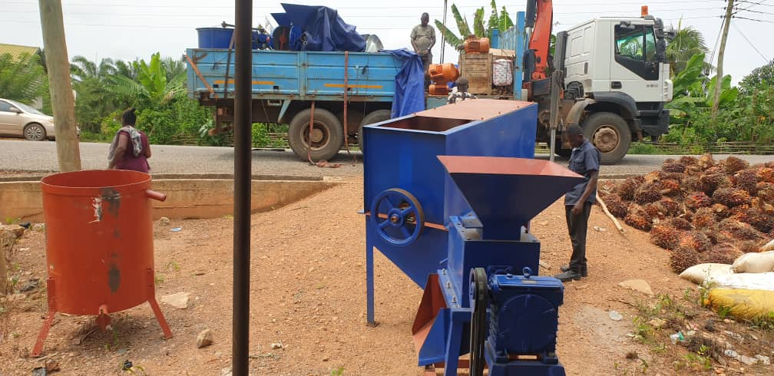
KEY ACHIEVEMENTS (2022)
ECONOMIC DEVELOPMENT CONT.
EDUCATION
  Rubber cultivation
  4,440 pieces of rubber seedlings were distributed.
  10 farmers benefited
  Coconut farming
  8,000 seedlings were distributed
  86 farmers benefited
  Rearing of farm animals
  20 piglets were distributed
  500 cockerels were distributed
  Oil Extraction
  Installation of oil palm extractor for FBOs
380 mono desks, 294 hexagon desks & chairs, 40 teacher’s chairs, 13 teacher's tables, 4 wooden shelves & 4 library workstation were distributed to public schools.

Slide 20



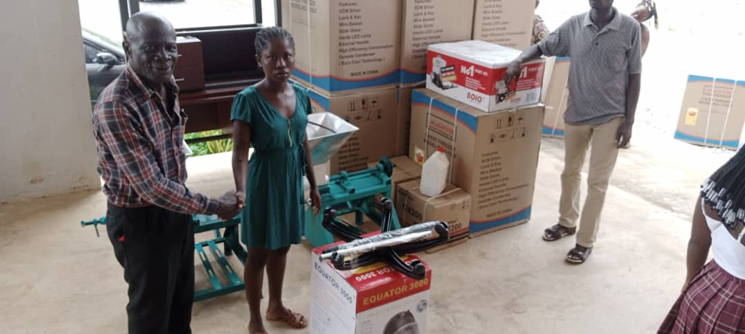
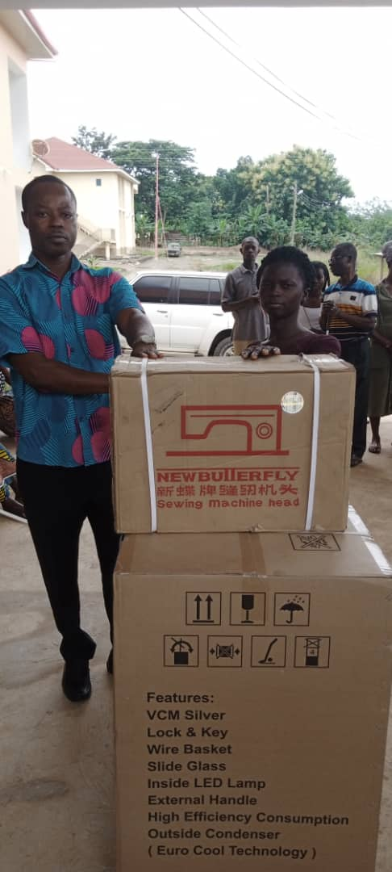
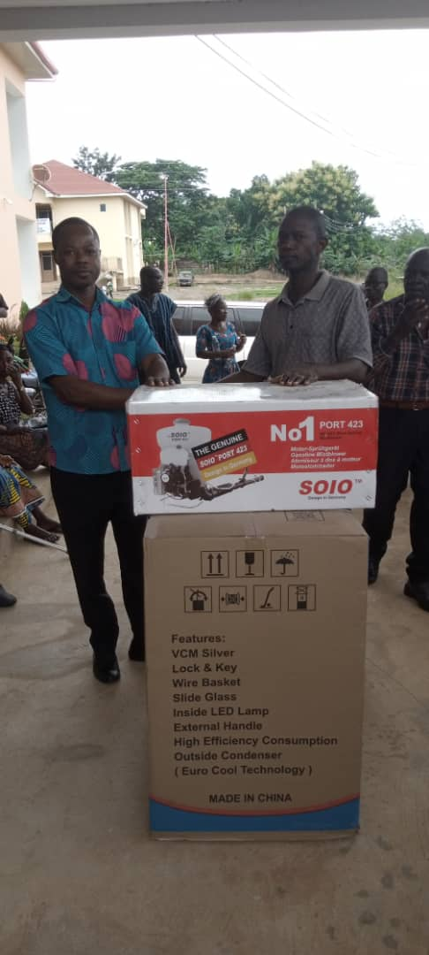
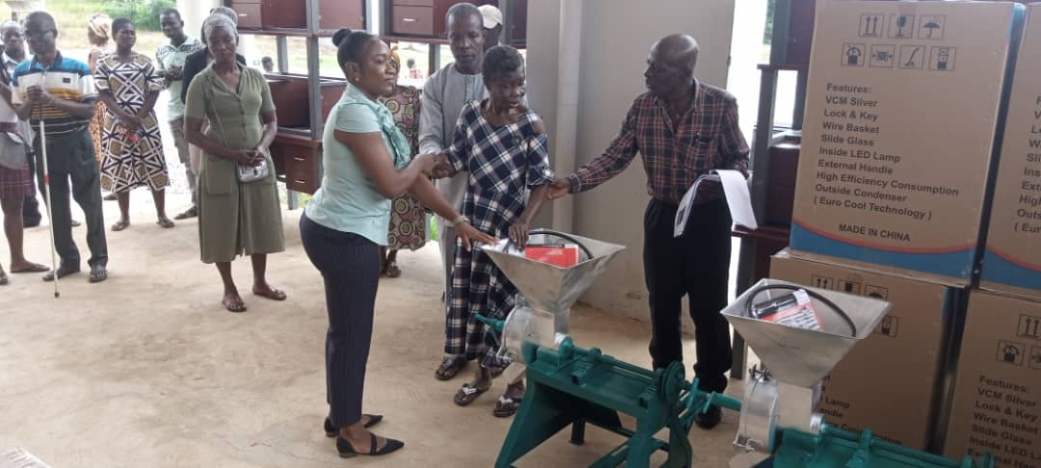
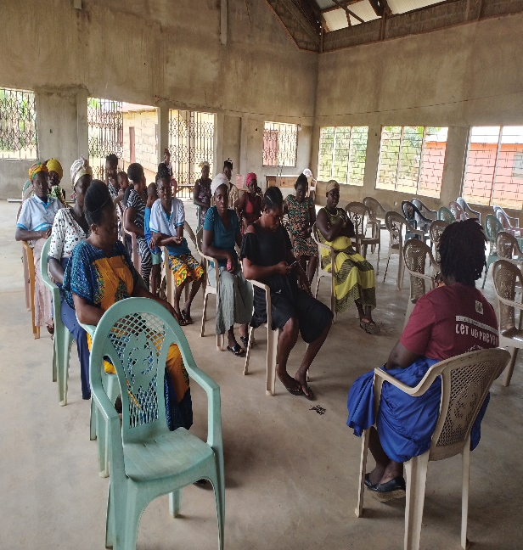
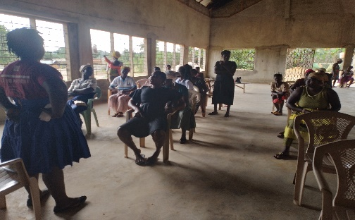
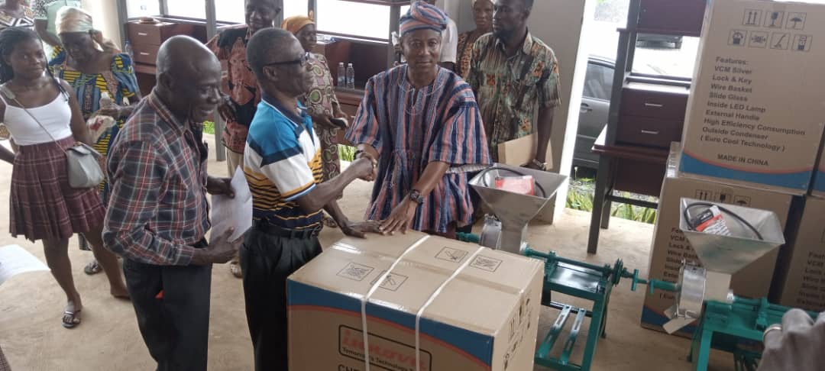
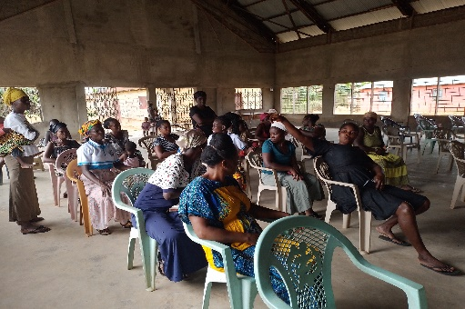
KEY ACHIEVEMENTS (2022)
SOCIAL WELFARE
APPRENTICESHIP
  Supported 23 PWDs with items to engage in IGA.
  Renewed NHIS card for 360 LEAP beneficiaries.
  7 communities sensitized on child protection, gender empowerment & domestic violence issues.
COMMUNITY SENSITIZATION

Slide 21

POLICY OUTCOME INDICATORS AND TARGETS

Slide 22
POLICY OUTCOME INDICATORS AND TARGETS
Outcome Indicator Description | Unit of Measurement | Previous year’s performance (2021) |  | Current year’s Actual Performance (2022)
 |  | Target | Actual | Target | Actuals as at August
Increased access to potable water | Percentage change in water coverage | 10% | 7% | 10% | 5%
Increased access to improved sanitation | Percentage change in sanitation coverage | 10% | 5% | 10% | 5%
Enhanced access to basic education | Net Enrolment Rate
 | i. KG | 50.0% | 48.3% | 51.0% | 49.3%
 | ii. Primary | 46.7% | 45.6% | 47.7% | 46.8%
 | iii. JHS | 23.2% | 24.4% | 23.5% | 23.8%
Efffective child protection activities implemented | Percentage change in child case management reported and resolved | 10% | 8% | 10% | 7%

Slide 23
POLICY OUTCOME INDICATORS AND TARGETS
Outcome Indicator Description | Unit of Measurement | Previous year’s performance (2021) |  | Current year’s Actual Performance (2022)
 |  | Target | Actual | Target | Actuals as at August
Enhanced access to quality health care | Percentage Change in OPD attendance | 25% | 100% | 2% | -4.3%
disaster communities | Proportion of communities in readiness to respond to emergency situations | 10% | 8% | 10% | 6%
Improved yield of crops (selected) produced | Change in maize produced (mt/ha ) | 2.8% | 2.75% | 3.0% | 3.0%
 | Change in rice (milled) produced (mt/ha) | 4.2% | 4.25% | 3.0% | 4.5%
 | Change in cassava produced (mt/ha) | 4.5% | 4.5% | 4.5% | 4.8%
 | Change in plantain produced (mt/ha) | 2.0% | 2.0% | 2.2% | 2.2%
Increased Internally Generated Fund (IGF) | Percentage change in IGF generated as against previous year | -0.07% | 0.18% | 8% | 48.1%

Slide 24
KEY PERFORMANCE INFORMATION FOR BUDGET PROGRAMMES
Management and Administration
Key/Main Outputs |  | Output Indicator | Past Years
 |  |  | 2021 Target | 2021 Actual | 2022 Target | 2022 Actual as at August
1. | I. General Assembly meetings organized | No. of meetings organized | 3 | 3 | 3 | 2
 | II. Executive meetings organized | No. of meetings organized | 3 | 3 | 3 | 2
 | III. Sub-Committee meetings organized | No. of meetings organized | 3 | 3 | 3 | 2
2. Town Hall meetings organized to discuss Plan and Budget implementation |  | No. of Town Hall Meetings organized | 2 | 2 | 2 | 2
3. Training organized for Assembly members and staff |  | No. of trainings organized | 1 | 1 | 2 | 2

Slide 25
KEY PERFORMANCE INFORMATION FOR BUDGET PROGRAMMES
Social Services Delivery
Key/Main Outputs | Output Indicator | Past Years
 |  | 2021 Target | 2021 Actual | 2022 Target | 2022 Actual as at August
1. School blocks constructed | No. of school blocks constructed | 1 | 0 | 1 | 1
2. Boreholes constructed | No. of boreholes constructed | 10 | 6 | 10 | `8
3. Communities sensitized on child protection | No. of communities sensitized | 20 | 5 | 10 | 7

Slide 26
KEY PERFORMANCE INFORMATION FOR BUDGET PROGRAMMES
Infrastructure Delivery and Management
Key/Main Outputs | Output Indicator | Past Years
 |  | 2021 Target | 2021 Actual | 2022 Target | 2022 Actual as at August
1. Spatial layout digitized and prepared | No. of spatial layout digitized and prepared | 2 | 2 | 2 | 2
2. Routine Building Inspection organized | Frequency of building inspection organized | 50 weeks | 30 weeks | 50 weeks | 25 weeks
3. Street bulbs received | No. of street bulbs received | 10 | 0 | 50 | 100

Slide 27
KEY PERFORMANCE INFORMATION FOR BUDGET PROGRAMMES
Economic Development
Key/Main Outputs | Output Indicator | Past Years
 |  | 2021 Target | 2021 Actual | 2022 Target | 2022 Actual as at August
1. Training held on | No. of FBOs trained | 23 | 23 | 23 | 23
2. Lockable stores constructed | No. of Lockable stores constructed | 1 | 1 | 2 | 1
3. Co-operative enterprises created | No. of groups registered | 4 | 4 | 4 | 2

Slide 28
KEY PERFORMANCE INFORMATION FOR BUDGET PROGRAMMES
Environmental Management
Key/Main Outputs | Output Indicator | Past Years
 |  | 2021 Target | 2021 Actual | 2022 Target | 2022 Actual as at August
1. Fringe communities sensitized on forest conservation | No. of communities sensitized | 15 | 15 | 15 | 11
2. Trees planted on greenery day | No. of trees planted | 90,000 | 70,530 | 100,000 | 90,429
3. Education on Public hygiene organized | No. of communities educated | 10 | 10 | 10 | 7

Slide 29

SANITATION BUDGET PERFORMANCE

Slide 30
SANITATION BUDGET PERFORMANCE
Liquid Waste
No. | Name of Activity/Project | Budget | Actuals as at August, 2022
1. | Dislodging & repairs 5 assembly toilet | 55,000.00 | 1,996.83
2. | Fumigation | 161,000.00 | 48,044.30
 | Total | 216,000.00 | 50,041.13
Solid Waste
No. | Name of Activity/Project | Budget | Actuals as at August, 2022
1. | Clearing and leveling of Refuse Sites | 160,000.00 | 40,000.00
2. | Refuse Evacuation | 30,000.00 | 30,000.00
 | Total | 190,000.00 | 70,000.00

Slide 31
DP SUPPORTED PROGRAMMES (MODERNIZATION OF AGRICULTURE IN GHANA)
Modernization of Agriculture in Ghana (MAG)
No | Name of Activity/Project | Budget | Actual as at August, 2022
1. | Administrative running | 18,564.00 | 10,070.00
2. | Home and farm visits | 35,040.00 | 17,520.00
3. | Monitoring | 1,496.00 | 748.00
4. | Data collection | 4,000.00 | 4,000.00
5. | Veterinary | 1,460.00 | 0.00
6. | RELC | 2,855.00 | 2,855.00
7. | Livestock training | 2,000.00 | 0.00
8. | E-Extension | 9,280.00 | 3,257.00
9. | Other Extension | 4,194.12 | 1,445.00
 | TOTAL | 78,889.12 | 39,895.00

Slide 32
GOVERNMENT FLAGSHIP PROJECTS OR PROGRAMMES
No | Name of Activity/Project | Budget | Actual as at August, 2022
1. | Planting for food and jobs
 | Sensitization of farmers on PFJ | 10,000.00 | 4,000.00
 | Awareness Creation on the use of Improved Seedling and Fertilizer Application | 10,000.00 | 5,000.00
2. | Planting for export & Rural Development
 | Raising 12,000 seedling | 20,000.00 | 20,000.00
 | Training Oil Palm Farmers on Fertilizer Application | 10,000.00 | 3,000.00
 | Training Farmers on Good Management Practices | 10,000.00 | 8,000.00
 | TOTAL | 60,000.00 | 40,000.00

Slide 33

OUTLOOK FOR
2023
DISTRICT ADOPTED POLICY OBJECTIVES FOR 2023
FOCUS AREA | ADOPTED POLICY OBJECTIVE | BUDGET ALLOCATION
Strong and resilient economy | Ensure improved fiscal performance and sustainability | 170,000.00
Agriculture and rural development | Double the agricultural productivity and incomes of small scale food producers for value addition. | 178,098.63
Education and training | Enhance equitable access to and participation in quality education at all levels | 97,882.15
Health and health services | Ensure accessible, and quality Universal Health Coverage (UHC) for all. | 22,780.64
Local Governance and Decentralisation | Deepen Political, Financial and Administration Decentralisation | 1,981,876.01
Child protection and development | Prevent and protect children from all forms of violence, abuse, neglect and exploitation | 17,000.00
Gender equality | Promote economic empowerment of particularly women | 10,000.00
Social protection | Strengthen social protection for the vulnerable | 15,000.00

Slide 34
DISTRICT ADOPTED POLICY OBJECTIVES FOR 2023
FOCUS AREA | ADOPTED POLICY OBJECTIVE | BUDGET ALLOCATION
Staff training and skill development | Ensure all learners acquire knowledge and skill to promote sustainability development | 67,378.00
Human settlements development and housing | Promote sustainable spatially integrated development of human settlement | 1,655,452.39
Drainage and flood control | Address recurrent devastating floods | 40,000.00
Reducing poverty and Inequality | Eradicate poverty and address vulnerability to poverty in all forms and dimensions | 178,982.66
Water and Environmental Sanitation | Improve access to safe reliable and sustainable water supply services for all | 423,000.00
Transport Infrastructure: Roads | Improve transport and road safety | 241,992.50
Total |  | 5,099,442.98

Slide 35


POLICY OUTCOME INDICATORS AND TARGETS

Slide 36
POLICY OUTCOME INDICATORS AND TARGETS
Outcome Indicator Description | Unit of Measurement | Baseline (2021) |  | Current year (2022) |  | Budget year (2023) | Indicative year (2024) | Indicative year (2025) | Indicative year (2026)
 |  | Target | Actual | Target | Actual as at August | Target | Target | Target | Target
Increased access to potable water (boreholes) | Percentage change in water coverage | 10% | 7% | 10% | 5% | 5% | 5% | 5% | 5%
Enhanced access to improved sanitation services | Percentage change in sanitation coverage | 10% | 5% | 10% | 5% | 5% | 5% | 5% | 5%
Increased access to basic education | Net Enrolment Rate
 | i. KG | 50.0% | 48.3% | 51.0% | 49.3% | 49.3% | 49.3% | 49.3% | 49.3%
 | ii. Primary | 46.7% | 45.6% | 47.7% | 46.8% | 47.3% | 47.7% | 48.1% | 48.3%
 | iii. JHS | 23.2% | 24.4% | 23.5% | 23.8% | 24.1% | 24.4% | 24.8% | 25.2%
Effective child protection activities implemented | Percentage change in child case management reported and resolved | 10% | 8% | 10% | 7% | 10% | 10% | 10% | 10%
Improved disaster resilient communities | Proportion of communities in readiness to respond to emergency situations | 10% | 8% | 10% | 6% | 10% | 10% | 10% | 10%

Slide 37
POLICY OUTCOME INDICATORS AND TARGETS
Outcome Indicator Description | Unit of Measurement | Baseline (2021) |  | Current year (2022) |  | Budget year (2023) | Indicative year (2024) | Indicative year (2025) | Indicative year (2026)
 |  | Target | Actual | Target | Actual as at August | Target | Target | Target | Target
Improved access to quality health care | Percentage Change in OPD attendance | 25% | 100% | 2% | -4.3% | 2% | 2% | 2% | 2%
Improved yield in crop (selected) production | Change in maize produced (mt/ha) | 2.8% | 2.75% | 3.0% | 3.0% | 3.1% | 3.3% | 3.4% | 3.6%
 | Change in rice (milled) produced (mt/ha) | 4.2% | 4.25% | 3.0% | 4.5% | 4.7% | 4.8% | 4.9% | 5.0%
 | Change in cassava produced (mt/ha) | 4.5% | 4.5% | 4.5% | 4.8% | 5.0% | 5.2% | 5.3% | 5.5%
 | Change in plantain produced (mt/ha) | 2.0% | 2.0% | 2.2% | 2.2% | 2.4% | 2.6% | 2.7% | 2.8%
Improved Internally Generated Fund (IGF) | Percentage change in IGF generated as against previous year | -0.07% | 0.18% | 8% | 48.1% | 2% | 2% | 2% | 2%

Slide 38
KEY PERFORMANCE INFORMATION FOR BUDGET PROGRAMMES
Management and Administration
 |  |  | Past Years |  |  |  | Projections
Key/Main Outputs |  | Output Indicator | 2021 | 2021 | 2022 | 2022 Actual | Budget Year | Indicative Year | Indicative Year | Indicative Year
 |  |  | Target | Actual | Target | As At August
 |  |  |  |  |  |  | 2023 | 2024 | 2025 | 2026
1. | I. General Assembly meetings organized | No. of meetings organized | 3 | 3 | 3 | 2 | 3 | 3 | 3 | 3
 | II. Executive meetings organized | No. of meetings organized | 3 | 3 | 3 | 2 | 3 | 3 | 3 | 3
 | III. Sub-Committee meetings organized | No. of meetings organized | 3 | 3 | 3 | 2 | 3 | 3 | 3 | 3

Slide 39
KEY PERFORMANCE INFORMATION FOR BUDGET PROGRAMMES
Management and Administration
 |  | Past Years |  |  |  | Projections
Key/Main Outputs | Output Indicator | 2021 | 2021 | 2022 | 2022 Actual | Budget Year | Indicative Year | Indicative Year | Indicative Year
 |  | Target | Actual | Target | As At August
 |  |  |  |  |  | 2023 | 2024 | 2025 | 2026
2. Town Hall meetings organized to discuss Plan and Budget implementation | No. of Town Hall Meetings organized | 2 | 2 | 2 | 2 | 2 | 2 | 2 | 2
3. Training organized for Assembly members and staff | No. of trainings organized | 1 | 1 | 2 | 2 | 2 | 2 | 2 | 2

Slide 40
KEY PERFORMANCE INFORMATION FOR BUDGET PROGRAMMES
Social Services Delivery
 |  | Past Years |  |  |  | Projections
Key/Main Outputs | Output Indicator | 2021 | 2021 | 2022 | 2022 Actual | Budget Year | Indicative Year | Indicative Year | Indicative Year
 |  | Target | Actual | Target | As At August
 |  |  |  |  |  | 2023 | 2024 | 2025 | 2026
1. School blocks constructed | No. of school blocks constructed | 1 | 0 | 1 | 1 | 1 | 1 | 1 | 1
2. Health awareness campaigns organized | No. of health Awareness campaigns organized | 9 | 9 | 9 | 9 | 10 | 10 | 10 | 10
3. Communities sensitized on child protection | No. of communities sensitized | 20 | 5 | 10 | 7 | 10 | 10 | 10 | 10

Slide 41
KEY PERFORMANCE INFORMATION FOR BUDGET PROGRAMMES
Infrastructure Delivery and Management
 |  | Past Years |  |  |  | Projections
Key/Main Outputs | Output Indicator | 2021 | 2021 | 2022 | 2022 Actual | Budget Year | Indicative Year | Indicative Year | Indicative Year
 |  | Target | Actual | Target | As At August
 |  |  |  |  |  | 2023 | 2024 | 2025 | 2026
1. Spatial layout digitized and prepared | No. of spatial layout digitized and prepared | 2 | 2 | 2 | 2 | 2 | 2 | 2 | 2
2. Feeder roads reshaped | Length of roads reshaped | 20 | 15 | 20 | 25.9km | 25km | 25km | 25km | 25km
3. Street bulbs received | No. of street bulbs received | 10 | 0 | 50 | 100 | 50 | 50 | 50 | 50

Slide 42
KEY PERFORMANCE INFORMATION FOR BUDGET PROGRAMMES
Economic Development
 |  | Past Years |  |  |  | Projections
Key/Main Outputs | Output Indicator | 2021 | 2021 | 2022 | 2022 Actual | Budget Year | Indicative Year | Indicative Year | Indicative Year
 |  | Target | Actual | Target | As At August
 |  |  |  |  |  | 2023 | 2024 | 2025 | 2026
1.Training held on climate smart agriculture | No. of FBOs trained | 4 | 4 | 4 | 3 | 4 | 4 | 4 | 4
2. Co-operative enterprise created | No. of new groups registered | 4 | 4 | 4 | 2 | 3 | 3 | 4 | 5
3. Internal revenue realized | Amount of IGF generated | 426,760.00 | 344,292.56 | 460,919.00 | 213,381.94 | 501,297.00 | 511,322.94 | 521,549.40 | 531,980.39

Slide 43
KEY PERFORMANCE INFORMATION FOR BUDGET PROGRAMMES
Environmental and Sanitation Management
 |  | Past Years |  |  |  | Projections
Key/Main Outputs | Output Indicator | 2021 | 2021 | 2022 | 2022 Actual | Budget Year | Indicative Year | Indicative Year | Indicative Year
 |  | Target | Actual | Target | As At August
 |  |  |  |  |  | 2023 | 2024 | 2025 | 2026
1.Public toilets rehabilitated and dislodged | No. of toilets dislodged and rehabilitated | 4 | 4 | 4 | 4 | 5 | 4 | 4 | 4
2. Disaster campaigns organized | No. of communities visited | 10 | 8 | 15 | 9 | 15 | 15 | 15 | 15
3. Education on Public hygiene organized | No. of communities educated | 10 | 10 | 10 | 7 | 12 | 12 | 12 | 12

Slide 44

2023 - 2026
REVENUE
PROJECTIONS

Slide 45
2023-2026 REVENUE PROJECTIONS – IGF ONLY
ITEM | 2022 |  | 2023 | 2024 | 2025 | 2026
 | Budget | Actual as at August | Projection | Projection | Projection | Projection
Property Rate | 99,873.00 | 35,346.94 | 103,270.00 | 105,335.40 | 107,442.11 | 109,590.95
Basic Rates | 550.00 | 0.00 | 550.00 | 561.00 | 572.22 | 583.66
Fees | 50,150.00 | 24,726.00 | 65,355.00 | 66,662.10 | 67,995.34 | 69,355.25
Fines | 3,800.00 | 0.00 | 4,650.00 | 4,743.00 | 4,837.86 | 4,934.62
Licence | 77,750.00 | 48,304.00 | 98,472.00 | 100,441.44 | 102,450.27 | 104,499.27
Land | 156,796.00 | 101,760.00 | 182,000.00 | 185,640.00 | 189,352.80 | 193,139.86
Rent | 62,000.00 | 1,245.00 | 37,000.00 | 37,740.00 | 38,494.80 | 39,264.70
Investment | 10,000.00 | 2,000.00 | 10,000.00 | 10,200.00 | 10,404.00 | 10,612.08
Sub-Total | 460,919.00 | 213,381.94 | 501,297.00 | 511,322.94 | 521,549.40 | 531,980.39
Royalties | 0.00 | 0.00 | 0.00 | 0.00 | 0.00 | 0.00
TOTAL | 460,919.00 | 213,381.94 | 501,297.00 | 511,322.94 | 521,549.40 | 531,980.39

Slide 46
REVENUE IMPROVEMENT ACTION PLAN FOR 2023
OBJECTIVE | ACTIVITIES/STRATEGIES | QUARTER |  |  |  | EXPECTED OUTPUT | ESTIMATED COST (GH₵) | FUNDING SOURCE | IMPLEMENTATION AGENCY | COLLABORATORS
 |  | 1 QTR | 2 QTR | 3 QTR | 4 QTR
Strengthen Domestic Resource Mobilization | Value properties in the district |  |  |  |  | Property Rate to be increased by 10% | 100,000.00 | DACF/ DDF | PPD | Lands Commission/LVD, Other Stakeholders
 | Update revenue database by March, 2023 |  |  |  |  | Business operating fees to increase by 2% | 20,000.00 | IGF/ DACF | Budget unit/ finance dept | Area Councils
 | Mount Revenue Post |  |  |  |  | Revenue performance levels to be increased | 15,000.00 | IGF | Finance dept /Works dept | Revenue Collectors
 | Empower taskforce to ensure land property developers pay approved fees |  |  |  |  | Increase in Rent of land, buildings by 5% | 4,000.00 | DACF | DA | Works
 | Sensitize stakeholder/revenue education |  |  |  |  | Responsiveness to revenue mobilization to improve | 5,000.00 | IGF | Budget unit/ Finance Dept | Stakeholders
 | Train revenue collectors on fee fixing and collection strategies |  |  |  |  | Revenue collection to be increased by 8% | 8,000.00 | IGF/ DACF | Budget unit/ Finance Dept | HR dept
TOTAL |  |  |  |  |  |  | 152,000.00

Slide 47
REVENUE MOBILIZATION STRATEGIES FOR KEY REVENUE SOURCES
REVENUE SOURCE | KEY STRATEGIES
1. RATES (Basic Rates/Property Rates) | Basic Rate: Adding the Basic Rate component to all B.O. Ps and all other charges to reduce the cost of collection and make collection easier. Property Rates: Valuation of existing properties in the District. Establishing and enforcing a Development Control Task Force. Provide logistical support for the Development Control Task Force.
2. LANDS | Undertake weekly monitoring of newly developed sites. Enforcing the payments of reclamation fees by sand winners. Provide logistical support for the Development Control Task Force. Organising monthly Spatial Planning Committee meetings
3. LICENSES | Public education on payment of taxes. Review and update existing business database. Establish Task Force for revenue mobilization in the District. Gazette Bye-laws. Prosecute rate defaulters.

Slide 48
REVENUE MOBILIZATION STRATEGIES FOR KEY REVENUE SOURCES
REVENUE SOURCE | KEY STRATEGIES
4. RENT | Sensitize occupants of Government stores on the need to pay rent. Timely Issuance of demand notice. Prosecute defaulters.
5. FEES AND FINES | Sensitize various business operators by organising stakeholders’ consultative meetings. Formation of revenue monitoring team to check on the activities of revenue collectors, especially on market days.
6. INVESTMENT | Investment in shares.
7. REVENUE COLLECTORS | Quarterly rotation of revenue collectors. Setting target for revenue collectors. Train and resource revenue collectors on effective strategies of mobilizing revenue. Sanction underperforming revenue collectors. Awarding best performing revenue collectors.

Slide 49
2023-2026 REVENUE PROJECTIONS – ALL REVENUE SOURCES
ITEM | 2022 |  | 2023 | 2024 | 2025 | 2026
 | Budget | Actual as at August | Projection | Projection | Projection | Projection
IGF | 460,919.00 | 213,381.94 | 501,297.00 | 511,322.94 | 521,549.40 | 531,980.39
Compensation of Employee | 1,622,171.00 | 1,657,847.81 | 2,604,566.45 | 2,656,657.78 | 2,709,790.93 | 2,763,986.75
Goods and Services Transfer | 113,134.00 | 34,278.24 | 56,000.00 | 57,120.00 | 58,262.40 | 59,427.65
Assets Transfer | 25,180.00 | 0.00 | 25,180.00 | 25,683.60 | 26,197.27 | 26,721.22
DACF | 4,905,399.54 | 907,394.90 | 2,901,547.09 | 2,959,578.0. | 3,018,769.59 | 3,079,144.98
DACF-RFG | 2,002,808.84 | 1,134,512.80 | 1,525,053.96 | 1,555,555.04 | 1,586,666.14 | 1,618,399.46
MAG-DP | 78,889.12 | 78,899.12 | 59,098.63 | 60,280.60 | 61,486.21 | 62,715.94
MP-DACF | 500,000.00 | 238,761.93 | 500,000.00 | 510,000.00 | 520,200.00 | 530,604.00
HIV/Malaria | 34,701.00 | 11,660.55 | 14,580.64 | 14,872.25 | 15,169.70 | 15,473.09
PWD-Funds | 316,163.00 | 86,526.77 | 178,982.66 | 182,562.31 | 186,213.56 | 189,937.83
Total | 10,059,365.50 | 4,363,264.06 | 8,366,306.43 | 8,533,632.56 | 8,704,305.21 | 8,878,391.31

Slide 50

2023 EXPENDITURE BY BUDGET PROGRAMME, PROJECTS

Slide 51
EXPENDITURE BY BUDGET PROGRAMME AND ECONOMIC CLASSIFICATION-ALL FUNDING SOURCES
BUDGET PROGRAMME | COMPENSATION OF EMPLOYEES | AMOUNT GH¢
 |  | GOODS & SERVICE | CAPITAL EXPENDITURE | TOTAL
Management and Administration | 1,510,489.00 | 1,436,438.00 | 308,180.00 | 3,255,107.00
Social Services Delivery | 463,110.00 | 652,563.00 | 671,280.00 | 1,786,953.00
Infrastructure Delivery and Management | 271,857.00 | 152,000.00 | 1,957,080.00 | 2,380,937.00
Economic Development | 465,210.00 | 218,099.00 | 220,000.00 | 903,309.00
Environmental Management | 0.00 | 40,000.00 | 0.00 | 40,000.00
TOTAL | 2,710,666.00 | 2,499,100.00 | 3,156,540.00 | 8,366,306.00

Slide 52
2023 EXPENDITURE BY BUDGET PROGRAMME, PROJECTS
Budget Programme | Key Priority Project For 2023 | Amount Gh¢
 |  | Goods & Service | Capital Expenditure | Total
Management and Administration | Purchase of Office Equipment |  | 85,180.00 | 85,180.00
 | Maintenance of Security Law and Order | 40,000.00 |  | 40,000.00
 | Monitoring and Evaluation | 40,000.00 |  | 40,000.00
Social Services Delivery | Reducing Poverty among PWD,s | 178,982.66 |  | 178,982.66
 | Support for COVID-19 | 10,000.00 |  | 10,000.00
 | Purchase of Dual Desk for Basic schools |  | 51,122.55 | 51,122.55
Infrastructure Delivery and Management | Construction of 1N0. Semi-detached Staff Bungalow at AKIM SWEDRU. |  | 400,000.00 | 400,000.00
 | Street Naming Exercise |  | 50,000.00 | 50,000.00
 | Preparation of 2 Local Plans | 20,000.00 |  | 20,000.00

Slide 53
2023 EXPENDITURE BY BUDGET PROGRAMME, PROJECTS
Budget Programme | Key Priority Project For 2023 | Amount Gh¢
 |  | Goods & Service | Capital Expenditure | Total
Economic Development | Support for Local Economic Development |  | 40,000.00 | 40,000.00
 | Construction of 1No. 10 Units Satellite Market at AKOTEKROM |  | 220,000.00 | 220,000.00
 | Reshaping of Access Roads (25.9km) at FOSUKROM, BREPRO, AKOTEKROM |  | 220,000.00 | 20,000.00
Environmental Management | Disaster Prevention and Management | 40,000.00 |  | 40,000.00
GRAND TOTAL |  | 328,982.66 | 1,066,302.55 | 1,195,285.21

Slide 54
GOVERNMENT FLAGSHIP PROJECTS OR PROGRAMMES FOR 2023
No | Type of Flagship project/programme | Name of Activity/Project | Budget | Funding Source
1. | Planting for Food and Jobs | Sensitization of Farmers on PFJ | 10,000.00 | DACF
 |  | Awareness Creation on the use of Improved Seedling and Fertilizer Application | 10,000.00 | DACF
2. | Planting for Export and Rural Development | Raising 12,000 Seedling | 20,000.00 | DACF
 |  | Training Oil Palm Farmers on Fertilizer Application | 10,000.00 | DACF
 |  | Training Farmers on Good Management Practices | 10,000.00 | DACF

Slide 55
2023-2026 EXPENDITURE PROJECTIONS BY ECONOMIC CLASSIFICATION- ALL FUNDING SOURCES
Expenditure items | 2022 budget | Actuals | 2023 | 2024 | 2025 | 2026
 |  | As at August, 2022
COMPENSATION OF EMPLOYEES | 1,731,006.00 | 1,715,573.88 | 2,710,666.00 | 2,764,879.32 | 2,820,176.91 | 2,876,580.44
GOODS AND SERVICES | 3,094,164.50 | 1,475,639.96 | 2,499,100.00 | 2,549,082.00 | 2,600,063.64 | 2,652,064.91
ASSETS | 5,234,186.00 | 129,460.04 | 3,156,540.00 | 3,219,670.80 | 3,284,064.22 | 3,349,745.50
TOTAL | 10,059,365.50 | 3,320,673.88 | 8,366,306.00 | 8,533,632.12 | 8,704,304.76 | 8,878,390.86

Slide 56
SUMMARY OF EXPENDITURE BUDGET BY DEPARTMENT, ECON. CLASSIFICATION AND FUNDING SOURCES-2023
 | Department | Compensation of Employees | Goods and services | Assets | Total | Funding (indicate amount against the funding source) |  |  |  |  | Total
 |  |  |  |  |  | Assembly’s IGF | GOG | DACF | DACF-RFG | MAG
1 | Central Administration | 1,358,277.00 | 1,313,260.00 | 305,180.00 | 3,003,717.00 | 376,038.00 | 1,304,357.00 | 1,323,322.00 | 0.00 | 0.00 | 3,003,717.00
2 | Works | 219,971.00 | 70,000.00 | 1,957,080.00 | 2,247,051.00 | 104,259.00 | 231,971.00 | 913,102.00 | 997,719.00 | 0.00 | 2,247,051.00
3 | Agriculture | 465,210.00 | 178,099.00 | 0.00 | 643,309.00 | 2,000.00 | 477,210.00 | 105,000.00 |  | 59,099.00 | 643,309.00
4 | Social Welfare and Community Development | 187,857.00 | 220,982.00 | 0.00 | 408,839.00 | 2,000.00 | 197,857.00 | 208,982.00 | 0.00 | 0.00 | 408,839.00
5 | Human Resource | 66,512.00 | 67,378.00 | 0.00 | 133,890.00 | 2,000.00 | 72,512.00 | 5,000.00 | 54,378.00 | 0.00 | 133,890.00
6 | Statistics | 58,700.00 | 10,000.00 | 3,000.00 | 71,700.00 | 2,000.00 | 64,700.00 | 5,000.00 | 0.00 | 0.00 | 71,700.00
 | SUB-TOTAL | 2,383,527.00 | 1,859,719.00 | 2,265,260.00 | 6,508,506.00 | 488,297.00 | 2,348,607.00 | 2,560,406.00 | 1,052,097.00 | 59,099.00 | 6,508,506.00

Slide 57
SUMMARY OF EXPENDITURE BUDGET BY DEPARTMENT, ECON. CLASSIFICATION AND FUNDING SOURCES-2023
 | Department | Compensation of Employees | Goods and services | Assets | Total | Funding (indicate amount against the funding source) |  |  |  |  | Total
 |  |  |  |  |  | Assembly’s IGF | GOG | DACF | DACF-RFG | MAG
7 | Physical Planning | 51,886.00 | 82,000.00 | 0.00 | 133,886.00 | 2,000.00 | 61,886.00 | 70,000.00 | 0.00 | 0.00 | 133,886.00
8 | Trade and Industry | 0.00 | 40,000.00 | 220,000.00 | 260,000.00 | 0.00 | 0.00 | 40,000.00 | 220,000.00 | 0.00 | 260,000.00
9 | Finance | 0.00 | 45,800.00 | 0.00 | 45,800.00 | 5,000.00 | 0.00 | 40,800.00 | 0.00 | 0.00 | 45,800.00
10 | Education youth and sports | 0.00 | 17,000.00 | 311,280.00 | 328,280.00 | 2,000.00 | 0.00 | 73,323.00 | 252,957.00 | 0.00 | 328,280.00
11 | Disaster Prevention and Management | 0.00 | 40,000.00 | .00 | 40,000.00 | 0.00 | 0.00 | 40,000.00 | 0.00 | 0.00 | 40,00 0.00
12 | Birth and Death | 37,162.00 | 7,000.00 | 0.00 | 44,162.00 | 2,000.00 | 37,162.00 | 5,000.00 | 0.00 | 0.00 | 44,162.00
13 | Health | 238,091.00 | 407,581.00 | 360,000.00 | 1,005,672.00 | 2,000.00 | 238,091.00 | 765,581.00 | 0.00 | 0.00 | 1,005,672.00
 | SUB-TOTAL | 327,139.00 | 639,381.00 | 891,280.00 | 1,857,800.00 | 13,000.00 | 337,139.00 | 1,034,704.00 | 472,957.00 | 0.00 | 1,857,800.00
 | GRAND TOTAL | 2,710,666.00 | 2,499,100.00 | 3,156,540.00 | 8,366,306.00 | 501,297.00 | 2,685,746.00 | 3,595.110.00 | 1,525,054.00 | 59,099.00 | 8,366,306.00

Slide 58
PROJECTS FOR 2023 AND CORRESPONDING COST AND JUSTIFICATION
List all Projects | IGF (GHc) | GOG (GHc) | DACF (GHc) | DACF-RFG (GHc) | MAG (GHc) | Total Budget (GHc) | Justification- What do you intend to achieve with the programmes/projects and how does this link to your objectives?
MANAGEMENT AND ADMINISTRATION
A. GENERAL ADMINISTRATION
1. Compensation of Employees | 79,100.00 | 1,279,176.12 |  |  |  | 1,358,276.12 | Staff compensation
2. Workshops seminars & conferences |  |  | 40,000.00 |  |  | 40,000.00 | Capacity of staff enhanced
3. Internal Management of the Assembly(Fuel, T&T Allowances,Commission, Refreshment etc) | 296,937.60 |  |  |  |  | 296,937.60 | Effective implementation of the decentralization policy, plans and programmes ensured.
4. Strengthening of Sub- Structures |  |  | 58,323.00 |  |  | 58,323.00 | Grassroots participation in local governance promoted for the overall development of the district.
5. Purchase of Office supplies & Equipment |  | 25,180.00 | 60,000.00 |  |  | 85,180.00 | Work effectiveness and efficiency enhanced.
Sub-Total | 376,037.60 | 1,304,356.12 | 158,323.00 |  |  | 1,838,716.12

Slide 59
PROJECTS FOR 2023 AND CORRESPONDING COST AND JUSTIFICATION
List all Projects | IGF (GHc) | GOG (GHc) | DACF (GHc) | DACF-RFG (GHc) | MAG (GHc) | Total Budget (GHc) | Justification- What do you intend to achieve with the programmes/projects and how does this link to your objectives?
6. Purchase of Office Furniture |  |  | 60,000.00 |  |  | 60,000.00 | Work effectiveness and efficiency enhanced.
7. Procurement Plan Preparation |  |  | 10,000.00 |  |  | 10,000.00 | Financial discipline instilled in the disbursement of Assembly funds.
8. Maintenance of Security, Law & Order |  |  | 40,000.00 |  |  | 40,000.00 | Life and property protected in the District.
9. Servicing & Maintenance of Assembly Vehicles |  |  | 70,000.00 |  |  | 70,000.00 | Service delivery enhanced.
10. Contributions |  |  | 20,000.00 |  |  | 20,000.00 | Assembly's obligation to stakeholders met
Sub-Total |  |  | 200,000.00 |  |  | 200,000.00

Slide 60
PROJECTS FOR 2023 AND CORRESPONDING COST AND JUSTIFICATION
List all Projects | IGF (GHc) | GOG (GHc) | DACF (GHc) | DACF-RFG (GHc) | MAG (GHc) | Total Budget (GHc) | Justification- What do you intend to achieve with the programmes/projects and how does this link to your objectives?
11.Running Cost of vehicles |  |  | 110,000.00 |  |  | 110,000.00 | Service delivery enhanced
12. MP’S Projects |  |  | 500,000.00 |  |  | 500,000.00 | Community development promoted.
13. Public Education and Sensitization |  |  | 30,000.00 |  |  | 30,000.00 | Grassroots participation in local governance promoted for the overall development of the district.
Sub-Total |  |  | 640,000.00 |  |  | 640,000.00

Slide 61
PROJECTS FOR 2023 AND CORRESPONDING COST AND JUSTIFICATION
List all Projects | IGF (GHc) | GOG (GHc) | DACF (GHc) | DACF-RFG (GHc) | MAG (GHc) | Total Budget (GHc) | Justification- What do you intend to achieve with the programmes/projects and how does this link to your objectives?
14. Official celebrations |  |  | 45,000.00 |  |  | 45,000.00 | National Celebration Conducted
15. Repair & Maintenance of Assembly Buildings |  |  | 30,000.00 |  |  | 30,000.00 | Assembly buildings maintained for a longer period.
16.Rental Accommodation for Staff |  |  | 20,000.00 |  |  | 20,000.00 | Key Staff Accommodated
17. Acqusition of Intercom and Internet Bosters |  |  | 10,000.00 |  |  | 10,000.00 | Staff work performance enhanced.
Sub-Total |  |  | 105,000.00 |  |  | 105,000.00

Slide 62
PROJECTS FOR 2023 AND CORRESPONDING COST AND JUSTIFICATION
List all Projects | IGF (GHc) | GOG (GHc) |  | DACF (GHc) | DACF-RFG (GHc) | MAG (GHc) | Total Budget (GHc) | Justification- What do you intend to achieve with the programmes/projects and how does this link to your objectives?
MANAGEMENT AND ADMINISTRATION
B.PLANNING,BUDGETING, COORDINATION AND STATISTICS
18. DPCU Activities |  |  |  | 10,000.00 |  |  | 10,000.00 | Progress of DMTDP implementation tracked for effective decision making.
19. Preparation of 2024 Composite Budget. |  |  |  | 40,000.00 |  |  | 40,000.00 | Financial discipline instilled in the disbursement of Assembly funds.
20.Monitoring & Evaluation |  |  |  | 40,000.00 |  |  | 40,000.00 | Progress of M&E implementation tracked for effective decision making
21.Statistical Collection Data | 2,000.00 | 6,000.00 |  | 5,000.00 |  |  | 13,000.00 | Improve Revenue generation.
Compensation |  | 58,700.12 |  |  |  |  | 58,700.12 | Internal revenue base expanded for more revenue generation
Sub-Total | 2,000.00 | 64,700.12 |  | 95,000.00 |  |  | 161,700.12

Slide 63
PROJECTS FOR 2023 AND CORRESPONDING COST AND JUSTIFICATION
List all Projects | IGF (GHc) | GOG (GHc) | DACF (GHc) | DACF-RFG (GHc) | MAG (GHc) | Total Budget (GHc) | Justification- What do you intend to achieve with the programmes/projects and how does this link to your objectives?
MANAGEMENT AND ADMINISTRATION
C. HUMAN RESOURCE MANAGEMENT
Compensation |  | 66,512.33 |  |  |  | 66,512.33
Staff Training and Skills Development | 2,000.00 | 6,000.00 | 5,000.00 | 54,378.00 |  | 67,378.00 | Capacity of staff and Assembly members enhanced for effective implementation of the decentralization policy, plans and programmes.
D. FINANCE AND AUDIT
24. Revenue Collection and Management | 5,000.00 |  | 25,000.00 |  |  | 30,000.00 | Revenue generation Improvewd
25. Internal Audit Operations |  |  | 15,800.00 |  |  | 15,800.00
Property Revaluation |  |  | 100,000.00 |  |  | 100,000.00 | Revenue generation Improvewd
Revenue Data Update |  |  | 30,000.00 |  |  | 30,000.00 | Internal revenue base Expanded
Sub-Total | 7,000.00 | 72,512.33 | 175,800.00 | 54,378.00 |  | 309,690.33

Slide 64
PROJECTS FOR 2023 AND CORRESPONDING COST AND
JUSTIFICATION
List all Projects | IGF (GHc) | GOG (GHc) |  | DACF (GHc) | DACF-RFG (GHc) |  | MAG (GHc) | Total Budget (GHc) | Justification- What do you intend to achieve with the programmes/projects and how does this link to your objectives?
SOCIAL SERVICE DELIVERY
A. EDUCATION,YOUTH AND SPORTS SERVICES
1. District Education Fund(Bursaries & Dual Desk) |  |  |  | 58,323.00 |  |  |  | 58,323.00 | Financial barriers and constraints to access secondary and tertiary education reduced for needy and brilliant student.
2. Support for District Education Service (Sports &Culture, STME, My first Day at School & DEOC ) | 2,000.00 |  |  | 15,000.00 |  |  |  | 17,000.00 | Education service delivery improved.
3. Completion of 1NO. 2- Units KG Classroom block with Ancilliary facilities at AKIM ADUASA |  |  |  |  |  | 252,956.60 |  | 252,956.60 | Quality of teaching and learning improved.
Sub-Total | 2,000.00 |  |  | 73,323.00 |  | 252,956.60 |  | 328,279.60

Slide 65
PROJECTS FOR 2023 AND CORRESPONDING COST AND
JUSTIFICATION
List all Projects | IGF (GHc) | GOG (GHc) | DACF (GHc) | DACF-RFG (GHc) | MAG (GHc) | Total Budget (GHc) | Justification- What do you intend to achieve with the programmes/projects and how does this link to your objectives?
B. PUBLIC HEALTH SERVICES AND MANAGEMENT
Construction of 1No. CHPS Compound with Borehole at MENSAKROM |  |  | 360,000.00 |  |  | 360,000.00 | Access to Health care Increased.
5.Support for HIV/AIDS AND Malaria(T&T, Allowance) |  |  | 14,580.64 |  |  | 14,580.64 | Spread of diseases reduced
6. Support for COVID-19( Travel and Transport) |  |  | 10,000.00 |  |  | 10,000.00 | Spread of diseases reduced
Sub-Total |  |  | 384,580.64 |  |  | 384,580.64

Slide 66
PROJECTS FOR 2023 AND CORRESPONDING COST AND
JUSTIFICATION
List all Projects | IGF (GHc) | GOG (GHc) | DACF (GHc) | DACF-RFG (GHc) | MAG (GHc) | Total Budget (GHc) | Justification- What do you intend to achieve with the programmes/projects and how does this link to your objectives?
C. SOCIAL WELFARE AND COMMUNITY DEVELOPMENT
7. Compensation of Employees |  | 187,857.16 |  |  |  | 187,857.16 | Staff compensated
8. Social Dev’t Activities (Violence, Exploitation, injustice, child protection) | 2,000.00 | 10,000.00 | 20,000.00 |  |  | 32,000.00 | Social inequality among the vulnerable is marginalized.
9. Gender, child right and social protection Activities |  |  | 10,000.00 |  |  | 10,000.00 | Gender, child right and social protection Activity Enhanced
10. PWD Funds(Scholarships and Bursaries) |  |  | 178,982.66 |  |  | 178,982.66 | Poverty among PWD’s reduced.
Sub-Total | 2,000.00 | 197,857.16 | 208,982.66 |  |  | 408,839.82

Slide 67
PROJECTS FOR 2023 AND CORRESPONDING COST AND
JUSTIFICATION
List all Projects | IGF (GHc) | GOG (GHc) | DACF (GHc) |  | DACF-RFG (GHc) | MAG (GHc) | Total Budget (GHc) | Justification- What do you intend to achieve with the programmes/projects and how does this link to your objectives?
D. BIRTH & DEATH REGISTRATION SERVICES
11.Compensation of Employees |  | 37,162.27 |  |  |  |  | 37,162.27 | Staff compensated
12.Data Collection | 2,000.00 |  |  | 5,000.00 |  |  | 7,000.00 | Internal database enhanced
Sub-Total | 2,000.00 | 37,162.27 |  | 5,000.00 |  |  | 44,162.77

Slide 68
PROJECTS FOR 2023 AND CORRESPONDING COST AND JUSTIFICATION
List all Projects | IGF (GHc) | GOG (GHc) | DACF (GHc) | DACF-RFG (GHc) | MAG (GHc) | Total Budget (GHc) | Justification- What do you intend to achieve with the programmes/projects and how does this link to your objectives?
E. ENVIRONMENTAL HEALTH AND SANITATION SERVICES
Compensation |  | 238,091.32 |  |  |  | 238,091.32 | Staff Compensation
1. Purchase of sanitary tools. | 2,000.00 |  |  |  |  | 2,000.00 | Environmental sanitation improved
2. Clearing and Leveling of Refuse sites |  |  | 160,000.00 |  |  | 160,000.00 | Environmental sanitation improved
3. Evacuation refuse Dumps |  |  | 30,000.00 |  |  | 30,000.00 | Environmental sanitation improved
4. Fumigation |  |  | 161,000.00 |  |  | 161,000.00 | Environmental sanitation improved.
5.Dislodging and Repair of 5 Assembly Toilets |  |  | 30,000.00 |  |  | 30,000,00
Sub-Total | 2,000.00 | 238,091.32 | 381,000.00 |  |  | 621,091.32

Slide 69
PROJECTS FOR 2023 AND CORRESPONDING COST AND
JUSTIFICATION
List all Projects | IGF (GHc) | GOG (GHc) | DACF (GHc) | DACF-RFG (GHc) | MAG (GHc) | Total Budget (GHc) | Justification- What do you intend to achieve with the programmes/projects and how does this link to your objectives?
INFRASTRUCTURE DELIVERY AND MANAGEMENT
A. PUBLIC WORKS,RURAL HOUSING AND WATER MANAGEMENT
1.Compensations of Employees |  | 219,971.23 |  |  |  | 219,971.23 | Staff compensated
2. Completion of 5-bedroom DCE Bungalow at SWEDRU |  |  | 297,757.39 |  |  | 297,757.39 | Key Staff Accommodated
3. Completion of 4-bedroom DCD Bungalow at SWEDRU |  |  | 270,538.21 |  |  | 270,538.21 | Key Staff Accommodated
4.Repair of Boreholes District-wide |  |  | 10,000.00 |  |  | 10,000.00 | Access to portable water improved
5.Construction of 1 No. 2-unit Semi-detached Staff Bungalow at SWEDRU |  |  |  | 400,000.00 |  | 400,000.00 | Key Staff Accommodated
Sub-Total |  | 219,971.23 | 578,295.60 | 400,000.00 |  | 1,198,266.83

Slide 70
PROJECTS FOR 2023 AND CORRESPONDING COST AND
JUSTIFICATION
List all Projects | IGF (GHc) | GOG (GHc) | DACF (GHc) | DACF-RFG (GHc) | MAG | Total Budget (GHc) | Justification- What do you intend to achieve with the programmes/projects and how does this link to your objectives?
6. IGF Capital Project(Repair of Markets, Assembly Building and Schools) | 100,259.40 |  |  |  |  | 100,259.40 | Assembly properties Maintained
7.Works Department activities (Stationery and Office Equipment) | 4,000.00 | 12,000.00 |  |  |  | 16,000.00 | Work effectiveness and efficiency enhanced.
Completion of Leveling & gravelling of Assembly Compound. |  |  | 20,000.00 |  |  | 20,000.00 | Road conditions improved for easy access/movement of people, goods and services
9. Self-help/ Community Initiated projects( Building Materials) |  |  | 145,806.39 |  |  | 145,806.39 | Communal spirit promoted/encouraged for community development.
Sub-Total | 104,259.40 | 12,000.00 | 165,806.39 |  |  | 282,065.79

Slide 71
PROJECTS FOR 2023 AND CORRESPONDING COST AND JUSTIFICATION
List all Projects | IGF (GHc) | GOG (GHc) | DACF (GHc) | DACF-RFG (GHc) | MAG (GHc) | Total Budget (GHc) | Justification- What do you intend to achieve with the programmes/projects and how does this link to your objectives?
9. Reshaping of Access Roads (25.9km) at FOSUKROM,BREPRO,MENSAKROM |  |  |  | 241,992.50 |  | 241,992.50 | Road conditions improved for easy access/movement of people, goods and services.
10.Dredging of River at KYEKYEREPUA |  |  | 119,000.00 | 299,846.00 |  | 418,846.00 | Environmental sanitation improved
11. Maintenance & Supply of streetlights district wide |  |  | 50,000.00 |  |  | 50,000.00 | Security district-wide maintained
12.Completion Extension of Electricity at ADUASA, ASAWASE, AKISS |  |  |  | 24,789.86 |  | 24,789.86 | Night visibility improved
Sub-Total |  |  | 169,000.00 | 566,628.36 |  | 735,628.36

Slide 72
PROJECTS FOR 2023 AND CORRESPONDING COST AND
JUSTIFICATION
List all Projects | IGF (GHc) | GOG (GHc) | DACF (GHc) | DACF-RFG (GHc) | MAG (GHc) | Total Budget (GHc) | Justification- What do you intend to achieve with the programmes/projects and how does this link to your objectives?
10.Completion of 7No. Mechanized Boreholes at ASAWASE etc |  |  |  | 25,606.00 |  | 25,606.00 | Access to potable water improved
11.Completion of 1 NO. Fire Hydrant at AKIM SWEDRU |  |  |  | 5,485.00 |  | 5,485.00 | Fire fighting improved
B. PHYSICAL AND SPATIAL PLANNING DEVELOPMENT
12. Compensation of Employees |  | 51,886.02 |  |  |  | 51,886.02 | Staff compensated
13. Physical Planning Activities (Prepare 2 Local Plans, Procure Stationery and Office Equipment) | 2,000.00 | 10,000.00 | 20,000.00 |  |  | 32,000.00 | Sustainable and orderly development of human settlements ensured.
14. Street Naming Exercise |  |  | 50,000.00 |  |  | 50,000.00 | Sustainable and orderly development of human settlements ensured.
Sub-Total | 2,000.00 | 61,886.02 | 70,000.00 | 31,091.00 |  | 164,977.02

Slide 73
PROJECTS FOR 2023 AND CORRESPONDING COST AND
JUSTIFICATION
List all Projects | IGF (GHc) | GOG (GHc) | DACF (GHc) | DACF-RFG (GHc) |  | MAG (GHc) | Total Budget (GHc) | Justification- What do you intend to achieve with the programmes/projects and how does this link to your objectives?
ECONOMIC DEVELOPMENT
A. AGRICULTURAL SERVICES AND MANAGEMENT
1. Compensation of Employees |  | 465,209.88 |  |  |  |  | 465,209.88 | Staff compensated
2. Farmers Day |  |  | 45,000.00 |  |  |  | 45,000.00 | Support implementation of National Policy ensure food security in the District.
3. Agric Dept. Activities & Programmes | 2,000.00 | 12,000.00 |  |  |  |  | 14,000.00 | Food Security Enhanced.
4. Planting for food and jobs |  |  | 20,000.00 |  |  |  | 20,000.00 | Food Security Enhanced.
5. Agric Developments |  |  |  |  |  | 59,099.00 | 59,099.00 | Food Security Enhanced.
6. Planting for Export and Rural Development |  |  | 40,000.00 |  |  |  | 40,000.00 | Food security and employment Ehanced
Sub-Total | 2,000.00 | 477,209.88 | 105,000.00 |  |  | 59,099.00 | 643,309.00

Slide 74
PROJECTS FOR 2023 AND CORRESPONDING COST AND
JUSTIFICATION
List all Projects | IGF (GHc) | GOG (GHc) | DACF (GHc) | DACF-RFG (GHc) | MAG (GHc) | Total Budget (GHc) | Justification- What do you intend to achieve with the programmes/projects and how does this link to your objectives?
ECONOMIC DEVELOPMENT
B. TRADE ,TOURISM AND INDUSTRIAL DEVELOPMENT
7.Construction of 1No. 10Units Satellite Market at AKOTEKROM |  |  |  | 220,000.00 |  | 220,000.00 | Local Business enterprises promoted for job creation
8. Support for Local Economic Development |  |  | 40,000.00 |  |  | 40,000.00 | Operations of local businesses in the district. Boosted
Sub-Total |  |  | 40,000.00 | 220,000.00 |  | 260,000.00

Slide 75
PROJECTS FOR 2023 AND CORRESPONDING COST AND
JUSTIFICATION
List all Projects | IGF (GHc) | GOG (GHc) | DACF (GHc) | DACF-RFG (GHc) | MAG (GHc) | Total Budget (GHc) | Justification- What do you intend to achieve with the programmes/projects and how does this link to your objectives?
ENVIRONMENTAL MANAGEMENT
1.Disaster Prevention and Management |  |  | 40,000.00 |  |  | 40,000.00 | Proactive planning for disaster prevention and mitigation promoted
Sub-Total |  |  | 40,000.00 |  |  | 40,000.00
GRAND TOTAL | 501,297.00 | 2,685,746.00 | 3,595,110.00 | 1,525,054.00 | 59,099.00 | 8,366,306.00

Slide 76
SANITATION BUDGET
Liquid Waste
No | Name of Activity/Project | Budget
1. | Dislodging & repair 5 assembly toilet | 30,000.00
2. | Fumigation | 161,000.00
Solid Waste
No | Name of Activity/Project | Budget
1. | Clearing and Leveling of Refuse Sites | 160,000.00
2. | Refuse Evacuation | 30,000.00

Slide 77
DP SUPPORTED PROGRAMMES (MODERNIZATION OF AGRICULTURE IN GHANA (MAG) )
Modernization of Agriculture in Ghana (MAG)
No | Name of Activity/Project | Budget
 | Administrative running | 8,000.00
 | Home and farm visits | 18,000.00
 | Monitoring | 4,000.00
 | Data collection | 2,000.00
 | Veterinary | 5,000.00
 | RELC | 4,000.00
 | Livestock training | 4,000.00
 | E-Extension | 4,098.63
 | Other Extension | 10,000.00
TOTAL |  | 59,098.63

Slide 78


Slide 79

MDA/MMDA : LOCAL GOVERNMENT SERVICE
DEPARTMENT: CENTRAL ADMNISTRATION
COST CENTRE: 0221-BIRIM SOUTH DISTRICT ASSEMBLY
PROGRAMME : MANAGEMENT AND ADMINISTRATION
REPUBLIC OF GHANA
SN | STAFF NAMES | GRADE/STAFF TYPE | DATE OF BIRTH | STAFF NUMBER |  |  | SALARY |  | TYPE(S) OF ALLOWANCES |  |  |  |  |  |  |  |  | TOTAL
 |  |  |  |  | LEVEL | STEP | BASIC | ANNUAL | Interim Premium | ACCOMODATION | FUEL | DOMESTIC SERVANTS | UTILITIES | WATCHMAN | CLOTHING | ENTERTAINMENT | DOMESTIC SERVANTS
1 | Firimin-Roger Nabiebakye | Co-ordinating Director | 13/04/1983 | 612569 | 23 | 1 | 5,109.98 | 61,319.79 | 9,197.97 |  |  | 5,510.40 | 6,048.00 | 6,417.60 | 5,241.60 | 5,241.60 | 5,510.40 | 104,487.36
2 | Ofori Nuamah | Deputy Director | 15/09/1984 | 739210 | 21 | 2 | 3,968.31 | 47,619.67 | 7,142.95 |  |  |  |  |  |  |  |  | 54,762.62
3 | Ebenezer Ofosu | Assistant Director IIA | 08/08/1985 | 1207495 | 18 | 2 | 2,647.90 | 31,774.85 | 4,766.23 |  |  |  |  |  |  |  |  | 36,541.08
4 | Kudohia Georgina | Assistant Director IIB | 26/09/1983 | 1329015 | 16 | 3 | 2,199.74 | 26,396.90 | 3,959.54 |  |  |  |  |  |  |  |  | 30,356.44
5 | Gifty Gyimah | Assistant Director IIB | 05/06/1991 | 1501458 | 16 | 1 | 2,126.82 | 25,521.79 | 3,828.27 |  |  |  |  |  |  |  |  | 29,350.06
6 | Zakaria Abdul-Haalik | Assistant Director IIB | 01/08/1985 | 1512305 | 16 | 1 | 2,126.82 | 25,521.79 | 3,828.27 |  |  |  |  |  |  |  |  | 29,350.06
7 | Suleman Salahudeen | Assistant Director IIB | 04/02/1995 | 1466488 | 16 | 1 | 2,126.82 | 25,521.79 | 3,828.27 |  |  |  |  |  |  |  |  | 29,350.06
8 | Eric Eyiah-Donkor | Senior Budget Analyst | 20/04/1976 | 917774 | 19 | 2 | 2,880.76 | 34,569.11 | 5,185.37 |  |  |  |  |  |  |  |  | 39,754.48
9 | Sayibu Anisah | Assistant Budget Analyst | 30/03/1994 | 1326220 | 16 | 3 | 2,199.74 | 26,396.90 | 3,959.54 |  |  |  |  |  |  |  |  | 30,356.44
10 | Harry Opare-Addo | Assistant Budget Analyst | 18/09/1984 | 1342934 | 16 | 3 | 2,199.74 | 26,396.90 | 3,959.54 |  |  |  |  |  |  |  |  | 30,356.44
11 | Mansah Oduro Yeboah | Assistant Budget Analyst | 23/06/1988 | 1409545 | 16 | 2 | 2,162.97 | 25,955.66 | 3,893.35 |  |  |  |  |  |  |  |  | 29,849.01
12 | Adjewi Tetteh Andy | Assistant Budget Analyst | 09/01/1984 | 1427495 | 16 | 2 | 2,162.97 | 25,955.66 | 3,893.35 |  |  |  |  |  |  |  |  | 29,849.01
13 | Hannah Graham | Assistant Budget Analyst | 17/04/1989 | 1506011 | 16 | 1 | 2,126.82 | 25,521.79 | 3,828.27 |  |  |  |  |  |  |  |  | 29,350.06
14 | Adolphus Selorm Dotse | Assistant Budget Analyst | 04/11/1998 | 1506054 | 16 | 1 | 2,126.82 | 25,521.79 | 3,828.27 |  |  |  |  |  |  |  |  | 29,350.06

Slide 80
MDA/MMDA : LOCAL GOVERNMENT SERVICE
DEPARTMENT: CENTRAL ADMNISTRATION
COST CENTRE: 0221-BIRIM SOUTH DISTRICT ASSEMBLY
PROGRAMME : MANAGEMENT AND ADMINISTRATION
REPUBLIC OF GHANA
SN | STAFF NAMES | GRADE/STAFF TYPE | DATE OF BIRTH | STAFF NUMBER |  |  | SALARY |  | TYPE(S) OF ALLOWANCES |  |  |  |  |  |  |  |  | TOTAL
 |  |  |  |  | LEVEL | STEP | BASIC | ANNUAL | Interim Premium | ACCOMODATION | FUEL | DOMESTIC SERVANTS | UTILITIES | WATCHMAN | CLOTHING | ENTERTAINMENT | DOMESTIC SERVANTS
15 | Korbla Ganyo Akpablie | Internal Auditor | 3/11/1970 | 913758 | 18 | 5 | 2,785.26 | 33,423.07 | 5,013.46 |  |  |  |  |  |  |  |  | 38,436.53
16 | John Magnus Yankson | Assistant Internal Auditor | 22/09/1977 | 540183 | 16 | 3 | 2,199.74 | 26,396.90 | 3,959.54 |  |  |  |  |  |  |  |  | 30,356.44
17 | Isaac Frimpong Debrah | Assistant Internal Auditor | 07/06/1984 | 1451061 | 16 | 1 | 2,126.82 | 25,521.79 | 3,828.27 |  |  |  |  |  |  |  |  | 29,350.06
18 | Tinadu Kwakye David | Assistant Internal Auditor Trainee | 09/08/1987 | 877855 | 15 | 11 | 2,237.14 | 26,845.65 | 4,026.85 |  |  |  |  |  |  |  |  | 30,872.50
19 | Prince Yeboah | Assistant Internal Auditor Trainee | 04/11/1990 | 1426179 | 15 | 3 | 1,954.90 | 23,458.83 | 3,518.82 |  |  |  |  |  |  |  |  | 26,977.65
20 | Nana Turkson Amissah | Development Planning officer | 29/08/1990 | 937154 | 18 | 2 | 2,647.90 | 31,774.85 | 4,766.23 |  |  |  |  |  |  |  |  | 36,541.08
21 | Ageh Selase Francis | Assistant Dev. Planning officer | 01/10/1988 | 1411813 | 16 | 2 | 2,162.97 | 25,955.66 | 3,893.35 |  |  |  |  |  |  |  |  | 29,849.01
22 | Osew Clement | Senior Executive officer | 28/03/1998 | 1415157 | 15 | 2 | 1,922.23 | 23,066.70 | 3,460.01 |  |  |  |  |  |  |  |  | 26,526.71
23 | Boateng Felix Obeng | Senior Executive officer | 18/05/1987 | 1505205 | 15 | 1 | 1,890.09 | 22,681.12 | 3,402.17 |  |  |  |  |  |  |  |  | 26,083.29
24 | Obeng Lawrence | Executive Officer | 9/10/1990 |  | 11 | 1 | 1,178.95 | 14,147.44 | 2,122.12 |  |  |  |  |  |  |  |  | 16,269.56
25 | Philomena Osei-Sarfo | Stenograper Grade II | 20/11/1975 | 692222 | 12 | 11 | 1,570.19 | 18,842.30 | 2,826.35 |  |  |  |  |  |  |  |  | 21,668.65
26 | Korankye Ofosu | Yard Foreman | 22/08/1979 | 703551 | 14 | 2 | 1,708.27 | 20,499.28 | 3,074.89 |  |  |  |  |  |  |  |  | 23,574.17
27 | Dominic Okyere | Heavy Duty Driver | 05/05/1982 | 899240 | 12 | 1 | 1,326.61 | 15,919.32 | 2,387.90 |  |  |  |  |  |  |  |  | 18,307.22
28 | Samuel Asare Smith | Driver Grade III | 26/12/1976 | 1320165 | 8 | 1 | 827.48 | 9,929.74 | 1,489.46 |  |  |  |  |  |  |  |  | 11,419.20
29 | Ankomah Ebenezer | Driver Grade III | 2/7/1982 |  | 8 | 1 | 827.48 | 9,929.74 | 1,489.46 |  |  |  |  |  |  |  |  | 11,419.20

Slide 81
MDA/MMDA : LOCAL GOVERNMENT SERVICE
DEPARTMENT: CENTRAL ADMNISTRATION
COST CENTRE: 0221-BIRIM SOUTH DISTRICT ASSEMBLY
PROGRAMME : MANAGEMENT AND ADMINISTRATION
REPUBLIC OF GHANA
SN | STAFF NAMES | GRADE/STAFF TYPE | DATE OF BIRTH | STAFF NUMBER |  |  | SALARY |  | TYPE(S) OF ALLOWANCES |  |  |  |  |  |  |  |  | TOTAL
 |  |  |  |  | LEVEL | STEP | BASIC | ANNUAL | Interim Premium | ACCOMODATION | FUEL | DOMESTIC SERVANTS | UTILITIES | WATCHMAN | CLOTHING | ENTERTAINMENT | DOMESTIC SERVANTS
30 | Yeboah Kwame | Assistant Security | 1/7/1972 |  | 10 | 1 | 1,047.73 | 12,572.77 | 1,885.92 |  |  |  |  |  |  |  |  | 14,458.69
31 | Kofi Ampomah | Assistant Procurement offier | 25/11/1984 | 925287 | 16 | 7 | 2,353.18 | 28,238.19 | 4,235.73 |  |  |  |  |  |  |  |  | 32,473.92
32 | Manu Patrick | Assistant Procurement officer | 05/11/1988 | 1427551 | 16 | 2 | 2,162.97 | 25,955.66 | 3,893.35 |  |  |  |  |  |  |  |  | 29,849.01
33 | Ofori Lawrence | Assistant Procurement offier | 18/11/1983 | 1505521 | 16 | 1 | 2,126.82 | 25,521.79 | 3,828.27 |  |  |  |  |  |  |  |  | 29,350.06
34 | Obeng Augustine Anim | Assistant Procurement offier | 29/08/1992 | 1502959 | 16 | 1 | 2,126.82 | 25,521.79 | 3,828.27 |  |  |  |  |  |  |  |  | 29,350.06
35 | Raymond Kojo Boadi | Information Technology Technician | 07/12/1987 | 1439947 | 12 | 1 | 1,326.61 | 15,919.32 | 2,387.90 |  |  |  |  |  |  |  |  | 18,307.22
36 | Paulina Gbedemah | Snr. Revenue Superintendent | 30/05/1981 | 864621 | 16 | 2 | 2,162.97 | 25,955.66 | 3,893.35 |  |  |  |  |  |  |  |  | 29,849.01
37 | Ebenezer Owusu | Revenue Superintendent | 21/11/1983 | 508521 | 15 | 5 | 2,021.93 | 24,263.21 | 3,639.48 |  |  |  |  |  |  |  |  | 27,902.69
38 | John Arthur | Revenue Superintendent | 19/12/1965 | 512337 | 15 | 2 | 1,922.23 | 23,066.70 | 3,460.01 |  |  |  |  |  |  |  |  | 26,526.71
39 | Anti Kwasi Harold | Revenue Superintendent | 17/05/1965 | 130929 | 15 | 7 | 2,091.26 | 25,095.17 | 3,764.28 |  |  |  |  |  |  |  |  | 28,859.45
40 | Isaac Oppong | Higher Revenue Inspector | 15/10/1964 | 691843 | 12 | 2 | 1,349.16 | 16,189.94 | 2,428.49 |  |  |  |  |  |  |  |  | 18,618.43
41 | Richard Entsie | Higher Revenue Inspector | 8/5/1987 | 691866 | 12 | 2 | 1,349.16 | 16,189.94 | 2,428.49 |  |  |  |  |  |  |  |  | 18,618.43
42 | Janet Tetteh | Higher Revenue Inspector | 21/07/1984 | 843264 | 11 | 2 | 1,199.00 | 14,387.94 | 2,158.19 |  |  |  |  |  |  |  |  | 16,546.13
43 | Leticia Adu | Higher Revenue Inspector | 26/12/1963 | 119133 | 12 | 11 | 1,570.19 | 18,842.30 | 2,826.35 |  |  |  |  |  |  |  |  | 21,668.65
44 | Christiana Kyei | Higher Revenue Inspector | 06/08/1968 | 789324 | 15 | 1 | 1,890.09 | 22,681.12 | 3,402.17 |  |  |  |  |  |  |  |  | 26,083.29
 | TOTAL |  |  |  |  |  | 90,232.36 | 1,082,788.28 | 162,418.24 |  |  |  |  |  |  |  |  | 1,279,176.12

Slide 82
MDA/MMDA : LOCAL GOVERNMENT SERVICE
DEPARTMENT: CENTRAL ADMNISTRATION
COST CENTRE: 0221-BIRIM SOUTH DISTRICT ASSEMBLY
PROGRAMME : MANAGEMENT AND ADMINISTRATION
REPUBLIC OF GHANA
SN | STAFF NAMES | GRADE/STAFF TYPE | DATE OF BIRTH | STAFF NUMBER |  |  | SALARY |  | TYPE(S) OF ALLOWANCES |  |  |  |  |  |  |  |  | TOTAL
 |  |  |  |  | LEVEL | STEP | BASIC | ANNUAL | Interim Premium | ACCOMODATION | FUEL | DOMESTIC SERVANTS | UTILITIES | WATCHMAN | CLOTHING | ENTERTAINMENT | DOMESTIC SERVANTS
45 | Tauh -Bonsu Yaw | Chief Enviromental Health officer | 16/06/1965 | 73347 | 20 | 5 | 3,586.57 | 43,038.85 | 6,455.83 |  |  |  |  |  |  |  |  | 53,081.25
46 | Joseph Offei Boakye | Environmental Health Officer | 26/11/1992 | 982965 | 13 | 3 | 1,543.95 | 18,527.34 | 2,779.10 |  |  |  |  |  |  |  |  | 22,850.39
47 | Obed Henry Bempong | Enviromental Health Officer | 22/03/1995 | 1249361 | 14 | 1 | 1,679.72 | 20,156.62 | 3,023.49 |  |  |  |  |  |  |  |  | 24,859.83
48 | Isaac Amponsah | Chief Environmental Health Asst | 11/8/1966 | 80660 | 17 | 9 | 2,738.70 | 32,864.38 | 4,929.66 |  |  |  |  |  |  |  |  | 40,532.74
49 | Esther Ofori | Snr. Enviromental Health Asst | 16/10/1986 | 1099804 | 13 | 3 | 1,543.95 | 18,527.34 | 2,779.10 |  |  |  |  |  |  |  |  | 22,850.39
50 | Oppong Emmanuel | Enviromental Health Assistant | 06/04/1990 | 1372464 | 12 | 1 | 1,326.61 | 15,919.32 | 2,387.90 |  |  |  |  |  |  |  |  | 19,633.83
51 | Salima Bukari | Enviromental Health Assistant | 14/02/1992 | 1408453 | 12 | 1 | 1,326.61 | 15,919.32 | 2,387.90 |  |  |  |  |  |  |  |  | 19,633.83
52 | Edward Oppong | Sanitary Labourer | 07/10/1966 | 87278 | 7 | 11 | 870.40 | 10,444.81 | 1,566.72 |  |  |  |  |  |  |  |  | 12,881.93
53 | Richard Bawa | Senior Gardener | 2/11/1986 |  | 7 | 1 | 735.38 | 8,824.52 | 1,323.68 |  |  |  |  |  |  |  |  | 10,883.57
54 | Kyeremah Adwoa | Labourer | 1/7/1989 |  | 7 | 1 | 735.38 | 8,824.52 | 1,323.68 |  |  |  |  |  |  |  |  | 10,883.57
 | TOTAL |  |  |  |  |  | 16,087.25 | 193,047.02 | 28,957.05 |  |  |  |  |  |  |  |  | 238,091.32

Slide 83
MDA/MMDA : LOCAL GOVERNMENT SERVICE
DEPARTMENT: SOCIAL WELFARE AND COMMUNITY DEVELOPMENT
COST CENTRE: 0221-BIRIM SOUTH DISTRICT ASSEMBLY
PROGRAMME : SOCIAL SERVICES DELIVERY
REPUBLIC OF GHANA
SN | STAFF NAMES | GRADE/STAFF TYPE | DATE OF BIRTH | STAFF NUMBER |  |  | SALARY |  | TYPE(S) OF ALLOWANCES |  |  |  |  |  |  |  |  | TOTAL
 |  |  |  |  | LEVEL | STEP | BASIC | ANNUAL | Interim Premium | ACCOMODATION | FUEL | DOMESTIC SERVANTS | UTILITIES | WATCHMAN | CLOTHING | ENTERTAINMENT | DOMESTIC SERVANTS
1 | Derrick Yeboah | Senior Social Dev't Officer | 13/08/1982 | 722581 | 19 | 6 | 2,880.10 | 34,561.16 | 5,184.17 |  |  |  |  |  |  |  |  | 39,745.33
2 | Janet Asante | Senior Social Dev't Asst | 09/09/1984 | 763525 | 16 | 5 | 2,275.17 | 27,302.03 | 4,095.30 |  |  |  |  |  |  |  |  | 31,397.33
3 | Sarah Obeng Robertson | Senior Social Dev't Asst | 31/07/1984 | 885164 | 16 | 6 | 2,313.85 | 27,766.16 | 4,164.92 |  |  |  |  |  |  |  |  | 31,931.08
4 | Mary Dompreh | Social Dev't Asst | 29/07/1992 | 1511029 | 15 | 1 | 1,890.09 | 22,681.12 | 3,402.17 |  |  |  |  |  |  |  |  | 26,083.29
5 | Opare Portia | Assistant Social Dev't Officer | 17/02/1992 | 1511846 | 16 | 1 | 2,126.82 | 25,521.79 | 3,828.27 |  |  |  |  |  |  |  |  | 29,350.06
6 | Efua Korsima Amissah | Assistant Social Dev't Officer | 06/11/1992 | 1512288 | 16 | 1 | 2,126.82 | 25,521.79 | 3,828.27 |  |  |  |  |  |  |  |  | 29,350.06
 | TOTAL |  |  |  |  |  | 13,612.84 | 163,354.05 | 24,503.11 |  |  |  |  |  |  |  |  | 187,857.16

Slide 84
MDA/MMDA : LOCAL GOVERNMENT SERVICE
DEPARTMENT: PHYSICAL PLANNING
COST CENTRE: 0221-BIRIM SOUTH DISTRICT ASSEMBLY
PROGRAMME : INFRASTRUCTURE DELIVERY AND MANAGEMENT
REPUBLIC OF GHANA
SN | STAFF NAMES | GRADE/STAFF TYPE | DATE OF BIRTH | STAFF NUMBER |  |  | SALARY |  | TYPE(S) OF ALLOWANCES |  |  |  |  |  |  |  |  | TOTAL
 |  |  |  |  | LEVEL | STEP | BASIC | ANNUAL | Interim Premium | ACCOMODATION | FUEL | DOMESTIC SERVANTS | UTILITIES | WATCHMAN | CLOTHING | ENTERTAINMENT | DOMESTIC SERVANTS
1 | Kingsley Odei | Technical Officer Grade I | 9/12/1983 | 691274 | 13 | 5 | 1,596.89 | 19,162.62 | 2,874.39 |  |  |  |  |  |  |  |  | 22,037.01
2 | Nii Amon Osei Addison | Assistant Physical planner | 04/07/1996 | 1443611 | 16 | 2 | 2,162.97 | 25,955.66 | 3,893.35 |  |  |  |  |  |  |  |  | 29,849.01
 | TOTAL |  |  |  |  |  | 3,759.86 | 45,118.28 | 6,767.74 |  |  |  |  |  |  |  |  | 51,886.02
MDA/MMDA : LOCAL GOVERNMENT SERVICE
DEPARTMENT: BIRTH AND DEATH
COST CENTRE: 0221-BIRIM SOUTH DISTRICT ASSEMBLY
PROGRAMME : SOCIAL SERVICES DELIVERY
REPUBLIC OF GHANA
SN | STAFF NAMES | GRADE/STAFF TYPE | DATE OF BIRTH | STAFF NUMBER |  |  | SALARY |  | TYPE(S) OF ALLOWANCES |  |  |  |  |  |  |  |  | TOTAL
 |  |  |  |  | LEVEL | STEP | BASIC | ANNUAL | Interim Premium | ACCOMODATION | FUEL | DOMESTIC SERVANTS | UTILITIES | WATCHMAN | CLOTHING | ENTERTAINMENT | DOMESTIC SERVANTS
1 | Elizabeth Manu | Principal Registration Officer | 29/12/1979 | 937320 | 18 | 3 | 2,692.92 | 32,315.02 | 4,847.25 |  |  |  |  |  |  |  |  | 37,162.27

Slide 85
MDA/MMDA : LOCAL GOVERNMENT SERVICE
DEPARTMENT: WORKS
COST CENTRE: 0221-BIRIM SOUTH DISTRICT ASSEMBLY
PROGRAMME : INFRASTRUCTURE DELIVERY AND MANAGEMENT
REPUBLIC OF GHANA
SN | STAFF NAMES | GRADE/STAFF TYPE | DATE OF BIRTH | STAFF NUMBER |  |  | SALARY |  | TYPE(S) OF ALLOWANCES |  |  |  |  |  |  |  |  | TOTAL
 |  |  |  |  | LEVEL | STEP | BASIC | ANNUAL | Interim Premium | ACCOMODATION | FUEL | DOMESTIC SERVANTS | UTILITIES | WATCHMAN | CLOTHING | ENTERTAINMENT | DOMESTIC SERVANTS
1 | Emmanuel Otchere Brenya | Engineer | 14/08/1969 | 72610 | 19 | 9 | 3,241.56 | 38,898.68 | 5,834.80 |  |  |  |  |  |  |  |  | 44,733.48
2 | Kofi Gyasi Gyebi | Assistant Quantity Surveyor | 3/7/1992 | 1426175 | 16 | 2 | 2,162.97 | 25,955.66 | 3,893.35 |  |  |  |  |  |  |  |  | 29,849.01
3 | Baba Abu-Adams | Assistant Engineer | 23/11/1985 | 1427499 | 16 | 2 | 2,162.97 | 25,955.66 | 3,893.35 |  |  |  |  |  |  |  |  | 29,849.01
4 | Darko Vincent | Technician Engineer | 14/10/1988 | 1405276 | 15 | 2 | 1,922.23 | 23,066.70 | 3,460.01 |  |  |  |  |  |  |  |  | 26,526.71
5 | Yeboah Emmanuel | Technician Engineer | 19/03/1990 | 1509147 | 15 | 1 | 1,890.09 | 22,681.12 | 3,402.17 |  |  |  |  |  |  |  |  | 26,083.29
6 | Biney Wilfred Kwamena | Assistant Quantity Surveyor | 28/01/1995 |  | 16 | 1 | 2,126.82 | 25,521.79 | 3,828.27 |  |  |  |  |  |  |  |  | 29,350.06
7 | Gyimah Nicholas Sarkwa | Assistant Quantity Surveyor | 26/06/1980 | 603647 | 17 | 6 | 2,433.31 | 29,199.72 | 4,379.96 |  |  |  |  |  |  |  |  | 33,579.68
 | TOTAL |  |  |  |  |  | 15,939.94 | 191,279.33 | 28,691.90 |  |  |  |  |  |  |  |  | 219,971.23

Slide 86
MDA/MMDA : LOCAL GOVERNMENT SERVICE
DEPARTMENT: AGRIC
COST CENTRE: 0221-BIRIM SOUTH DISTRICT ASSEMBLY
PROGRAMME : ECONOMIC DEVELOPMENT
REPUBLIC OF GHANA
SN | STAFF NAMES | GRADE/STAFF TYPE | DATE OF BIRTH | STAFF NUMBER |  |  | SALARY |  | TYPE(S) OF ALLOWANCES |  |  |  |  |  |  |  |  | TOTAL
 |  |  |  |  | LEVEL | STEP | BASIC | ANNUAL | Interim Premium | ACCOMODATION | FUEL | DOMESTIC SERVANTS | UTILITIES | WATCHMAN | CLOTHING | ENTERTAINMENT | DOMESTIC SERVANTS
1 | Dr. Mawuli Cyril Lavoe | Senior Agric Officer | 10/5/1981 | 848880 | 19 | 2 | 2,880.76 | 34,569.11 | 5,185.37 |  |  |  |  |  |  |  |  | 39,754.48
2 | Theouphilus Oppong Addo | Senior Agric Officer | 02/06/1982 | 814782 | 19 | 3 | 2,929.73 | 35,156.79 | 5,273.52 |  |  |  |  |  |  |  |  | 40,430.31
3 | Eric Opoku Adjei | Agricultural Officer | 26/12/1965 | 30742 | 18 | 9 | 2,979.54 | 35,754.45 | 5,363.17 |  |  |  |  |  |  |  |  | 41,117.62
4 | Stephen Addin | Asst Agric Officer | 21/02/1978 | 788934 | 16 | 2 | 2,162.97 | 25,955.66 | 3,893.35 |  |  |  |  |  |  |  |  | 29,849.01
5 | Adarkwah Kwaku Daniel | Asst Agric Officer | 10/08/1983 | 1313562 | 16 | 2 | 2,162.97 | 25,955.66 | 3,893.35 |  |  |  |  |  |  |  |  | 29,849.01
6 | Birikorang Zakari | Agricultural Extension Agent | 07/07/1987 | 889602 | 12 | 2 | 1,349.16 | 16,189.94 | 2,428.49 |  |  |  |  |  |  |  |  | 18,618.43
7 | Yeboah Nti Remus | Technical Officer Grade II | 27/07/1985 | 922141 | 12 | 1 | 1,326.61 | 15,919.32 | 2,387.90 |  |  |  |  |  |  |  |  | 18,307.22
8 | Richard Agyekum | Agricultural Extension Agent | 24/06/1984 | 889342 | 12 | 2 | 1,349.16 | 16,189.94 | 2,428.49 |  |  |  |  |  |  |  |  | 18,618.43
9 | Bismark Baning | Production Officer | 10/1/1990 | 922290 | 15 | 2 | 1,922.23 | 23,066.70 | 3,460.01 |  |  |  |  |  |  |  |  | 26,526.71

Slide 87
MDA/MMDA : LOCAL GOVERNMENT SERVICE
DEPARTMENT: AGRIC
COST CENTRE: 0221-BIRIM SOUTH DISTRICT ASSEMBLY
PROGRAMME : ECONOMIC DEVELOPMENT
REPUBLIC OF GHANA
SN | STAFF NAMES | GRADE/STAFF TYPE | DATE OF BIRTH | STAFF NUMBER |  |  | SALARY |  | TYPE(S) OF ALLOWANCES |  |  |  |  |  |  |  |  | TOTAL
 |  |  |  |  | LEVEL | STEP | BASIC | ANNUAL | Interim Premium | ACCOMODATION | FUEL | DOMESTIC SERVANTS | UTILITIES | WATCHMAN | CLOTHING | ENTERTAINMENT | DOMESTIC SERVANTS
10 | Jacob Mantey | Production Officer | 4/6/1987 | 887583 | 15 | 2 | 1,922.23 | 23,066.70 | 3,460.01 |  |  |  |  |  |  |  |  | 26,526.71
11 | Felix Bonsu | Chief Headman | 9/5/1980 | 763088 | 8 | 6 | 900.25 | 10,802.95 | 1,620.44 |  |  |  |  |  |  |  |  | 12,423.39
12 | Bernice Adjei | Head Refuse Labourer | 18/07/1976 | 773401 | 8 | 4 | 870.40 | 10,444.81 | 1,566.72 |  |  |  |  |  |  |  |  | 12,011.53
13 | Kwame Akrasi | Night Watchman | 16/06/1970 | 763086 | 8 | 4 | 870.40 | 10,444.81 | 1,566.72 |  |  |  |  |  |  |  |  | 12,011.53
14 | Georgina Nyanteh | Chief Technical Assistant | 28/10/1983 | 763081 | 15 | 8 | 2,126.82 | 25,521.79 | 3,828.27 |  |  |  |  |  |  |  |  | 29,350.06
15 | Tijani Ayuba | Assistant Agric Officer | 10/3/1992 | 1310038 | 16 | 2 | 2,162.97 | 25,955.66 | 3,893.35 |  |  |  |  |  |  |  |  | 29,849.01
16 | Konadu Agyemang Sarah | Veterinary Officer | 18/07/1994 | 1198798 | 15 | 4 | 1,988.14 | 23,857.63 | 3,578.64 |  |  |  |  |  |  |  |  | 27,436.27
17 | Owusu Emmanuel | Assistant Veterinary Officer | 15/10/1996 |  | 16 | 1 | 2,126.82 | 25,521.79 | 3,828.27 |  |  |  |  |  |  |  |  | 29,350.06
18 | Alhassan Ibrahim | Veterinary Officer | 04/04/1992 |  | 14 | 1 | 1,679.72 | 20,156.62 | 3,023.49 |  |  |  |  |  |  |  |  | 23,180.11
 | TOTAL |  |  |  |  |  | 33,710.86 | 404,530.33 | 60,679.55 |  |  |  |  |  |  |  |  | 465,209.88

Slide 88
MDA/MMDA : LOCAL GOVERNMENT SERVICE
DEPARTMENT: HUMAN RESOURCE
COST CENTRE: 0221-BIRIM SOUTH DISTRICT ASSEMBLY
PROGRAMME : MANAGEMENT AND ADMINISTRATION
REPUBLIC OF GHANA
SN | STAFF NAMES | GRADE/STAFF TYPE | DATE OF BIRTH | STAFF NUMBER |  |  | SALARY |  | TYPE(S) OF ALLOWANCES |  |  |  |  |  |  |  |  | TOTAL
 |  |  |  |  | LEVEL | STEP | BASIC | ANNUAL | Interim Premium | ACCOMODATION | FUEL | DOMESTIC SERVANTS | UTILITIES | WATCHMAN | CLOTHING | ENTERTAINMENT | DOMESTIC SERVANTS
1 | Rafiu Abdul-Rahman Kotomah Kipo | Human Resource Manager | 03/08/1986 | 916015 | 18 | 3 | 2,692.92 | 32,315.02 | 4,847.25 |  |  |  |  |  |  |  |  | 37,162.27
2 | Narh Tetteh Eugene | Asst Human Resource Manager | 08/04/1997 | 1511070 | 16 | 1 | 2,126.82 | 25,521.79 | 3,828.27 |  |  |  |  |  |  |  |  | 29,350.06
 | TOTAL |  |  |  |  |  | 4,819.73 | 57,836.81 | 8,675.52 |  |  |  |  |  |  |  |  | 66,512.33
MDA/MMDA : LOCAL GOVERNMENT SERVICE
DEPARTMENT: STATISTICS
COST CENTRE: 0221-BIRIM SOUTH DISTRICT ASSEMBLY
PROGRAMME : MANAGEMENT AND ADMINISTRATIONS
REPUBLIC OF GHANA
SN | STAFF NAMES | GRADE/STAFF TYPE | DATE OF BIRTH | STAFF NUMBER |  |  | SALARY |  | TYPE(S) OF ALLOWANCES |  |  |  |  |  |  |  |  | TOTAL
 |  |  |  |  | LEVEL | STEP | BASIC | ANNUAL | Interim Premium | ACCOMODATION | FUEL | DOMESTIC SERVANTS | UTILITIES | WATCHMAN | CLOTHING | ENTERTAINMENT | DOMESTIC SERVANTS
1 | Sarpong Benjamin Kwadwo | Assistant Statistician | 01/05/1989 | 1502981 | 16 | 1 | 2,126.82 | 25,521.79 | 3,828.27 |  |  |  |  |  |  |  |  | 29,350.06
2 | Gabriel Tetteh | Assistant Statistician | 18/02/1992 | 1512299 | 16 | 1 | 2,126.82 | 25,521.79 | 3,828.27 |  |  |  |  |  |  |  |  | 29,350.06
 | TOTAL |  |  |  |  |  | 4,253.63 | 51,043.58 | 7,656.54 |  |  |  |  |  |  |  |  | 58,700.12

Slide 89
MDA/MMDA : LOCAL GOVERNMENT SERVICE
DEPARTMENT: IGF
COST CENTRE: 0221-BIRIM SOUTH DISTRICT ASSEMBLY
PROGRAMME : MANAGEMENT AND ADMINISTRATION
REPUBLIC OF GHANA
SN | STAFF NAME | DATE OF BIRTH | STAFF NUMBER | GRADE | BASIC SALARY |  | ANNUAL SALARY | SSNIT CONTRIBUTION (13%)
 |  |  |  |  | 2022 | 2023 (10%)
1 | Vida Pambim | 1/7/1989 | 0429 | Cleaner | 365.31 | 402.31 | 4,827.72 | 627.60
2 | Asana Mumuni | 20/03/1970 | 0432 | Cleaner | 365.31 | 402.31 | 4,827.72 | 627.60
3 | Veronica A. Acheamponmaa | 05/08/1971 | 0436 | Cleaner | 365.31 | 402.31 | 4,827.72 | 627.60
4 | Ankomea Kwabena | 16/08/1969 | 0441 | Watchman | 365.31 | 402.31 | 4,827.72 | 627.60
5 | Augustina Wiafoa | 05/05/1974 | 0452 | Cleaner | 365.31 | 402.31 | 4,827.72 | 627.60
6 | Isaac Ampofo | 5/7/1981 | 0427 | Watchman | 365.31 | 402.31 | 4,827.72 | 627.60
7 | Kwaku Tawiah |  | 0465 | Watchman | 365.31 | 402.31 | 4,827.72 | 627.60
8 | Salomey Adomakoa |  | 0466 | Cleaner | 365.31 | 402.31 | 4,827.72 | 627.60
9 | Susana Acheamponmaa | 9/28/1976 | 0431 | Cleaner | 365.31 | 402.31 | 4,827.72 | 627.60
10 | Rita Abeka | 5/7/1982 | 0464 | Cleaner | 365.31 | 402.31 | 4,827.72 | 627.60
11 | Gifty Aquaye |  | 0465 | Cleaner | 365.31 | 402.31 | 4,827.72 | 627.60
12 | Philomina Asante | 19/05/1982 | 0466 | Cleaner | 365.31 | 402.31 | 4,827.72 | 627.60
13 | Appenteng K. Michael | 15/02/1982 | 0464 | Junior Foreman | 365.31 | 402.31 | 4,827.72 | 627.60
14 | Louis Awisabo |  | 0468 | Watchman | 300.00 | 330.00 | 3,960.00 | 514.80
15 | Yaw Gyekye |  | 0469 | Watchman | 300.00 | 330.00 | 3,960.00 | 514.80
 | TOTAL |  |  |  | 5,349.03 | 5,890.03 | 70,680.36 | 9,188.45

Slide 90
RETIREES FOR 2023
MDA/MMDA : LOCAL GOVERNMENT SERVICE
DEPARTMENT: CENTRAL ADMINISTRATION
COST CENTRE: 0221-BIRIM SOUTH DISTRICT ASSEMBLY
PROGRAMME : MANAGEMENT AND ADMINISTRATION
REPUBLIC OF GHANA
S/N | NAME | DATE OF BIRTH | STAFF ID | CURRENT GRADE | MONTHLY BASIC SALARY | ANNUAL SALARY | DATE OF APPOINTMENT | DATE OF RETIREMENT
1 | Leticia Adu | 26/12/1963 | 119133 | Higher Revenue Inspector | 1,570.19 | 18,842.30 | 01/03/1984 | 26/12/2023

Slide 91


