Slide 1

BIRIM SOUTH DISTRICT ASSEMBLY
    BUDGET STATEMENT
2024 FISCAL YEAR

Slide 2
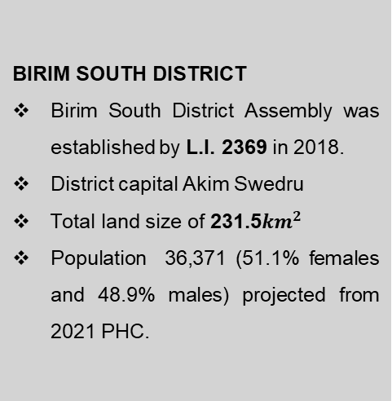
  STRATEGIC OVERVIEW OF BIRIM SOUTH DISTRICT
ESTABLISHMENT
DISTRICT ECONOMY
SECTORS OF THE ECONOMY
BIRIM SOUTH DISTRICT
Birim South District Assembly was established by L.I. 2369 in 2018.
District capital Akim Swedru
Total land size of 231.5${km}^{2}$
Population 36,371 (51.1% females and 48.9% males) projected from 2021 PHC.
Agriculture being the main occupation of the district with majority into crop production (50% of economically active population)
Wholesale & retail 20%, Services 20% and Manufacturing 5%.
EDUCATION (LEVELS)
The number of schools in the District at each level: 25-KG, 23-Primary, 20-JHS, 1-SHS, 1-TVET.
1-KG, 1 primary school, 1 JHS and 1-TVET are under construction.
HEALTH
The District has 9 CHPS compounds, 2 Health Centres, 1 Clinic.
1 District hospital is under construction.
PHYSICAL ENVIRONMENT
Road coverage: 121.0km
Bitumen covers 29.1km (24%).
Earth surface roads 91.9km (76%)
TOURISM / HOSPITALITY
Potential tourist sites:
Aboye confluence
Birim forest range
MARKET
There are three main market facilities in the district. (Swedru, Awisa, and Aduasa Markets).
Tuesdays and Fridays are the main market days for Aduasa whilst Wednesdays is for Swedru.
Lockable stores: 67
Stalls: 59
SANITATION
3 functional public toilets
1 WC public toilet under rehabilitation in Swedru.
11 skip containers across the district.

Slide 3
KEY CHALLENGES
Poor Road and Drainage infrastructure
Inadequate Sanitary Facilities
Inadequate basic school infrastructure
Limited access to Health Services
Inadequate market infrastructure
Low capacity of Substructures
Haphazard settlements and non-compliance to available planning schemes
High cost of Agricultural Inputs
Low Internal Revenue Generation
Inadequate support for vulnerable groups, ie. PLWHAs and PWDs
Inadequate support for Child Protection Activities

Slide 4









VISION, MISSION & CORE VALUES OF BIRIM SOUTH DISTRICT
Vision
C
Core Values
A
B
Mission
C
Transparency & Accountability
Client-oriented
Creativity and Innovativeness
Diligence and Discipline
Equity and Integrity
Timeliness
A world class local government institution promoting well-being and total peace.
To improve the living standards of its citizens through sustainable socio-economic development and effective institutions that are responsive to the needs of people.

Slide 5
CORE FUNCTIONS OF THE DISTRICT
The functions exercised by the Assembly are deliberative, legislative as well as executive. The specific functions among others as stipulated in the Local Governance Act of 2016, Act 936 include:
Responsible for the development, improvement and management of human settlements and the environment in the district;
The Assembly takes steps and measures that are necessary and expedient to execute approved development plans for the district;
Guide, encourage and support sub-district local structures, public agencies and local communities to perform their functions in the execution of approved development plans;
Initiate and encourage joint participation with other persons or bodies to execute approved development plans;
Promote or encourage other persons or bodies to undertake projects under approved development plans; and
Monitor the execution of projects under approved development plans and assess and evaluate their impact on the development of the district and national economy in accordance with government policy.
Exercise political and administrative authority in the district.
4

Slide 6
DISTRICT ADOPTED POLICY OBJECTIVES FOR 2023
FOCUS AREA | ADOPTED POLICY OBJECTIVE
Local Governance and Decentralisation | Deepen Political and Administrative Decentralization
Strong and resilient economy | Strengthen domestic resource mobilization to improve capacity for revenue collection
Agriculture and rural development | Create an enabling agribusiness environment
Education and training | Enhance equitable access to and participation in quality education at all levels.
Health and health services | Ensure accessible, and quality Universal Health Coverage (UHC) for all.
Child protection and development | Prevent and protect children from all forms of violence, abuse, neglect and exploitation.
Gender equality | Attain gender equality and equity in political, social and economic development
 | Promote economic empowerment of particularly women

Slide 7
DISTRICT ADOPTED POLICY OBJECTIVES FOR 2023
FOCUS AREA | ADOPTED POLICY OBJECTIVE
Disability-inclusive development | Implement social protection systems and measures for the poor and vulnerable.
Reducing poverty and Inequality | Eradicate poverty and address vulnerability to poverty in all forms and dimensions.
Drainage and flood control | Address recurrent devastating floods
Human settlement development and housing | Promote sustainable spatially integrated development of human settlement
Water and Environmental Sanitation | Improve access to safe reliable and sustainable water supply services for all.
 | Enhance access to improved and sustainable environmental sanitation services.
Transport Infrastructure: Roads | Improve efficiency and effectiveness of road transport infrastructure and services.

Slide 8
Financial Performance - Revenue
REVENUE PERFORMANCE- IGF ONLY
ITEM | 2021 |  | 2022 |  | 2023
 | Budget | Actual | Budget | Actual | Budget | REVISED | Actual as at August | % performance as at August
Property Rate | 66,300.00 | 76,507.38 | 99,873.00 | 62,359.60 | 103,270.00 | 60,000.00 | 590.00 | 0.27
Basic Rates | 200.00 | 93.6 | 200.00 | 108.00 | 200.00 | 200.00 | 86.40 | 0.04
Fees | 58,610.00 | 27,254.50 | 50,150.00 | 48,145.00 | 65,355.00 | 55,355.00 | 14,147.00 | 6.57
Fines | 3,800.00 | 400.00 | 3,800.00 | 2,400.00 | 4,650.00 | 3,800.00 | 200.00 | 0.09
Licenses | 95,350.00 | 66,184.25 | 77,750.00 | 95,733.26 | 98,472.00 | 78,472.00 | 41,918.44 | 19.48
Land | 27,500.00 | 62,646.43 | 56,796.00 | 96,098.00 | 82,000.00 | 60,000.00 | 38,977.00 | 18.11
Rent | 85,000.00 | 300.00 | 62,000.00 | 16,425.00 | 37,000.00 | 25,000.00 | 8,953.00 | 4.16
Investment | 0.00 | 0.00 | 0.00 | 0.00 | 0.00 | 0.00 | 0.00 | 0.00
Sub-Total | 336,760.00 | 233,386.16 | 350,569.00 | 319,268.86 | 390,947.00 | 282,827.00 | 104,871.84 | 48.73
Royalties | 80,000.00 | 111,000.00 | 100,350.00 | 95,000.00 | 100,350.00 | 134,047.00 | 110,355.66 | 51.27
Total | 416,760.00 | 344,386.16 | 450,919.00 | 414,268.86 | 491,297.00 | 416,874.00 | 215,227.50

Slide 9
Financial Performance - Revenue
REVENUE PERFORMANCE- ALL REVENUE SOURCES
ITEM |  | 2021 |  | 2022 |  | 2023
 |  | Budget | Actual | Budget | Actual | Budget | Actual as at August | % performance as at August
IGF |  | 416,760.00 | 344,386.16 | 450,919.00 | 414,268.86 | 416,874.00 | 215,227.50 | 51.63
Compensation of Employee |  | 1,247,369.17 | 2,999,325.24 | 1,622,171.00 | 2,415,609.91 | 2,604,566.00 | 2,006,534.63 | 77.04
Goods and Services Transfer |  | 89,441.00 | 52,558.71 | 113,134.00 | 34,278.24 | 56,000.00 | 23,710.24 | 42.34
Assets Transfer |  | 0.00 | 0.00 | 25,180.00 | 0.00 | 25,180.00 | 0.00 | 0.00
DACF | Assembly | 4,202,117.49 | 1,168,944.70 | 4,905,399.54 | 1,242,942.60 | 2,901,547.00 | 701,478.31 | 24.18
 | MP | 500,000.00 | 354,652.07 | 500,000.00 | 335,649.10 | 500,000.00 | 361,475.49 | 72.30
 | HIV/Malaria | 21,116.11 | 5,842.11 | 34,701.00 | 16,324.77 | 14,580.00 | 0.00 | 0.00
 | PWD | 190,045.00 | 78,703.65 | 316,163.00 | 164,039.55 | 178,983.00 | 46,099.90 | 25.76
DACF-RFG |  | 1,329,237.40 | 320,160.00 | 2,002,808.84 | 1,134,512.80 | 1,525,054.00 | 0.00 | 0.00
MAG |  | 108,564.00 | 86,811.96 | 78,889.12 | 78,899.12 | 59,099.00 | 59,098.63 | 99.99
Covid Funds |  | 10,000.00 | 10,000.00 | 0.00 | 0.00 | 0.00 | 0.00 | 0.00
Total |  | 8,114,650.17 | 5,421,384.60 | 10,049,365.50 | 5,836,524.95 | 8,281,883.00 | 3,413,624.70 | 41.22

Slide 10
Financial Performance – Expenditure Cont’d.
EXPENDITURE PERFORMANCE (ALL DEPARTMENTS) IGF ONLY
Expenditure | 2021 |  | 2022 |  | 2023
 | Budget | Actual | Budget | Actual | Budget | Actual as at August | % age Performance as at August
Compensation of Employees | 100,712.00 | 92,557,09 | 108,835.00 | 102,587.89 | 106,100.00 | 42,742.50 | 40.29
Goods and Services | 232,696.00 | 247,675.79 | 251,900.00 | 299,237.72 | 227,399.20 | 148,350.75 | 65.24
Assets | 83,352.00 | 4,536.00 | 90,184.00 | 0.00 | 83,374.80 | 20,707.20 | 24.84
Total | 416,760.00 | 344,768.88 | 450,919.00 | 401,825.61 | 416,874.00 | 211,800.45 | 50.81

Slide 11
Financial Performance – Expenditure Cont’d.
EXPENDITURE PERFORMANCE (ALL DEPARTMENTS) ALL FUNDING SOURCES
Expenditure | 2021 |  | 2022 |  | 2023
 | Budget | Actual | Budget | Actual | Budget | Actual as at August | % age Performance as at August
Compensation of Employees | 1,348,081.17 | 3,091,882.33 | 1,731,006.00 | 2,518,197.80 | 2,710,666.00 | 2,049,277.13 | 75.60
Goods and Services | 2,745,342.00 | 1,732,184.34 | 3,084,173.50 | 2,627,002.51 | 2,431,561.20 | 1,453,746.47 | 59.79
Assets | 4,021,227.00 | 600,361.43 | 5,234,186.00 | 1,045,190.34 | 3,139,655.80 | 276,721.50 | 8.81
Total | 8,114,650.17 | 5,424,428.10 | 10,049,365.50 | 6,190,390.65 | 8,281,883.00 | 3,779,745.10 | 45.64

Slide 12
2023 Budget Programme Performance
Budget Programme | Budget | Actual as at August 2023
Management and Administration | 3,203,568.20 | 2,369,162.89
Social Services Delivery | 1,780,953.00 | 588,663.91
Infrastructure Delivery and Management | 2,358,052.80 | 465,225.89
Economic Development | 899,309.00 | 326,757.41
Environmental Management | 40,000.00 | 29,935.00
Total | 8,281,883.00 | 3,779,745.10

Slide 13
2023 Key projects and programmes from all funding sources
No | Name of project | Amount budgeted | Actual Payment as at August, 2023 | Outstanding payment
1. | Completion of 5-Bedroom Bungalow for District Chief Executive at Akim Swedru | 297,757.39 | 73,115.55 | 224,641.84
2. | Completion of 1 no 2-unit KG-Block with ancillary facilities and furniture at Akim Aduasa | 252,956.00 | 223,196.40 | 29,759.60
 | Total | 550,713.39 | 296,311.95 | 254,401.44

Slide 14
NON FINANCIAL PERFORMANCE BY PROGRAMMES

Slide 15
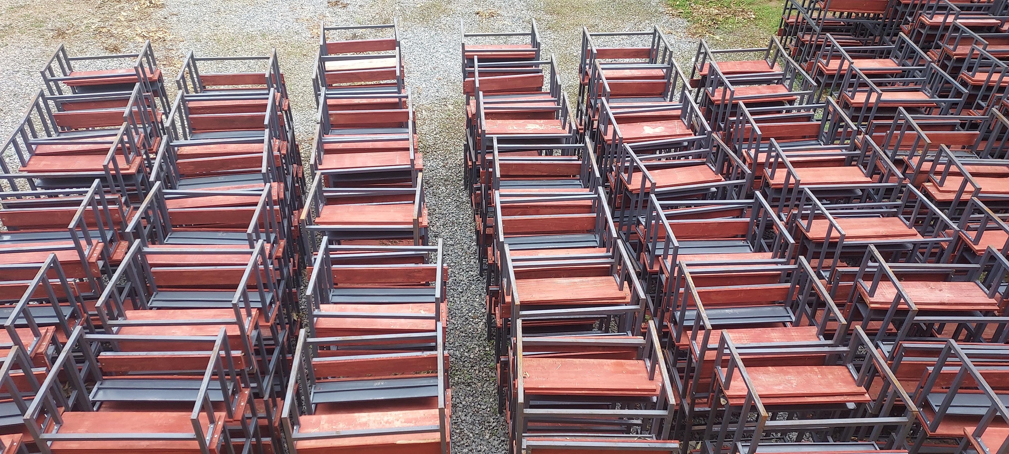
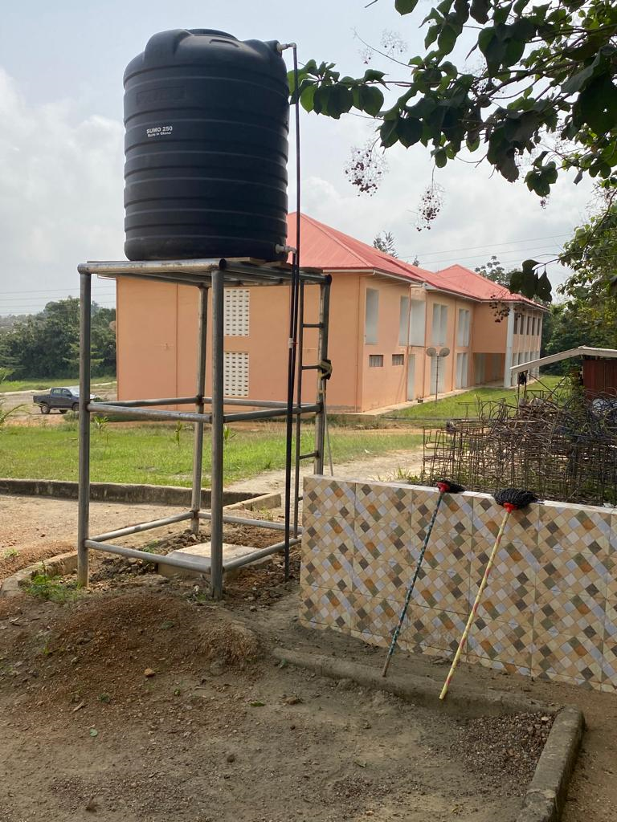
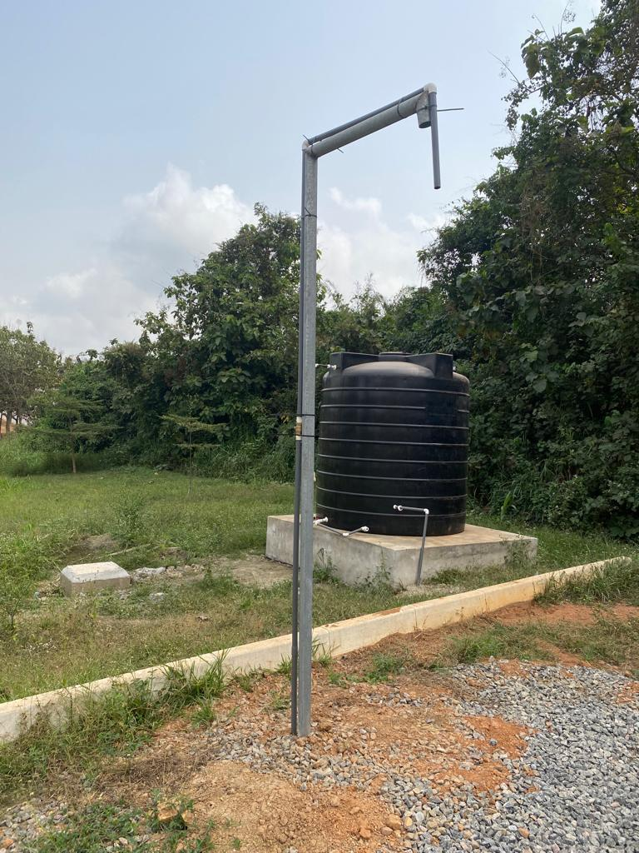
KEY ACHIEVEMENTS (2023)
PHYSICAL INFRASTRUCTURAL DEVELOPMENT
EDUCATION
WATER
Completed 7No. Mechanized Boreholes at New Salem, GES, Aduasa ICT Centre, Asawase, Mount Calvary, Catholic Clinic and Adeeto.
Drilled & constructed 1No. Mechanized borehole @Akim Swedru
400 pieces of dual desks were distributed to public schools.

Slide 16
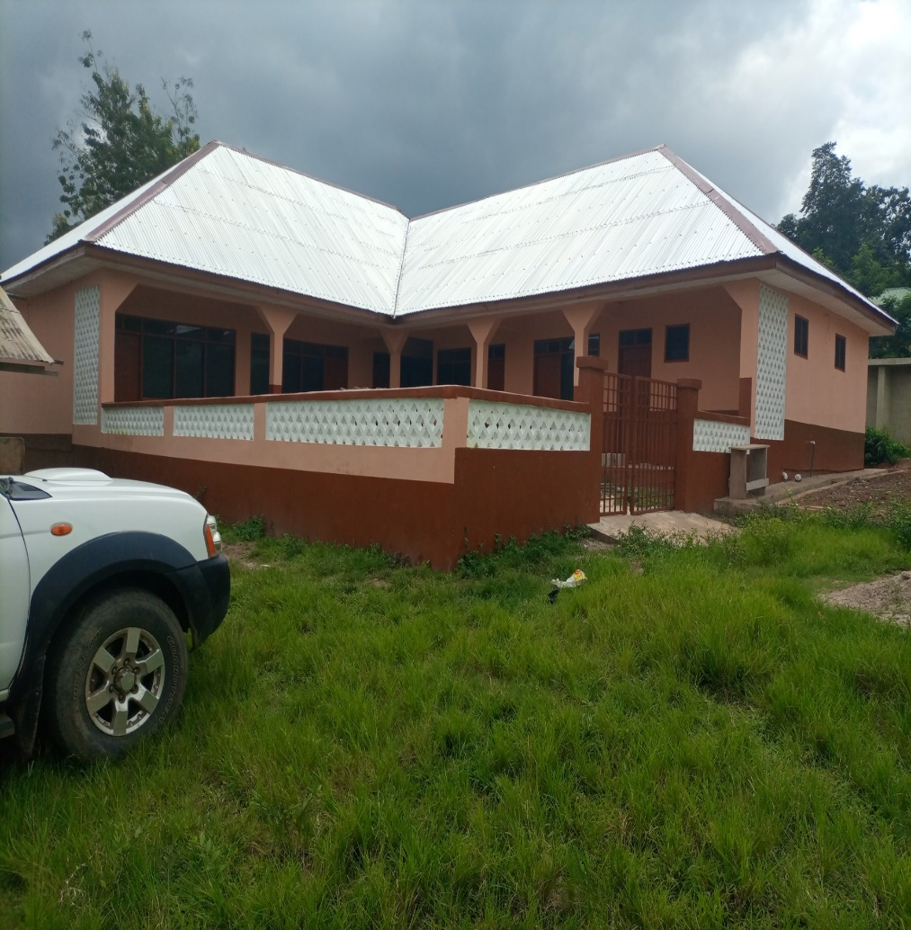
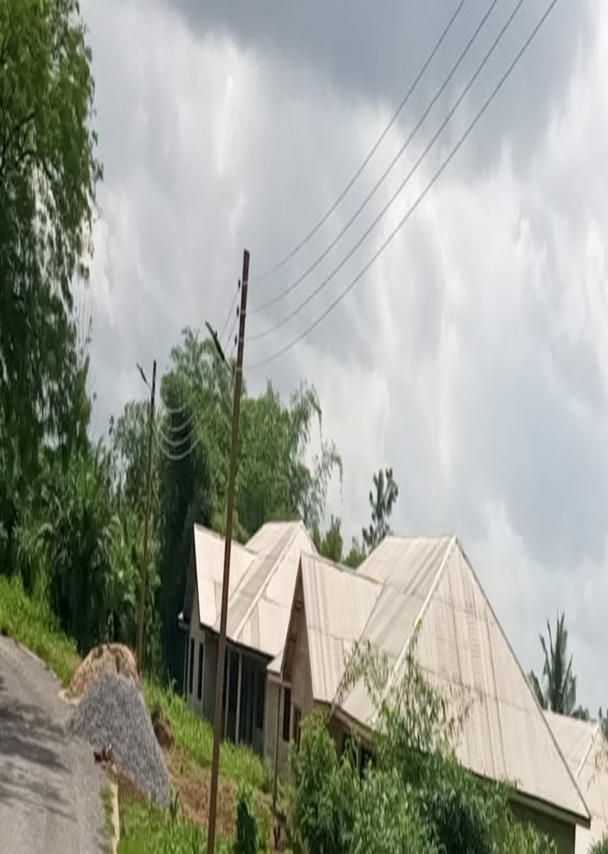
KEY ACHIEVEMENTS (2023)
EDUCATION
Construction of 1No. 2-unit KG Block with ancillary facilities and furniture at Akim Aduasa.
ENERGY
Extension of electricity to AKISS, Assembly Area, New Salem, Awisa Camp, Awisa Railine, Atuntumirem, Mount Calvary, Official Town and Akwatisu

Slide 17
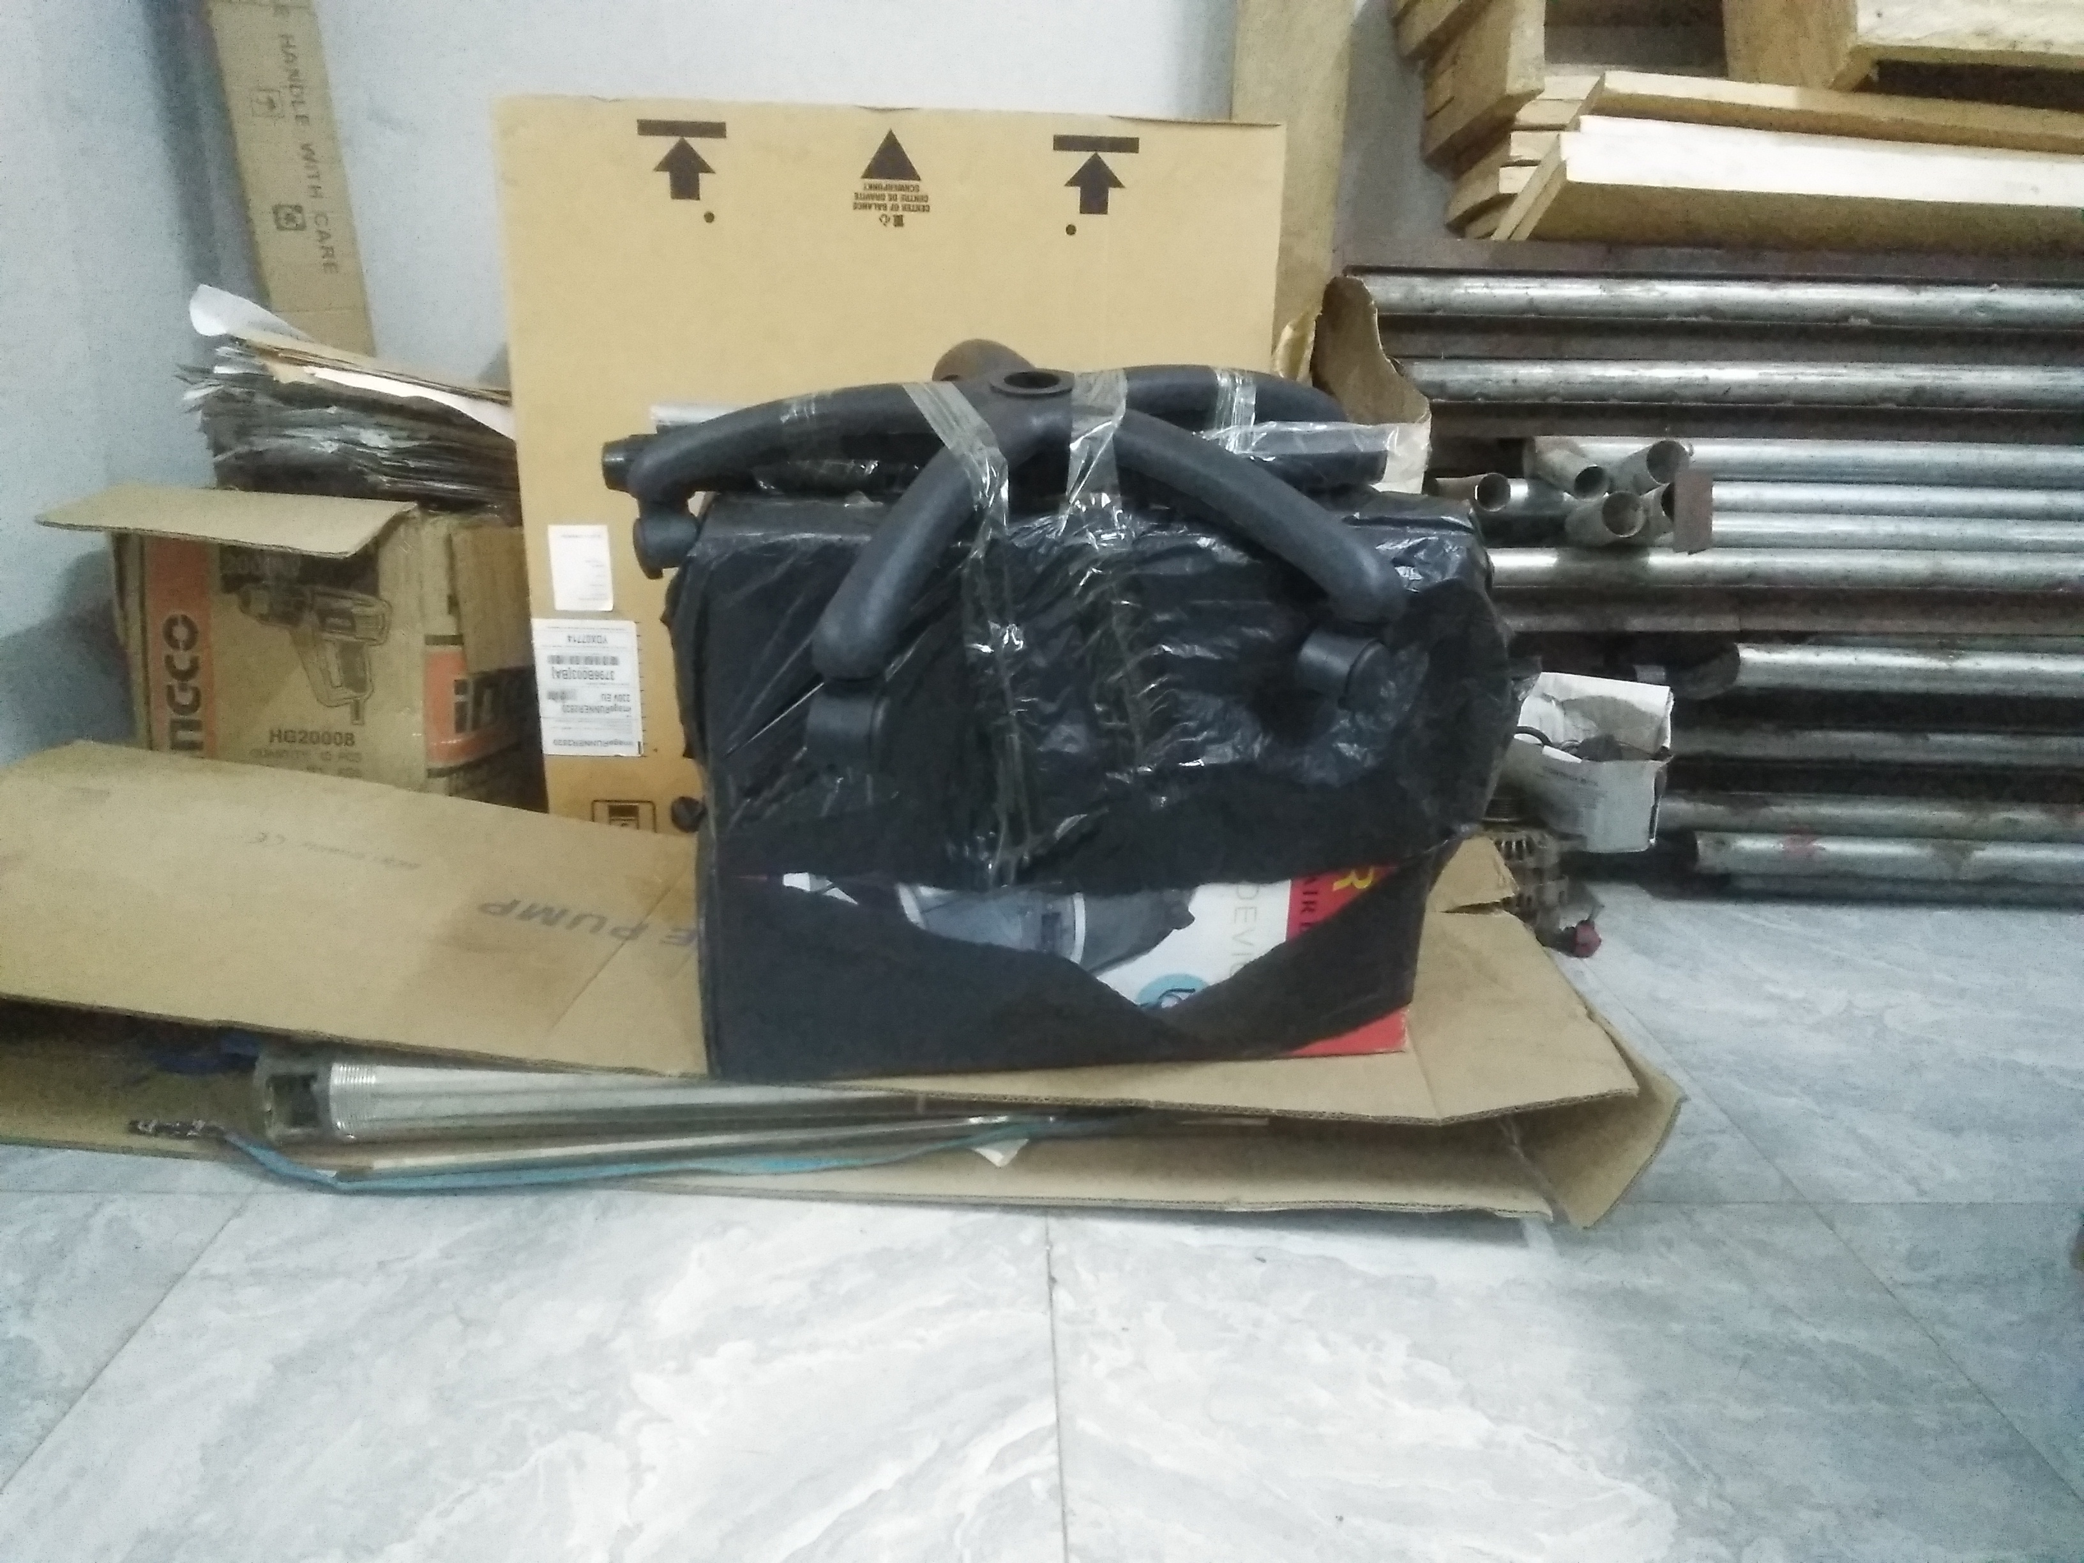
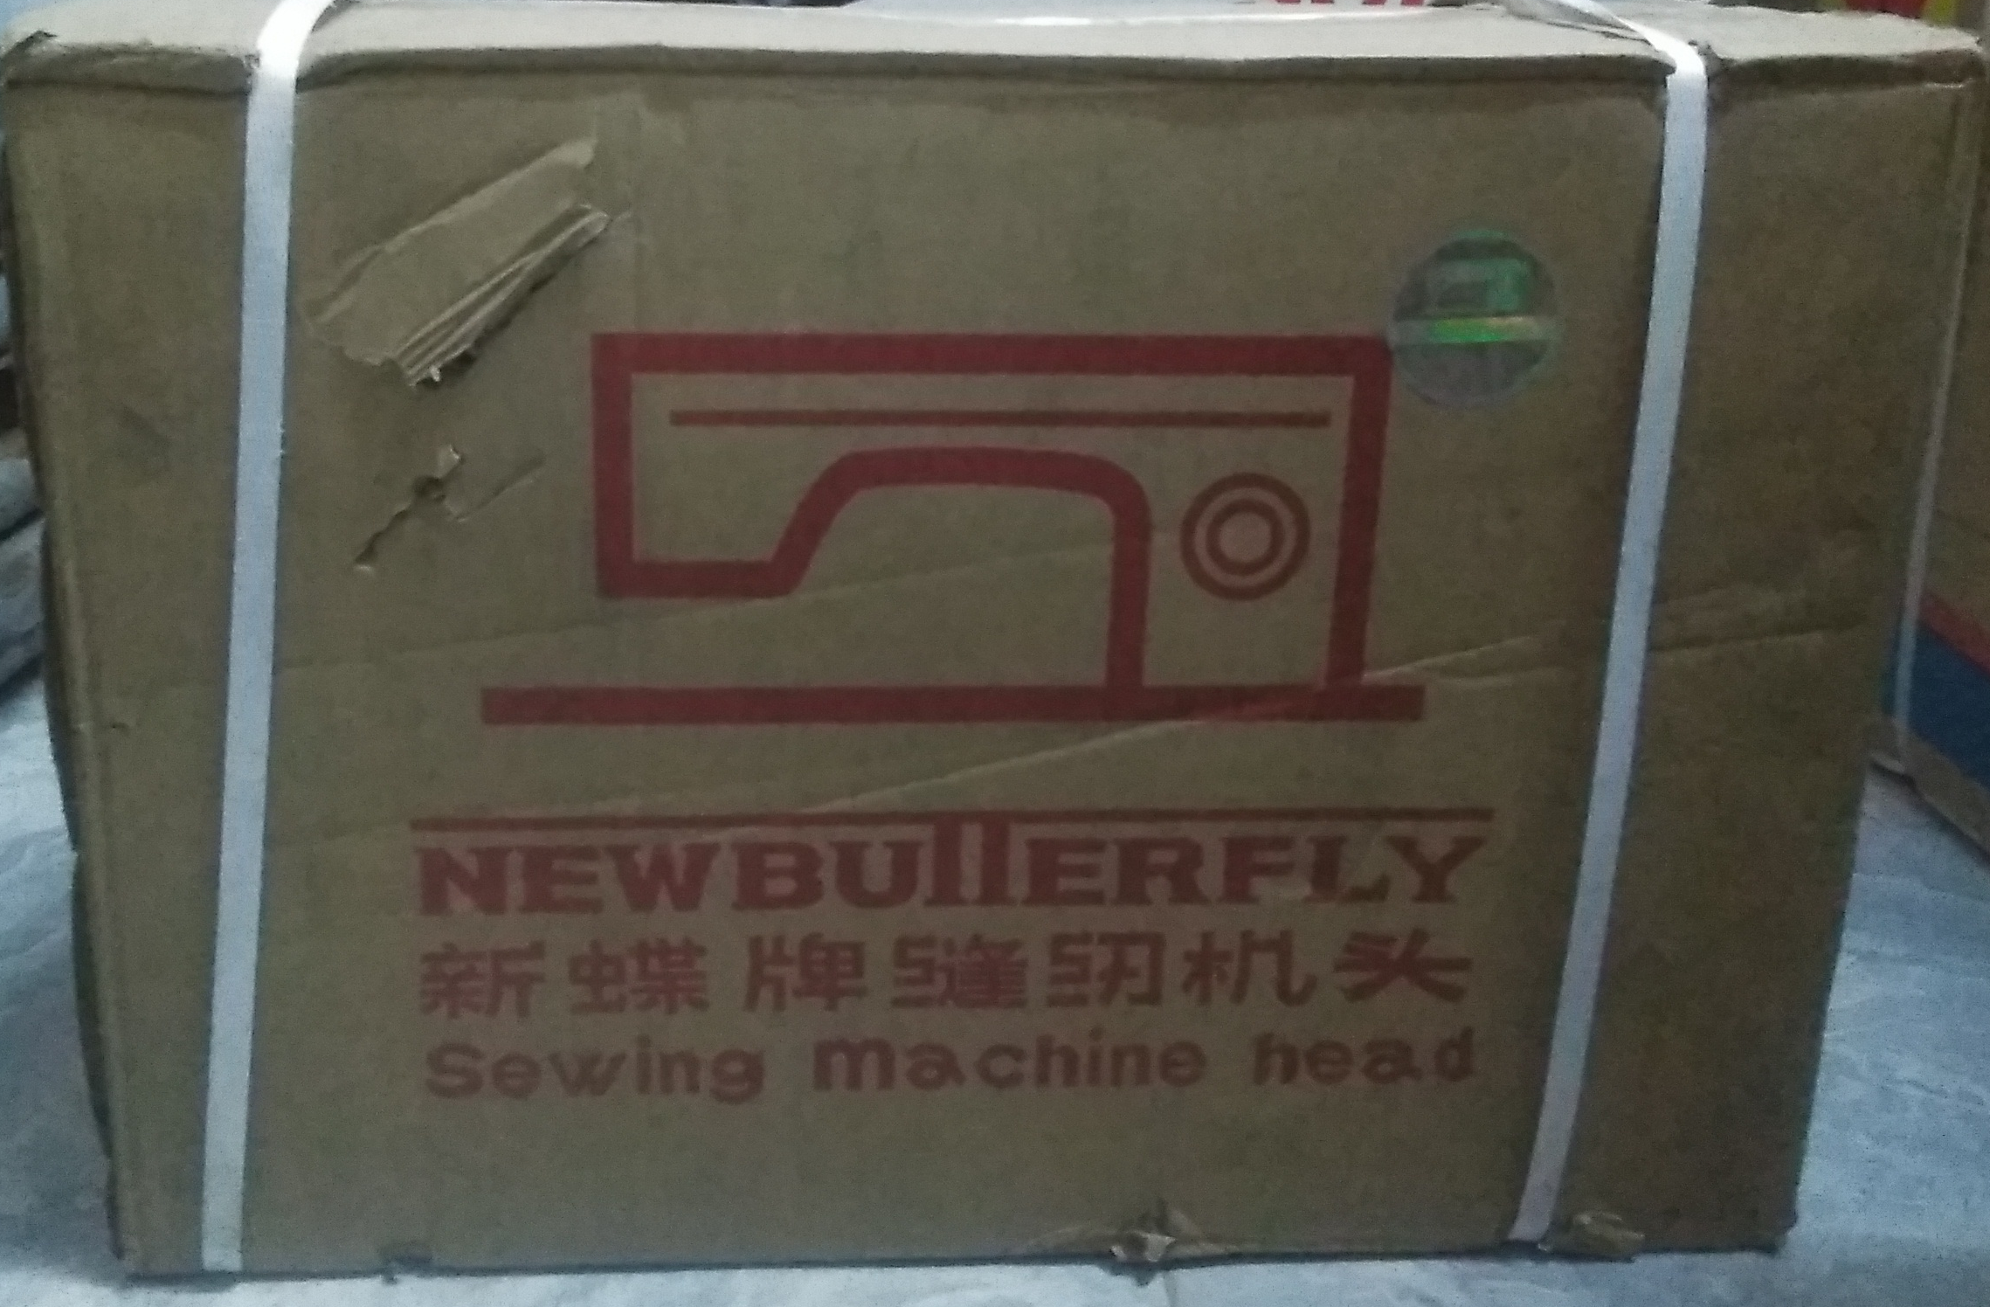
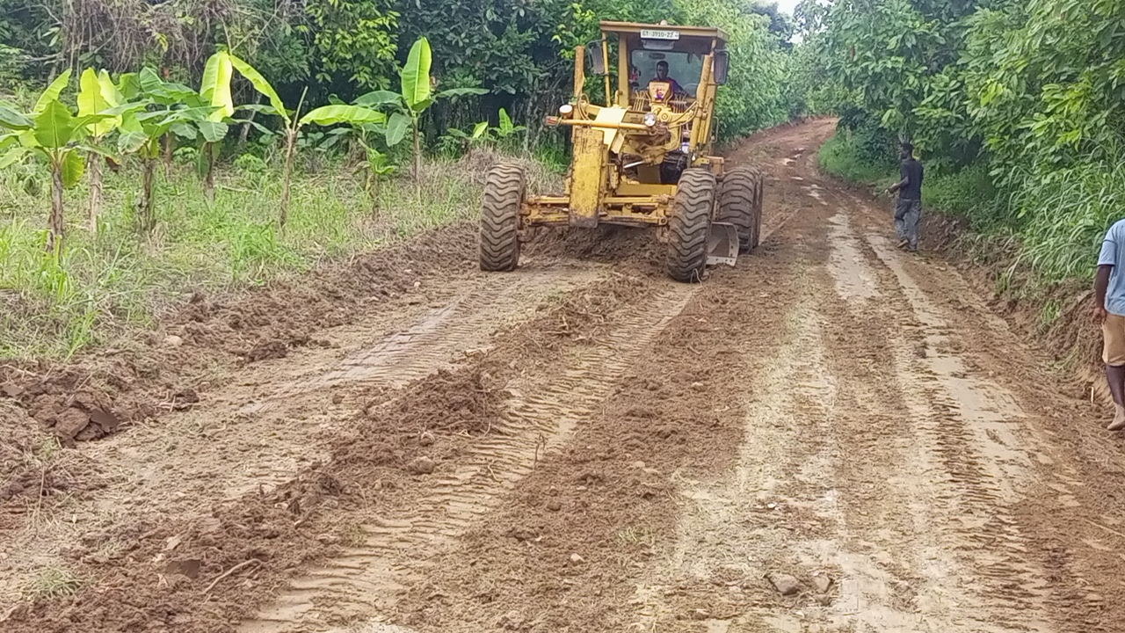
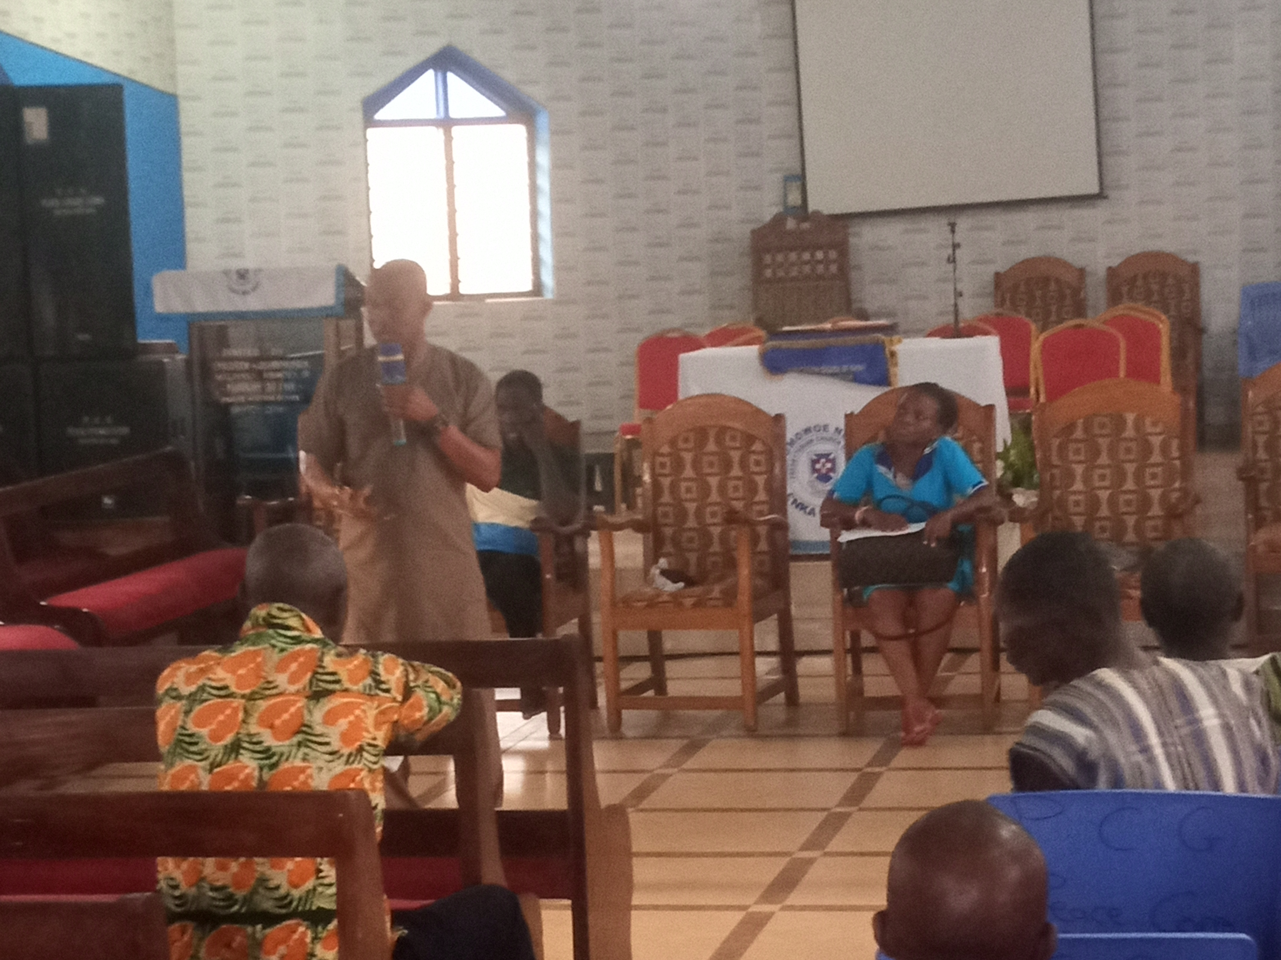
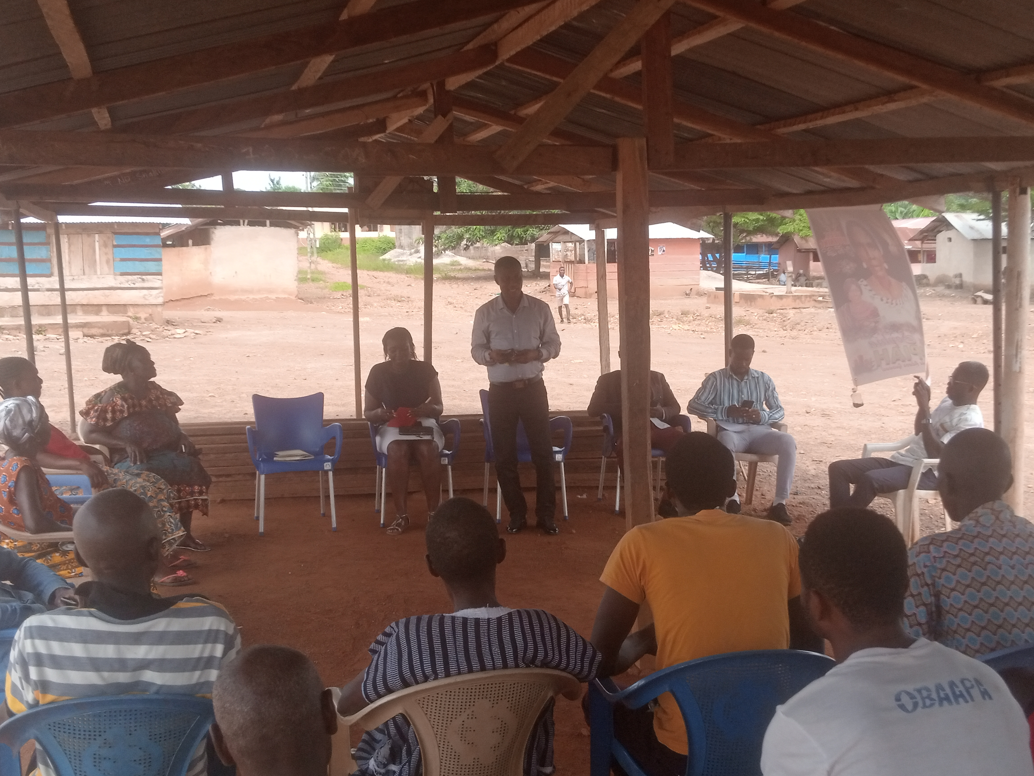
KEY ACHIEVEMENTS (2023)
TRANSPORTATION
APPRENTICESHIP
  Reshaped 25.9km Feeder Roads (Brepro Jn.-Kroboase, Sabentua-Adenkyensu, Fosukrom Jn.-Fosukrom and Akortekrom-Mensakrom-Achiasehene Akura)
55 Butterfly Sewing Machines and 50 Hair dryers were donated by MP to the apprentices in the district.
DCE’S COMMUNITY ENGAGEMENT ON GOVERNMENT FLAGSHIP PROGRAMS AND ANTI-GALAMSEY AT AKIM ADUASA AND OFORIKROM

Slide 18
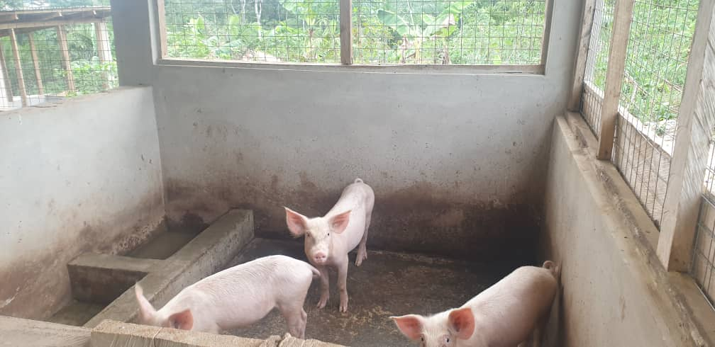
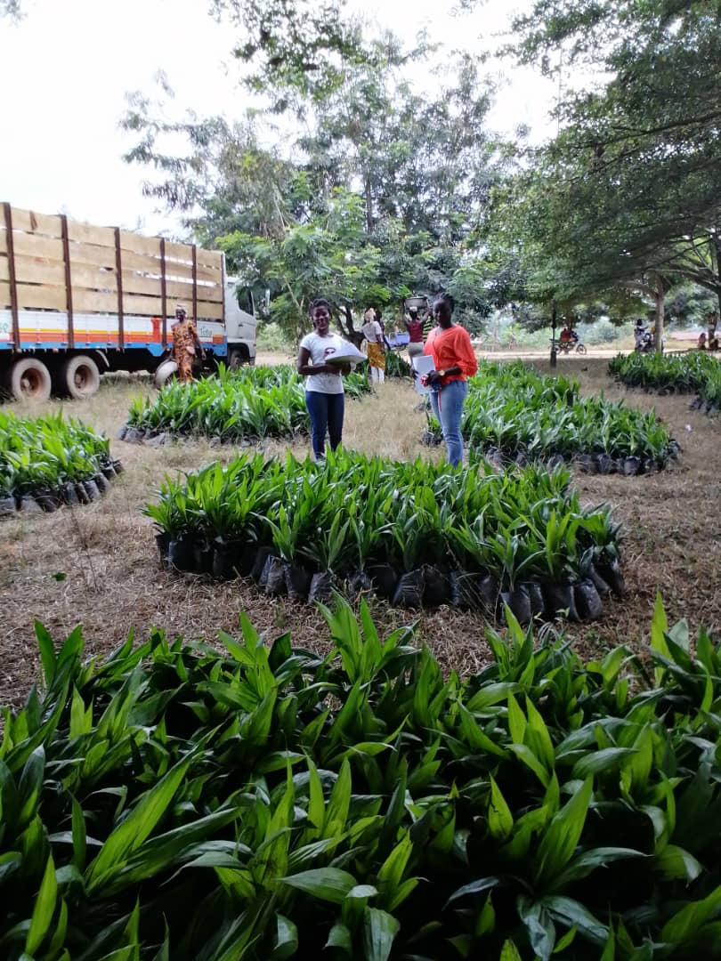
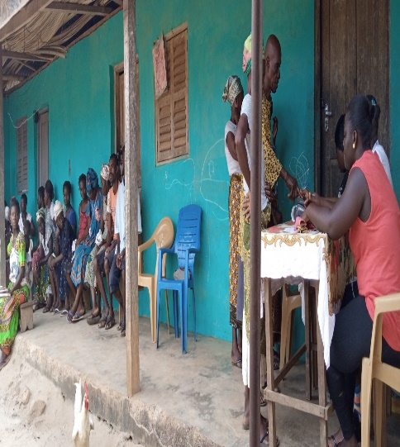
KEY ACHIEVEMENTS (2023)
SOCIAL WELFARE
ECONOMIC DEVELOPMENT
  Supervised payment of funds to 619 LEAP beneficiary households in 23 communities during the 83rd, 84th, 85th and 86th payment cycles.
  Sensitized the public in 5 communities on the effect of child labour and related issues during World’s Day against child labour.
  Supported NHIA to carry out free renewal of NHIS cards for 1,287 indigents, and registered 572 indigents in 10 communities onto the NHIS.
  Oil palm
  A total of 34,164 oil palm seedlings were distributed.
  413 farmers benefited from the seedlings.
  Coconut farming
  8,000 seedlings were distributed
  82 farmers benefited
  Rearing of farm animals
  20 piglets were distributed
  04 farmers benefited

Slide 19
POLICY OUTCOME INDICATORS AND TARGETS
Outcome Indicator Description | Unit of Measurement | Previous year’s performance (2022) |  | Current year’s Actual Performance (2023)
 |  | Target | Actual | Target | Actuals as at August
Improved access to basic education | Net Enrolment Rate
 | i. KG | 70.0% | 50.3% | 68.2% | 51.5%
 | ii. Primary | 61.8% | 52.6% | 62.0% | 48.1%
 | iii. JHS | 30.0% | 29.1% | 35.0% | 30.2%
Enhanced farmers access to better services (subsidized agricultural inputs) | Proportion of Farmers with access to government subsidies | 6.0% | 5.8% | 7.0% | 6.3%

Slide 20
POLICY OUTCOME INDICATORS AND TARGETS
Outcome Indicator Description | Unit of Measurement | Previous year’s performance (2022) |  | Current year’s Actual Performance (2023)
 |  | Target | Actual | Target | Actuals as at August
Improved access to health care | Proportion of the population with valid NHIS cards disaggregated by Gender | Male: 50% Female: 50% | Male: 42.7% Female: 57.3% | Male: 50% Female: 50% | Male: 41.2% Female: 58.8%
Improved access to sanitation | Percentage change in sanitation coverage | 10% | 5% | 10% | 7%

Slide 21
Sanitation Budget Performance
Liquid Waste
No. | Name of Activity/Project | Budget | Actuals as at August, 2023
1. | Dislodging & Repair of 5 Assembly Toilets | 30,000.00 | 13,000.00
2. | Fumigation | 161,000.00 | 123,087.20
 | Total | 191,000.00 | 136,087.20
Solid Waste
No. | Name of Activity/Project | Budget | Actuals as at August, 2023
1. | Clearing and Leveling of Refuse Sites | 160,000.00 | 146,725.77
2. | Refuse Evacuation | 30,000.00 | 18,000.00
 | Total | 190,000.00 | 164,725.77

Slide 22
DP SUPPORTED PROGRAMMES (MODERNIZATION OF AGRICULTURE IN GHANA)
Modernization of Agriculture in Ghana (MAG)
No | Name of Activity/Project | Budget | Actual as at August, 2023
1. | Printed Material and Stationary | 1,000.00 | 1,000.00
2. | Feeding Cost | 8,620.00 | 5,652.00
3. | Chemicals and Consumables | 3,880.00 | 2,545.00
4. | Telecommunications | 200.00 | 100.00
5. | Maintenance and Repairs – Official Vehicle | 3,800.00 | 1,293.34
6. | Running Cost – Official Vehicle | 14,559.00 | 8,150.00
7. | Other Travel and Transport | 27,040.00 | 14,900.00
 | TOTAL | 59,099.00 | 33,640.34

Slide 23
Government Flagship Projects or Programmes
No | Name of Activity/Project | Budget | Actual as at August, 2023
1. | Planting for Food and Jobs
 | Sensitization of 3,550 farmers on PFJ | 10,000.00 | 4,000.00
 | Awareness Creation on the use of improved seedlings and fertilizer application | 10,000.00 | 5,000.00
 | Raising 12,000 seedlings | 20,000.00 | 10,000.00
 | Training 483 oil palm farmers on fertilizer application | 10,000.00 | 3,000.00
 | Training 483 farmers on good management practices | 10,000.00 | 8,000.00
 | Total | 60,000.00 | 30,000.00

Slide 24
Outlook For 2024

Slide 25
DISTRICT ADOPTED POLICY OBJECTIVES FOR 2024
FOCUS AREA | ADOPTED POLICY OBJECTIVE | BUDGET ALLOCATION
Local Governance and Decentralisation | Deepen Political and Administrative Decentralisation | 285,119.02
Strong and resilient economy | Strengthen domestic resource mobilization to improve capacity for revenue collection | 120,000.00
Agriculture and rural development | Create an enabling agribusiness environment | 944,390.40
Education and training | Enhance equitable access to and participation in quality education at all levels. | 393,323.00
Health and health services | Ensure accessible, and quality Universal Health Coverage (UHC) for all. | 356,690.50
Child protection and development | Prevent and protect children from all forms of violence, abuse, neglect and exploitation. | 13,000.00
Gender equality | Attain gender equality and equity in political, social and economic development | 12,000.00
 | Promote economic empowerment of particularly women

Slide 26
DISTRICT ADOPTED POLICY OBJECTIVES FOR 2024
FOCUS AREA | ADOPTED POLICY OBJECTIVE | BUDGET ALLOCATION
Disability-inclusive development | Implement social protection systems and measures for the poor and vulnerable. | 178,983.00
Reducing poverty and Inequality | Eradicate poverty and address vulnerability to poverty in all forms and dimensions. | 368,331.15
Drainage and flood control | Address recurrent devastating floods | 205,806.39
Human settlement development and housing | Promote sustainable spatially integrated development of human settlement | 832,098.55
Water and Environmental Sanitation | Improve access to safe reliable and sustainable water supply services for all. | 200,000.36
 | Enhance access to improved and sustainable environmental sanitation services. | 1,272,717.88
Transport Infrastructure: Roads | Improve efficiency and effectiveness of road transport infrastructure and services. | 311,778.50
Total |  | 5,494,238.75

Slide 27
POLICY OUTCOME INDICATORS AND TARGETS
Outcome Indicator Description | Unit of Measurement | Baseline (2022) |  | Current year (2023) |  |  | Budget year (2024) |  | Indicative year (2025) | Indicative year (2026) | Indicative year (2027)
 |  | Target | Actual | Target | Actual as at August |  | Target |  | Target | Target | Target
Improved access to basic education | Net Enrolment Rate
 | i. KG | 70.0% | 50.3% | 68.2% | 51.5% | 51.5% | 53.3% | 53.3% | 55.3% | 58.3% | 60.3%
 | ii. Primary | 61.8% | 52.6% | 62.0% | 48.1% | 48.1% | 50.3% | 50.3% | 53.5% | 56.1% | 59.3%
 | iii. JHS | 30.0% | 29.1% | 35.0% | 30.2% | 30.2% | 34.1% | 34.1% | 37.4% | 40.8% | 42.2%
Enhanced farmers access to better services (subsidized agricultural inputs) | Proportion of Farmers with access to government subsidies | 6.0% | 5.8% | 7.0% | 6.3% | 6.3% | 8% | 8% | 9% | 10% | 11%
Improved access to health care | Proportion of the population with valid NHIS card disaggregated by Gender | Male: 50% Female: 50% | Male: 42.7% Female: 57.3 % | Male: 50% Female: 50% | Male: 41.2% Female: 58.8% | Male: 41.2% Female: 58.8% | Male: 50% Female: 50% | Male: 50% Female: 50% | Male: 50% Female: 50% | Male: 50% Female: 50% | Male: 50% Female: 50%

Slide 28
POLICY OUTCOME INDICATORS AND TARGETS
Outcome Indicator Description | Unit of Measurement | Baseline (2022) |  | Current year (2023) |  | Budget year (2024) | Indicative year (2025) | Indicative year (2026) | Indicative year (2027)
 |  | Target | Actual | Target | Actual as at August | Target | Target | Target | Target
Improved access to sanitation | Percentage change in sanitation coverage | 10% | 5% | 10% | 7% | 10% | 10% | 10% | 10%

Slide 29
2024-2027 Revenue Projections – IGF Only
ITEM | 2023 |  | 2024 | 2025 | 2026 | 2027
 | Budget | Actual as at August | Projection | Projection | Projection | Projection
Property Rate | 60,000.00 | 590.00 | 60,000.00 | 61,200.00 | 62,424.00 | 63,672.48
Basic Rates | 200.00 | 86.40 | 200.00 | 204.00 | 208.08 | 212.24
Fees | 55,355.00 | 14,147.00 | 55,355.00 | 56,462.10 | 57,591.34 | 58,743.17
Fines | 3,800.00 | 200.00 | 3,800.00 | 3,876.00 | 3,953.52 | 4,032.59
Licenses | 78,472.00 | 41,918.44 | 78,472.00 | 80,041.44 | 81,642.27 | 83,275.11
Land | 60,000.00 | 38,977.00 | 60,000.00 | 61,200.00 | 62,424.00 | 63,672.48
Rent | 25,000.00 | 8,953.00 | 25,000.00 | 25,500.00 | 26,010.00 | 26,530.20
Investment | 0.00 | 0.00 | 0.00 | 0.00 | 0.00 | 0.00
Sub-Total | 282,827.00 | 104,871.84 | 282,827.00 | 288,483.54 | 294,253.21 | 300,138.28
Royalties | 134,047.00 | 110,355.66 | 134,047.00 | 136,727.94 | 139,462.50 | 142,251.75
Total | 416,874.00 | 215,227.50 | 416,874.00 | 425,211.48 | 433,715.71 | 442,390.02

Slide 30
REVENUE IMPROVEMENT ACTION PLAN FOR 2024
OBJECTIVE | ACTIVITIES/STRATEGIES | QUARTER |  |  |  | EXPECTED OUTPUT | ESTIMATED COST (GH₵) | FUNDING SOURCE | IMPLEMENTATION AGENCY | COLLABORATORS
 |  | 1 QTR | 2 QTR | 3 QTR | 4 QTR
Strengthen Domestic Resource Mobilization | Rehabilitation of 12-Unit Water Closet with Borehole at Akim Swedru. |  |  |  |  | Fees increased by 2% | 198,584.00 | DACF | DA | Works Dept.
 | Update revenue database by March, 2024 |  |  |  |  | Business operating fees to increase by 2% | 20,000.00 | IGF/ DACF | Budget unit/ finance dept | Area Councils
 | Mount Revenue Post |  |  |  |  | Revenue performance levels to be increased | 15,000.00 | IGF | Finance dept /Works dept | Revenue Collectors
 | Empower taskforce to ensure land property developers pay approved fees |  |  |  |  | Increase in land and buildings by 5% | 10,000.00 | DACF | DA | Works Dept.
 | Sensitize stakeholder/revenue education |  |  |  |  | Responsiveness to revenue mobilization to improve | 5,000.00 | IGF | Budget unit/ Finance Dept | Stakeholders
 | Train revenue collectors on fee fixing and revenue collection strategies |  |  |  |  | Revenue collection to be increased by 5% | 10,000.00 | IGF/ DACF | Budget unit/ Finance Dept | HR Dept.
 | Construction of 1No. 10-Units Satellite Market at AKOTEKROM |  |  |  |  | Rent Increased by 2% | 220,000.00 | DACF-RFG | DA | Works Dept.
TOTAL |  |  |  |  |  |  | 478,584.00

Slide 31
REVENUE MOBILIZATION STRATEGIES FOR KEY REVENUE SOURCES
REVENUE SOURCE | KEY STRATEGIES
1. RATES (Basic Rates/Property Rates) | Basic Rate: Adding the Basic Rate component to all B.O. Ps and all other charges to reduce the cost of collection and make collection easier. Property Rates: Establishing and enforcing a Development Control Task Force. Provide logistical support for the Development Control Task Force.
2. LANDS | Undertake weekly monitoring of newly developed sites. Enforcing the payments of reclamation fees by sand winners. Provide logistical support for the Development Control Task Force. Organising monthly Spatial Planning Committee meetings
3. LICENSES | Public education on payment of fees. Review and update existing business database. Establish Task Force for revenue mobilization in the District. Gazette Bye-laws. Prosecute rate defaulters.

Slide 32
REVENUE MOBILIZATION STRATEGIES FOR KEY REVENUE SOURCES
REVENUE SOURCE | KEY STRATEGIES
4. RENT | Sensitize occupants of Government stores on the need to pay rent. Timely Issuance of demand notice. Prosecute defaulters.
5. FEES AND FINES | Sensitize various business operators by organising stakeholders’ consultative meetings. Formation of revenue monitoring team to check on the activities of revenue collectors, especially on market days.
6. REVENUE COLLECTORS | Quarterly rotation of revenue collectors. Setting target for revenue collectors. Train and resource revenue collectors on effective strategies of mobilizing revenue. Sanction underperforming revenue collectors. Awarding best performing revenue collectors.

Slide 33
2024-2027 Revenue Projections – All Revenue Sources
ITEM |  | 2023 |  | 2024 | 2025 | 2026 | 2027
 |  | Budget | Actual as at August | Projection | Projection | Projection | Projection
IGF |  | 416,874.00 | 215,227.50 | 416,874.00 | 425,211.48 | 433,715.71 | 442,390.02
Compensation of Employee |  | 2,604,566.00 | 2,006,534.63 | 4,269,918.00 | 4,355,316.36 | 4,442,422.69 | 4,531,271.14
Goods and Services Transfer |  | 56,000.00 | 23,710.24 | 93,500.00 | 95,370.00 | 97,277.40 | 99,222.95
Assets Transfer |  | 25,180.00 | 0.00 | 25,180.00 | 25,683.60 | 26,197.27 | 26,721.22
DACF | Assembly | 2,901,547.00 | 701,478.31 | 2,901,547.00 | 2,959,577.94 | 3,018,769.50 | 3,079,144.89
 | MP | 500,000.00 | 361,475.49 | 500,000.00 | 510,000.00 | 520,200.00 | 530,604.00
 | HIV/Malaria | 14,580.00 | 0.00 | 14,580.00 | 14,871.60 | 15,169.03 | 15,472.41
 | PWD Fund | 178,983.00 | 46,099.90 | 178,983.00 | 182,562.66 | 186,213.91 | 189,938.19
DACF-RFG |  | 1,525,054.00 | 0.00 | 1,443,889.00 | 1,472,766.78 | 1,502,222.12 | 1,532,266.56
MAG |  | 59,099.00 | 59,098.63 | 0.00 | 0.00 | 0.00 | 0.00
Total |  | 8,281,883.00 | 3,413,624.70 | 9,844,471.00 | 10,041,360.42 | 10,242,187.63 | 10,447,031.38

Slide 34
Expenditure By Budget Programme And Economic Classification-all Funding Sources
BUDGET PROGRAMME | AMOUNT GH¢
 | COMPENSATION OF EMPLOYEES | GOODS & SERVICE | CAPITAL EXPENDITURE | TOTAL
Management and Administration | 2,500,634.00 | 1,393,008.00 | 510,049.00 | 4,403,691.00
Social Services Delivery | 699,126.00 | 693,886.00 | 1,132,163.00 | 2,525,175.00
Infrastructure Delivery and Management | 376,082.00 | 158,000.00 | 945,602.00 | 1,479,684.00
Economic Development | 789,390.00 | 198,000.00 | 388,531.00 | 1,375,921.00
Environmental Management | 0.00 | 60,000.00 | 0.00 | 60,000.00
TOTAL | 4,365,232.00 | 2,502,894.00 | 2,976,345.00 | 9,844,471.00

Slide 35
Government Flagship Projects or Programmes For 2024
No | Type of Flagship project/programme | Name of Activity/Project | Budget | Funding Source
1. | Planting for Food and Jobs | Raising 30,000 seedling | 30,000.00 | DACF
 |  | Awareness Creation on the use of improved seedlings and fertilizer application | 10,000.00 | DACF
 |  | Training farmers on good management practices | 10,000.00 | DACF
 | TOTAL |  | 50,000.00

Slide 36
KEY PROJECTS FOR 2024 AND CORRESPONDING COST AND JUSTIFICATION
List all Projects | IGF (GHc) | GOG (GHc) | DACF (GHc) | DACF-RFG (GHc) | MAG (GHc) | Total Budget (GHc) | Justification- What do you intend to achieve with the programmes/projects and how does this link to your objectives?
MANAGEMENT AND ADMINISTRATION
A. GENERAL ADMINISTRATION
1. Purchase of Office Equipment and Logistics |  | 25,180.00 | 60,000.00 |  |  | 85,180.00 | Work effectiveness and efficiency enhanced.
2. Purchase of Office Furniture |  |  | 60,000.00 |  |  | 60,000.00 | Work effectiveness and efficiency enhanced.
3. Legislative Enactment and Oversight – MP (Construction of Durbar Grounds at Akotekrom) |  |  | 350,000.00 |  |  | 350,000.00 | Community development promoted.
SUB-TOTAL |  | 25,180.00 | 470,000.00 | 0.00 | 0.00 | 495,180.00

Slide 37
KEY PROJECTS FOR 2024 AND CORRESPONDING COST AND
JUSTIFICATION
List all Projects | IGF (GHc) | GOG (GHc) | DACF (GHc) | DACF-RFG (GHc) | MAG (GHc) | Total Budget (GHc) | Justification- What do you intend to achieve with the programmes/projects and how does this link to your objectives?
SOCIAL SERVICES DELIVERY
A. EDUCATION,YOUTH AND SPORTS SERVICES
1. Construction of 1NO. 2-Bedroom Teachers Quarters with FURNISHING at ADENKYENSU |  |  | 310,000.00 |  | . | 310,000.00 | Quality of teaching and learning improved
B. PUBLIC HEALTH SERVICES AND MANAGEMENT
1. Construction of 1No. CHPS Compound with Borehole at MENSAKROM |  |  |  | 332,110.50 |  | 332,110.50 | Access to Health care Increased.
SUB-TOTAL | 0.00 | 0.00 | 310,000.00 | 332,110.50 | 0.00 | 642,110.50

Slide 38
KEY PROJECTS FOR 2024 AND CORRESPONDING COST AND
JUSTIFICATION
List all Projects | IGF (GHc) | GOG (GHc) | DACF (GHc) | DACF-RFG (GHc) |  | MAG (GHc) |  | Total Budget (GHc) | Justification- What do you intend to achieve with the programmes/projects and how does this link to your objectives?
SOCIAL SERVICES DELIVERY
C. ENVIRONMENTAL HEALTH AND SANITATION SERVICES
1. Construction of 1No. 4 Seater WC Toilet with Borehole at AKIM SWEDRU. |  |  |  |  | 291,468.49 |  |  | 291,468.49 | Environmental Sanitation Improved
2. Rehabilitation of 12-Unit Water Closet Toilet and Bathhouse with a Borehole at AKIM SWEDRU |  |  | 198,584.00 |  |  |  |  | 198,584.00 | Environmental Sanitation Improved
SUB-TOTAL | 0.00 | 0.00 | 198,584.00 |  | 291,468.49 |  | 0.00 | 490,052.49

Slide 39
KEY PROJECTS FOR 2024 AND CORRESPONDING COST AND
JUSTIFICATION
List all Projects | IGF (GHc) | GOG (GHc) | DACF (GHc) | DACF-RFG (GHc) | MAG (GHc) | Total Budget (GHc) | Justification- What do you intend to achieve with the programmes/projects and how does this link to your objectives?
INFRASTRUCTURE DELIVERY AND MANAGEMENT
A. PUBLIC WORKS,RURAL HOUSING AND WATER MANAGEMENT
1. Completion of 5-bedroom DCE Bungalow at SWEDRU |  |  | 224,641.84 |  |  | 224,641.84 | Key Staff Accommodated
2. IGF Capital Project( Markets and Schools) | 83,374.80 |  |  |  |  | 83,374.80 | Assembly properties Maintained
3. Reshaping of Access Roads (15km) at ADUASA-ADIEMBRA, METHODIST - ADUASA |  |  |  | 208,237.50 |  | 208,237.50 | Road conditions improved for easy access/movement of people, goods and services.
4. Construction of Lorry Park at AKIM ADUASA |  |  |  | 103,541.00 |  | 103,541.00 | Road conditions improved for easy access/movement of people, goods and services
SUB-TOTAL | 83,374.80 | 0.00 | 224,641.84 | 311,778.50 | 0.00 | 619,795.14

Slide 40
KEY PROJECTS FOR 2024 AND CORRESPONDING COST AND
JUSTIFICATION
List all Projects | IGF (GHc) | GOG (GHc) | DACF (GHc) | DACF-RFG (GHc) | MAG (GHc) | Total Budget (GHc) | Justification- What do you intend to achieve with the programmes/projects and how does this link to your objectives?
INFRASTRUCTURE DELIVERY AND MANAGEMENT
A. PUBLIC WORKS,RURAL HOUSING AND WATER MANAGEMENT
1 Dredging of River at KYEKYEREPUA |  |  |  | 180,000.36 |  | 180,000.36 | Environmental sanitation improved
2.Self-help (Construction of Drainage at Akim Swedru) |  |  | 145,806.39 |  |  | 145,806.39 | Communal Spirit Promoted/ Encourage For Community Development
SUB-TOTAL | 0.00 | 0.00 | 145,806.39 | 180,000.36 | 0.00 | 325,806.75

Slide 41
KEY PROJECTS FOR 2024 AND CORRESPONDING COST AND
JUSTIFICATION
List all Projects | IGF (GHc) | GOG (GHc) | DACF (GHc) | DACF-RFG (GHc) | MAG (GHc) | Total Budget (GHc) | Justification- What do you intend to achieve with the programmes/projects and how does this link to your objectives?
ECONOMIC DEVELOPMENT
B. TRADE ,TOURISM AND INDUSTRIAL DEVELOPMENT
1.Rehabilitation of AKIM SWEDRU Market |  |  |  | 108,531.15 |  | 108,531.15 | Local Business enterprises promoted for job creation
2.Construction of 1No. 10-Units Satellite Market at AKOTEKROM |  |  |  | 220,000.00 |  | 220,000.00 | Local Business enterprises promoted for job creation
SUB-TOTAL | 0.00 | 0.00 |  | 328,531.15 | 0.00 | 328,531.15
GRAND TOTAL | 83,374.80 | 25,180.00 | 1,349,032.23 | 1,443,889.00 | 0.00 | 2,901,476.03

Slide 42
Sanitation Budget
Liquid Waste
No | Name of Activity/Project | Budget
1. | Rehabilitation of 12-Unit Water Closet Toilet and Bath at AKIM SWEDRU | 198,584.00
2 . | Fumigation | 161,000.00
 | TOTAL | 359,584.00
Solid Waste
No | Name of Activity/Project | Budget
1. | Clearing and Leveling of Refuse Sites | 160,000.00
2 . | Refuse Evacuation | 30,000.00
 | TOTAL | 190,000.00

Slide 43
THANK YOU

